Slide 1

The Twin Manifestations
A Brief History of the Báb and Bahá’u’lláh

Slide 2

Prayer from The Báb

Slide 3
1
In its broadest outline the first century of the Bahá’í Era may be said to comprise the Heroic, the Primitive, the Apostolic Age of the Faith of Bahá’u’lláh, and also the initial stages of the Formative, the Transitional, the Iron Age which is to witness the crystallization and shaping of the creative energies released by His Revelation.
Shogi Effendi, God Passes By, p. xiv.

Slide 4
2
The first period (1844–1853), centers around the gentle, the youthful and irresistible person of the Báb, matchless in His meekness, imperturbable in His serenity, magnetic in His utterance, unrivaled in the dramatic episodes of His swift and tragic ministry. It begins with the Declaration of His Mission, culminates in His martyrdom, and ends in a veritable orgy of religious massacre revolting in its hideousness. It is characterized by nine years of fierce and relentless contest, whose theatre was the whole of Persia, in which above ten thousand heroes laid down their lives, in which two sovereigns of the Qájár dynasty and their wicked ministers participated, and which was supported by the entire Shí’ah ecclesiastical hierarchy, by the military resources of the state, and by the implacable hostility of the masses.
Shogi Effendi, God Passes By, p. xiv.

Slide 5
3
The second period (1853–1892) derives its inspiration from the august figure of Bahá’u’lláh, preeminent in holiness, awesome in the majesty of His strength and power, unapproachable in the transcendent brightness of His glory. It opens with the first stirrings, in the soul of Bahá’u’lláh while in the Síyáh-Chál of Ṭihrán, of the Revelation anticipated by the Báb, attains its plenitude in the proclamation of that Revelation to the kings and ecclesiastical leaders of the earth, and terminates in the ascension of its Author in the vicinity of the prison-town of ‘Akká. It extends over thirty-nine years of continuous, of unprecedented and overpowering Revelation, is marked by the propagation of the Faith to the neighboring territories of Turkey, of Russia, of ‘Iráq, of Syria, of Egypt and of India, and is distinguished by a corresponding aggravation of hostility, represented by the united attacks launched by the Sháh of Persia and the Sulṭán of Turkey.
– Shogi Effendi, God Passes By, p. xiv

Slide 6
4
The Báb (The Gate, 1918-1850)
Born October 20, 1819, in Shiraz, Persia. His name was Siyyid ‘Alí-Muhammad. He was a descendant of Muhammad from both parents.
He had innate knowledge from God and did not need schooling.
On May 23rd, 1844, The Báb declared that He was the One Whose coming the people have been eagerly awaiting. He was 25 years old.
Mulla Husayn was the first of the 18 Letters of the Living who recognized the Báb. The Letters of the Living would spread the Faith and were called Bábi’s.
His Holy Book was called the Bayan.
He foretold the coming of Báhá’u’lláh (Him Whom God Shall Make Manifest)
Imprisoned in 1847 and executed July 9th, 1850. He was 30 years old.
He is buried in Haifa at the Bahá’í World Center.

Slide 7
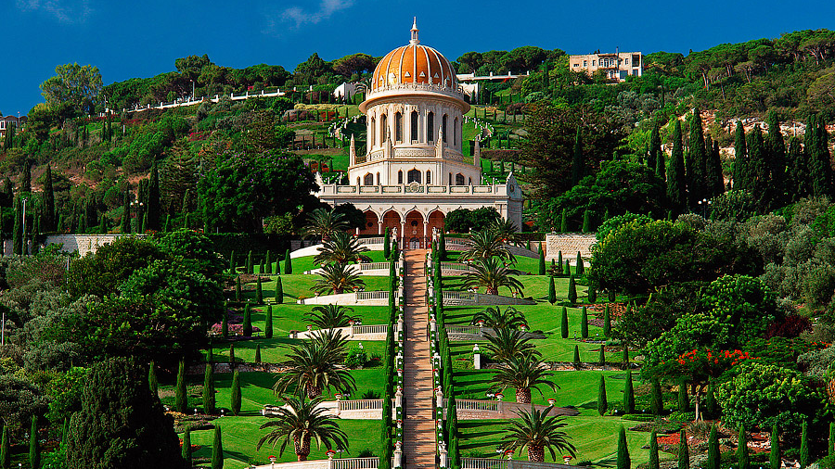
Shrine of the Báb

Slide 8
5
Bahá’u’lláh (The Glory of God – 1817-1892)
Born in a noble family in 1817 in Tehran, Persia. His name was Mírzá Husayn-’Ali. He was a descendant of Abraham and David.
He was born with innate knowledge and as a child was known for His knowledge and insights of difficult passages of the Qur'an. When He was older, He was known as a defender of the oppressed and He gave His wealth to the poor.
He became a Babí in 1844 when he was in His twenties.
In 1852, He was arrested & spent 4 months in a prison known as “Black Pit”. It was here that He had a Revelation.

Slide 9
6
Revelation of Bahá’u’lláh in the Black Pit
There, in that dark underground dungeon, bound by massive chains, Baha’u’llah had a dream, a vision, a revelation:
“While engulfed in tribulations I heard a most wondrous, a most sweet voice, calling above My head. Turning My face,
I beheld a Maiden —the embodiment of the remembrance of the name of My Lord—suspended in the air
before Me. So rejoiced was she in her very soul that her countenance shone with
the ornament of the good pleasure of God, and her cheeks glowed with the brightness
of the All-Merciful.
Betwixt earth and heaven she was raising a call which captivated the hearts and minds
of men. She was imparting to both My inward and outer
being tidings which rejoiced My soul, and the souls of God’s honoured servants.
Pointing with her finger unto My head, she addressed all who are in heaven and all who
are on earth, saying: By God! This is the Best-Beloved
of the worlds, and yet ye comprehend not. This is the Beauty of God amongst you,
and the power of His sovereignty within you, could ye
but understand. This is the Mystery of God and His Treasure, the Cause of God and His glory unto all who are
in the kingdoms of Revelation and of creation, if ye be of them that perceive. This is He Whose Presence is
the ardent desire of the denizens of the Realm of eternity,
and of them that dwell within the Tabernacle of glory, and yet from His Beauty do ye turn aside. “
Baha’u’llah, The Summons of the Lord of Hosts,
pp. 5-6.

Slide 10
7
Bahá’u’lláh
During His time in the Black Pit, this is what He had to say:
"During the days I lay in the prison of Ṭihrán, though the galling weight of the chains and the stench-filled air allowed Me but little sleep, still in those infrequent moments of slumber I felt as if something flowed from the crown of My head over My breast, even as a mighty torrent that precipitateth itself upon the earth from the summit of a lofty mountain. Every limb of My body would, as a result, be set afire. At such moments My tongue recited what no man could bear to hear.“
- Bahá’u’lláh, Epistle to the Son of the Wolf, p.22
“The breezes of the All-Glorious were wafted over Me and taught Me the knowledge of all that hath been. This thing is not from Me, but from One Who is Almighty and All-Knowing. And He bade Me lift up My voice between earth and heaven.“
-Bahá’u’lláh, Epistle to the Son of the Wolf, p.11

Slide 11
8
In 1852 Bahá’u’lláh was released from prison and banished from Persia to Baghdad until 1863.
He was then banished from Baghdad to Constantinople. Before leaving Baghdad, He stayed for 12 days at the Garden of Ridván. Here he announced that He was The Manifestation of God, which the Báb had prophesized.
In a few months, He was banished to Adrianople (Turkey).
In 1868 He was banished to ‘Akká, a prison city in Turkey (now Israel) where He was confined for 9 years.
Eventually He moved to a house known as Bahjí (Delight) where he lived the rest of His life, writing and receiving pilgrims and visitors.
He passed away on May 29, 1892, and is buried in a small stone house adjacent to Bahjí.

Slide 12
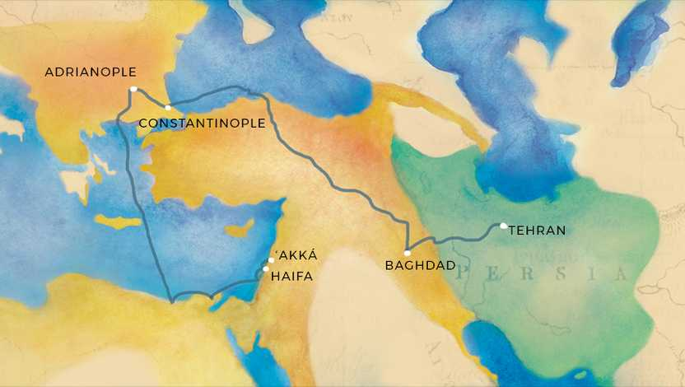

Slide 13

The Shrine of BahÁ’u’llÁh

