Slide 1


The Transforming Power of Love

Slide 2
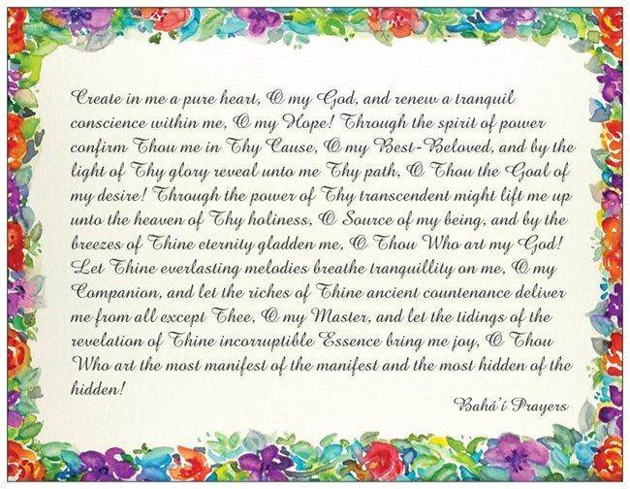
1

Slide 3

https://youtu.be/nlHpnJBbXEs?t=36
What a Power is Love by Shireen and Carmel Zein

Slide 4

2
Love is, indeed, a most potent elixir that can transform the vilest and meanest of people into heavenly souls. May your example serve to further confirm the truth of this beautiful teaching of our Faith.
Shogi Effendi, From a letter written on behalf of Shogi Effendi to an individual believer, 6 December 1935.

Slide 5


3
“Love gives life to the lifeless. Love lights a flame in the heart that is cold. Love brings hope to the hopeless and gladdens the hearts of the sorrowful. In the world of existence there is indeed no greater power than the power of love”
― Abdu'l-Bahá

Slide 6

4
Be as brilliant as the light and as splendid as the fire that blazed in the Burning Bush. The brightness of the fire of your love will no doubt fuse and unify the contending peoples and kindreds of the earth.
- Bahá’u’lláh, Tablets of Bahá’u’lláh, p. 88

Slide 7

5

Slide 8

https://youtu.be/4UPDlIXsM7k?t=50
Where There is Love, Durban Bahá’í Choir

Slide 9

6

Slide 10
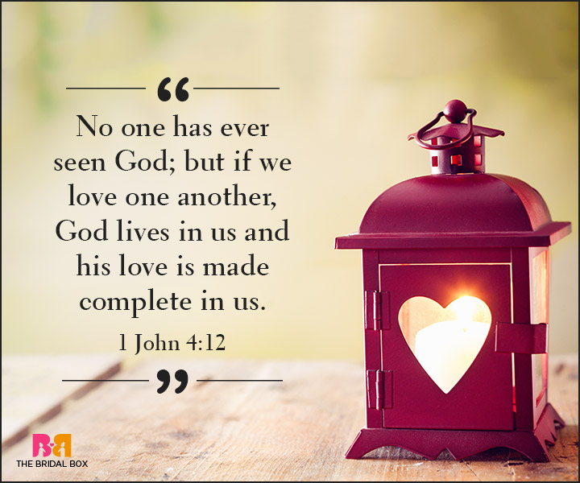
7

Slide 11
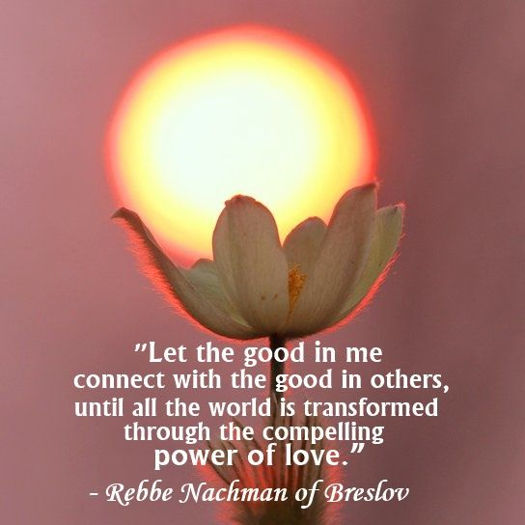
8

Slide 12

9
“Darkness cannot drive out darkness: only light can do that. Hate cannot drive out hate: only love can do that.” ― Martin Luther King Jr

Slide 13
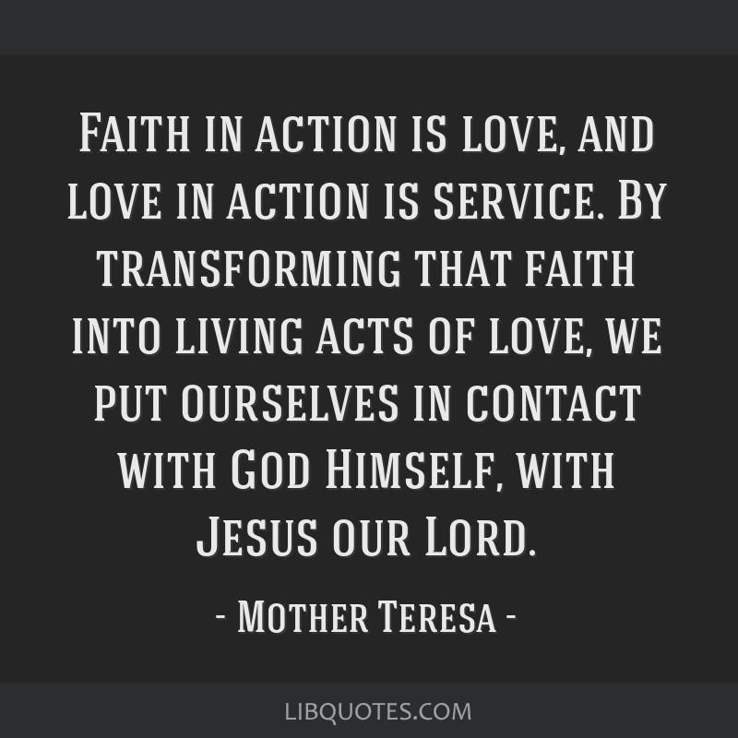
10

Slide 14

11
If the learned and worldly-wise men of this age were to allow mankind to inhale the fragrance of fellowship and love, every understanding heart would apprehend the meaning of true liberty, and discover the secret of undisturbed peace and absolute composure.
- Bahá’u’lláh, Gleanings from the Writings of Bahá’u’lláh, p. 260

Slide 15

12
What a power is love! It is the most wonderful, the greatest of all living powers.
- ‘Abdu’l-Bahá, Paris Talks, p. 179

Slide 16
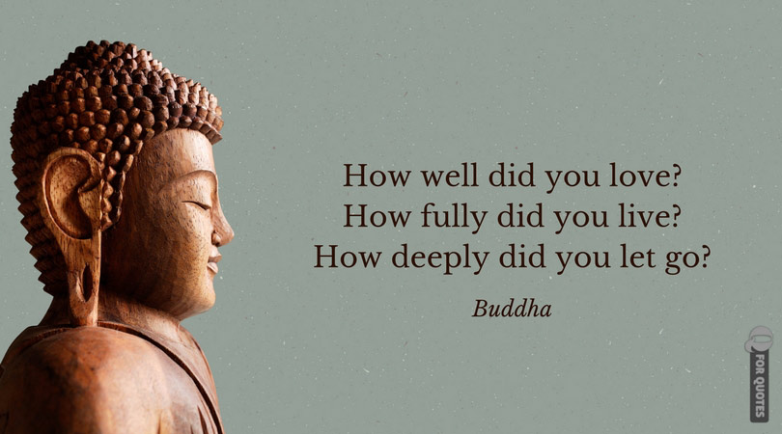
13

Slide 17

14

Slide 18

15

Slide 19

https://youtu.be/iY9dP9kI-VQ?t=50
Thought of Love, Mica, Sahar and Delara

