Slide 1
PEACE
An End to War

Slide 2
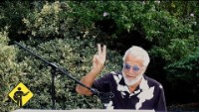
Peace Train Featuring Yusuf/Cat Stevens/Playing for Change/Song Around the World
https://youtu.be/0QpjR6-Uuks?t=57

Slide 3
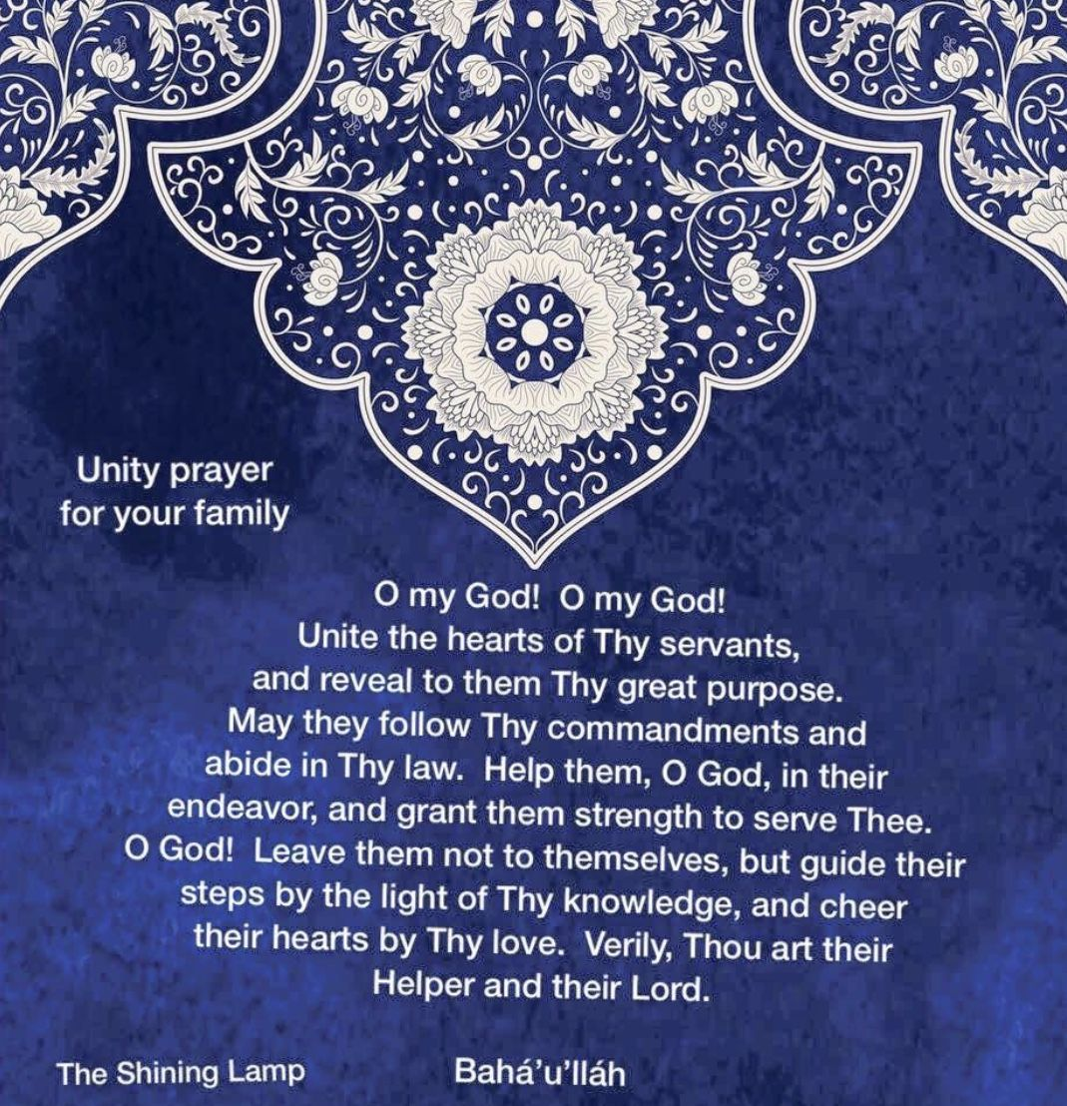
1

Slide 4
2
"I charge you all that each one of you concentrate all the thoughts of your heart on love and unity. When a thought of war comes, oppose it by a stronger thought of peace. A thought of hatred must be destroyed by a more powerful thought of love." ‘Abdu'l-Baha

Slide 5
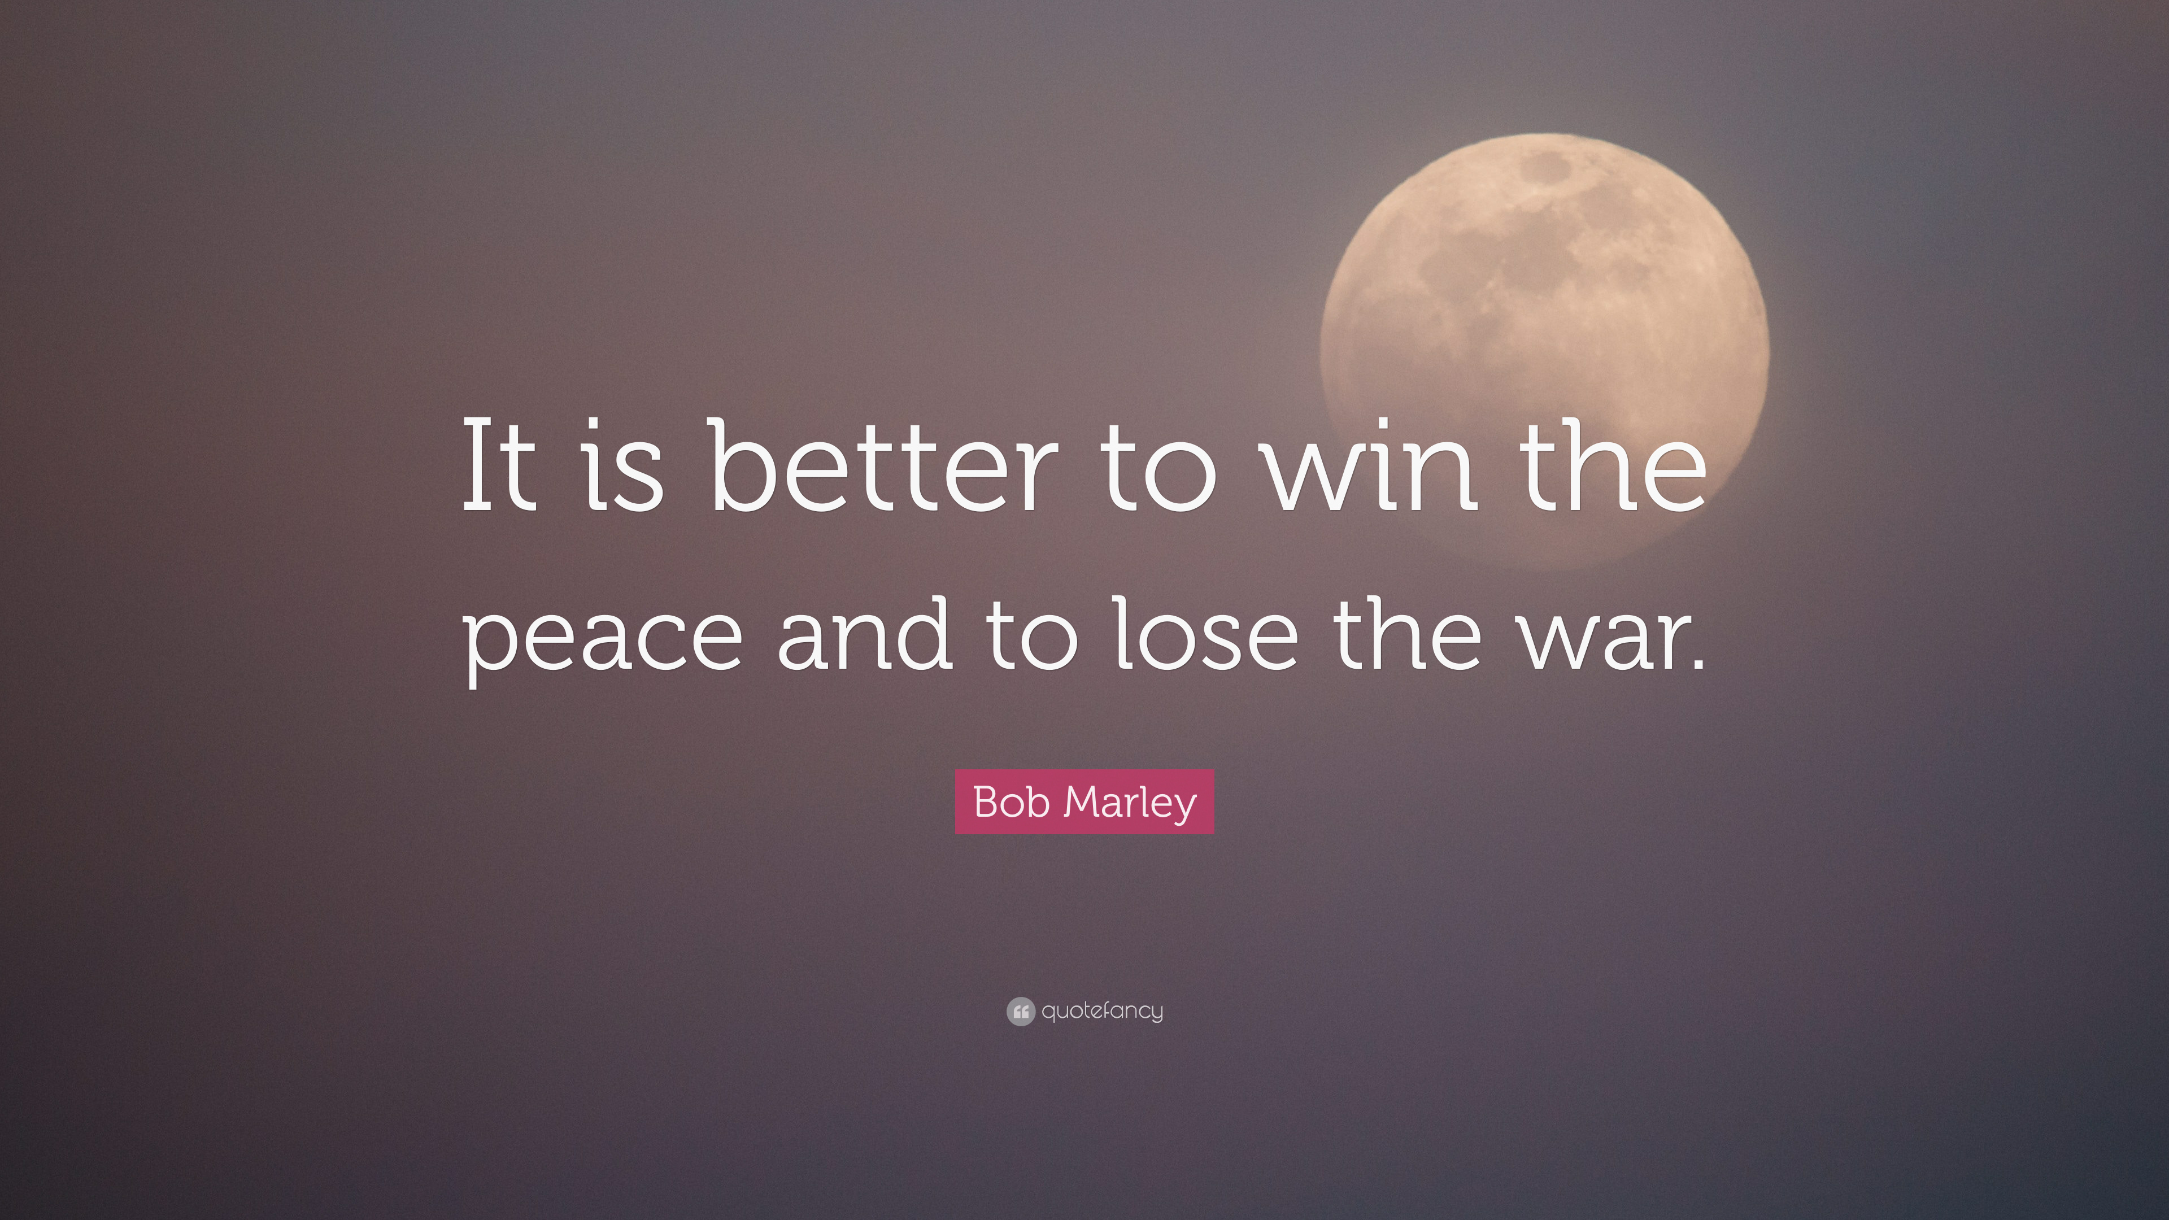
3

Slide 6
4
In this age, therefore, universal peace is like unto the sun, which bestoweth life upon all things, and it is thus incumbent upon all to endeavor in the path of this mighty cause. …The oneness of humanity must therefore be established, that the edifice of universal peace may be raised in turn.
‘Abdu’l-Bahá, Second Tablet to the Hague, 1 July,1920.

Slide 7
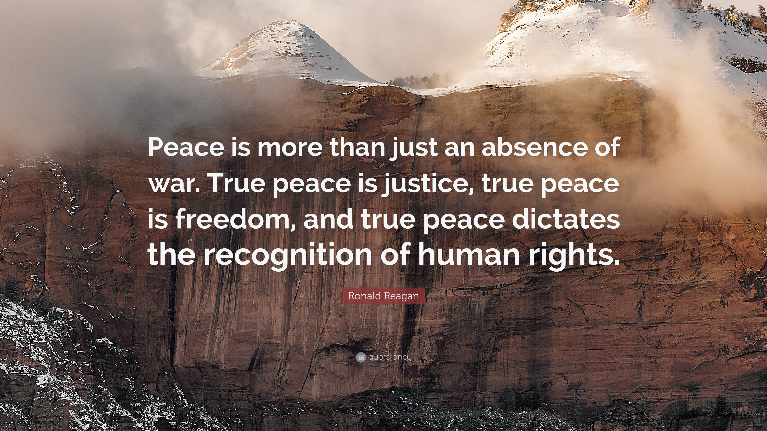
5

Slide 8
6
The time must come when the imperative necessity for the holding of a vast, an all-embracing assemblage of men will be universally realized. The rulers and kings of the earth must needs attend it, and, participating in its deliberations, must consider such ways and means as will lay the foundations of the world's Great Peace amongst men. Such a peace demandeth that the Great Powers should resolve, for the sake of the tranquility of the peoples of the earth, to be fully reconciled among themselves. Should any king take up arms against another, all should unitedly arise and prevent him. If this be done, the nations of the world will no longer require any armaments, except for the purpose of preserving the security of their realms and of maintaining internal order within their territories. This will ensure the peace and composure of every people, government and nation.
Bahá’u’lláh, Gleanings from the Writings of Bahá’u’lláh, p. 248

Slide 9
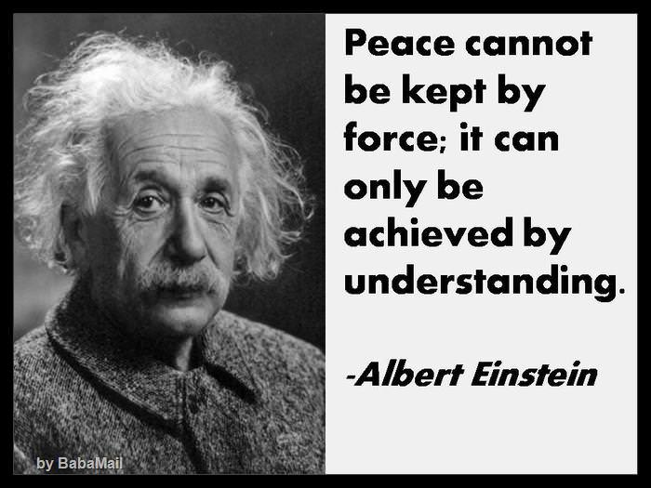
7

Slide 10
8
So let us try, as an experiment, peace, and if the results of peace are bad, then we can choose if it would be better to go back to the old state of war! Let us in any case make the experiment. If we see that unity brings Light we shall continue it. For six thousand years we have been walking on the left-hand path; let us walk on the right-hand path now. We have passed many centuries in darkness, let us advance towards the light.
‘Abdu’l-Bahá, ‘Abdu’l-Bahá in London, p. 61

Slide 11
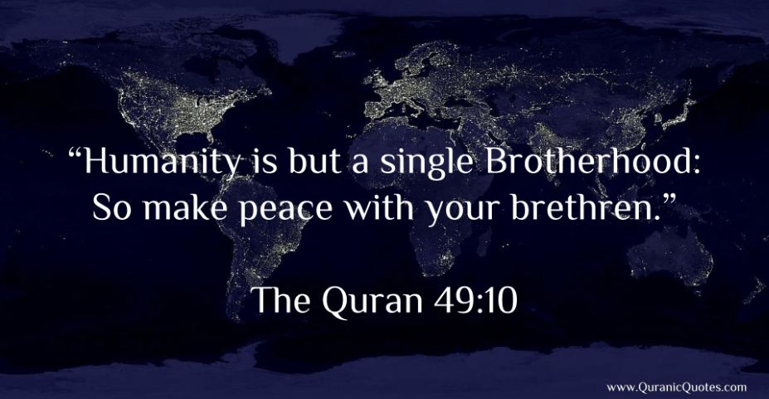
9

Slide 12
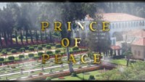
https://www.youtube.com/watch?v=NcDKeQUzEK0
Prince of Peace || Baha'i songs || Ruhi book 3 songs

Slide 13
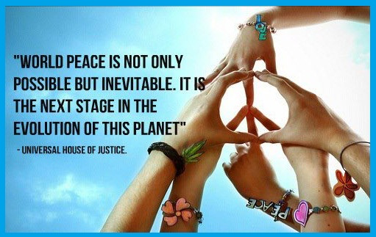
10

Slide 14
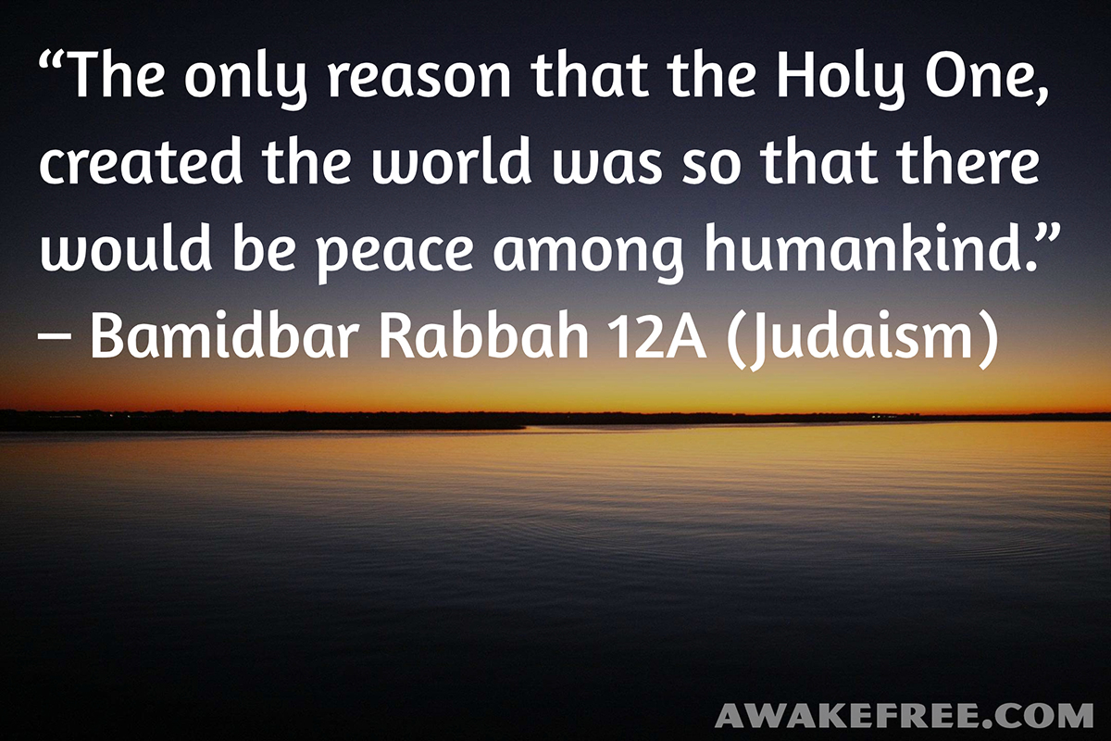
11

Slide 15
12
Today there is no greater glory for man than that of service in the cause of the Most Great Peace. Peace is light, whereas war is darkness. Peace is life; war is death. Peace is guidance; war is error. Peace is the foundation of God; war is a satanic institution. Peace is the illumination of the world of humanity; war is the destroyer of human foundations. When we consider outcomes in the world of existence, we find that peace and fellowship are factors of up
building and betterment, whereas war and strife are the causes of destruction and disintegration.
‘Abdu’l-Bahá, Promulgation of Universal Peace, pg 163-171

Slide 16
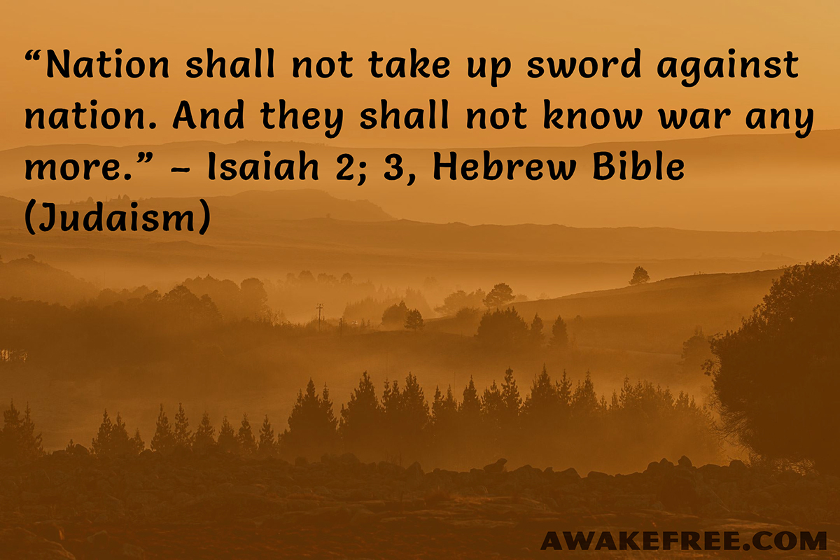
13

Slide 17
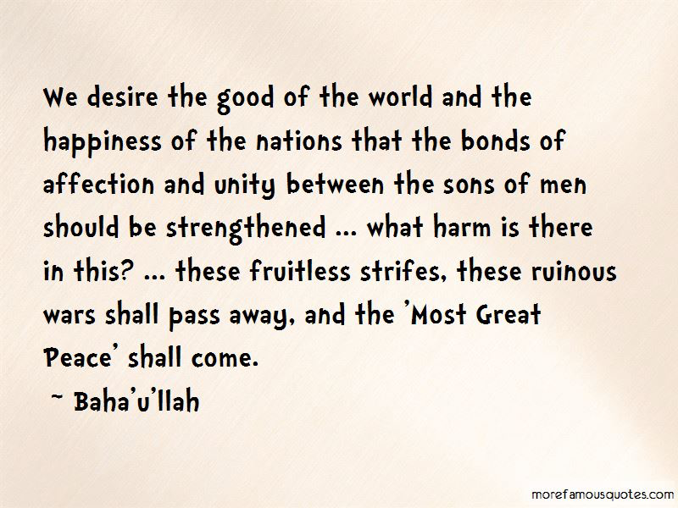
14

Slide 18
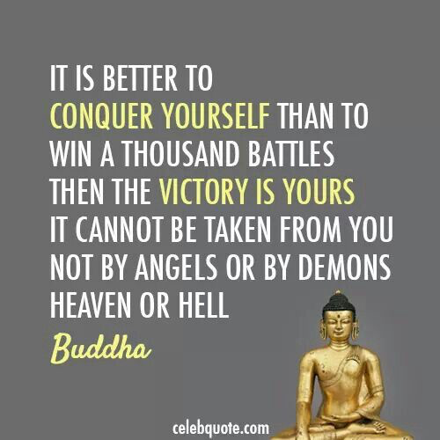
15

Slide 19
16
The Most Great Peace, on the other hand, as conceived by Bahá’u’lláh—a peace that must inevitably follow as the practical consequence of the spiritualization of the world and the fusion of all its races, creeds, classes and nations—can rest on no other basis, and can be preserved through no other agency, except the divinely appointed ordinances that are implicit in the World Order that stands associated with His Holy Name.
“The World Order of Bahá’u’lláh: Selected Letters”, pp. 162–63, 201–4) [48]

Slide 20
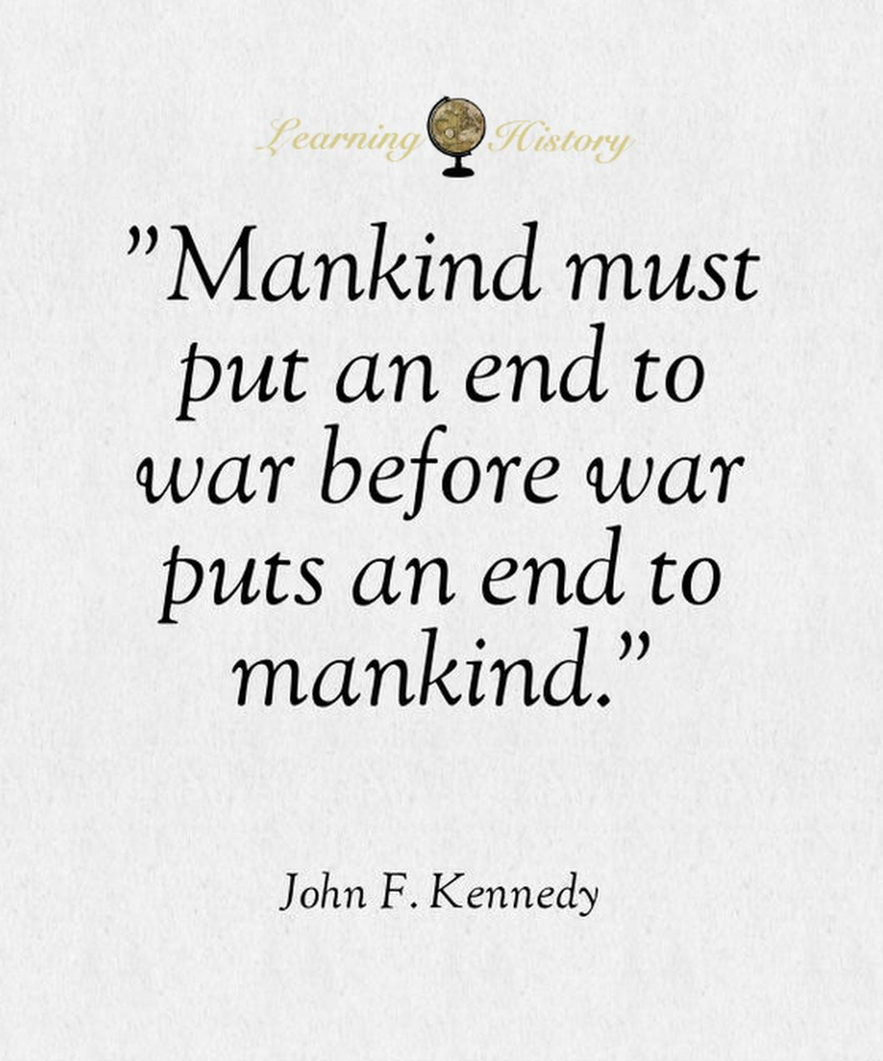
17

Slide 21
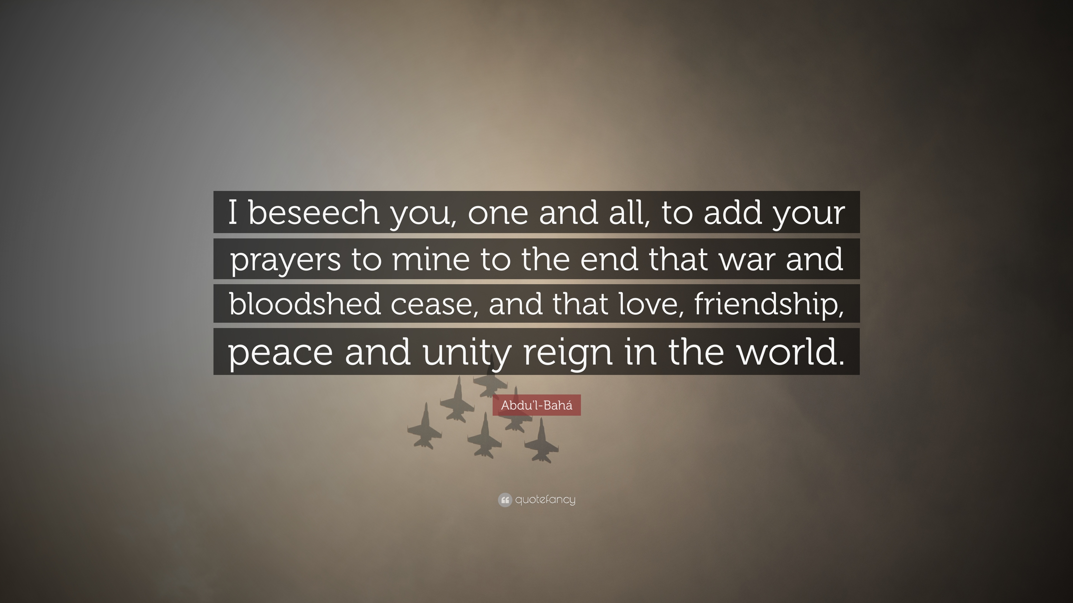
18

Slide 22

https://www.youtube.com/watch?v=iY9dP9kI-VQ
"Thought of Love" by Nica, Sahar and Delara

