Slide 1

DIVERSITY

Slide 2
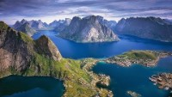
“All Humanity,” a Baha'i Prayer for Mankind, (performed by Alessandro)
https://youtu.be/tYyMjyfiBw8?t=47

Slide 3
1
O my God! O my God! Unite the hearts of Thy servants, and reveal to them Thy great purpose. May they follow Thy commandments, and abide in Thy law. Help them, O God, in their endeavor, and grant them strength to serve Thee. O God! Leave them not to themselves, but guide their steps by the light of Thy knowledge, and cheer their hearts by Thy love. Verily, Thou art their Helper and their Lord.
Bahá’u’lláh

Slide 4
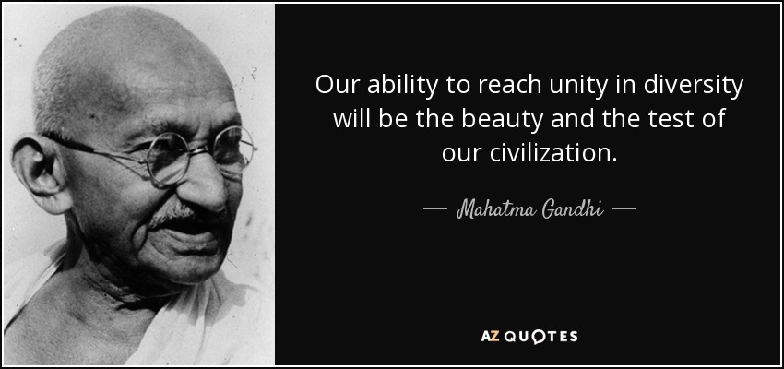
2

Slide 5

3

Slide 6
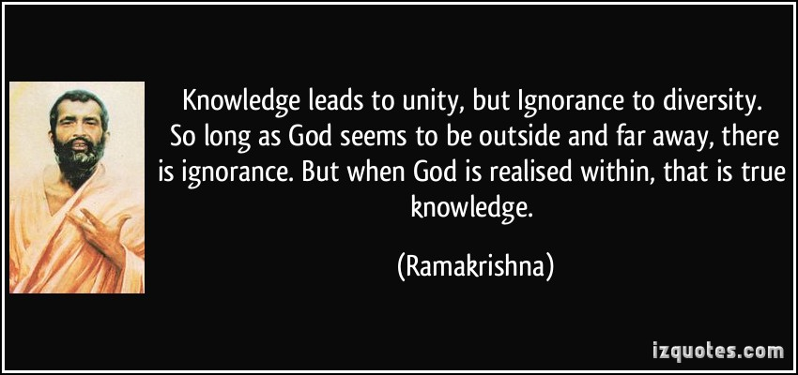
4

Slide 7
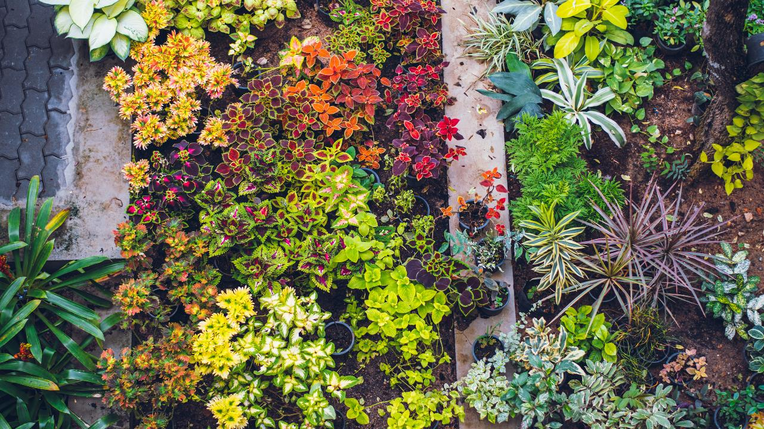
  5
  Behold a beautiful garden full of flowers, shrubs, and trees. Each flower has a different form, a peculiar beauty, its own delicious perfume and beautiful color. So it is with humanity. It is made up of many races, and its peoples are of different colour, white, black, yellow, brown and red – but they all come from the same God, and all are servants to Him.
‘Abdu’l-Bahá, Paris Talks, p. 52.

Slide 8
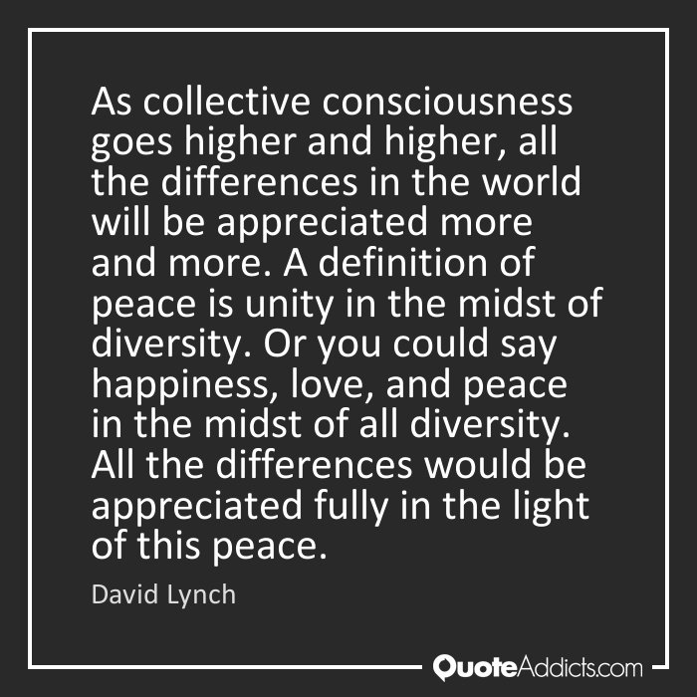
6

Slide 9

7
Please God, that we avoid the land of denial, and advance into the ocean of acceptance, so that we may perceive, with an eye purged from all conflicting elements, the worlds of unity and diversity, of variation and oneness, of limitation and detachment, and wing our flight unto the highest and innermost sanctuary of the inner meaning of the Word of God.
Bahá’u’lláh, The Book of Certitude, p.160.

Slide 10
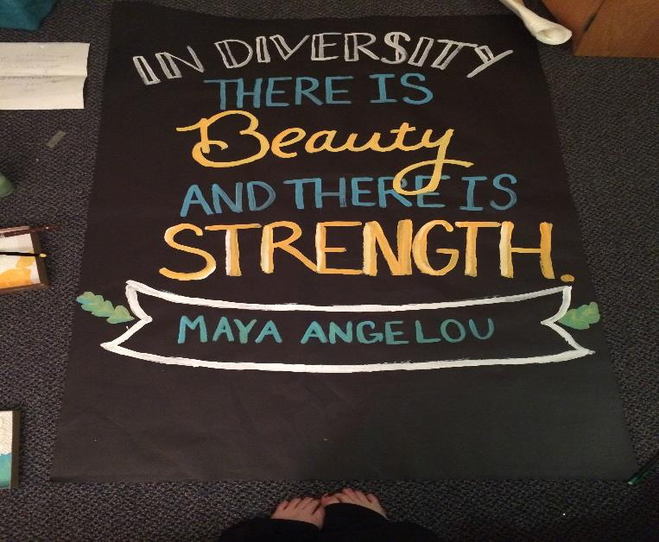
8
6

Slide 11
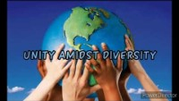
https://www.youtube.com/watch?v=D1ca3vH5cjA
Unity amidst diversity

Slide 12

9
God does not look at colors, He looks at the hearts.
‘Abdu’l-Bahá

Slide 13
9
God does not look at colors, He looks at the hearts.
‘Abdu’l-Bahá

Slide 14
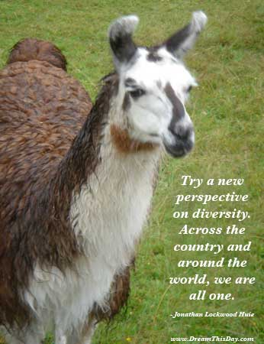
10

Slide 15
11
Consider the flowers of a garden: though differing in kind, color, form and shape, yet, inasmuch as they are refreshed by the waters of one spring, revived by the breath of one wind, invigorated by the rays of one sun, this diversity increaseth their charm, and addeth unto their beauty.
Selections from the Writings of ‘Abdu’l-Bahá

Slide 16
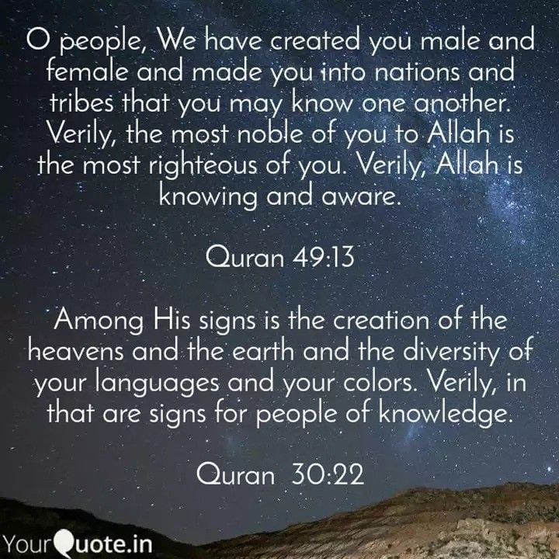
12

Slide 17
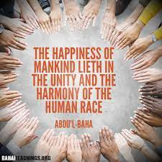
13

Slide 18
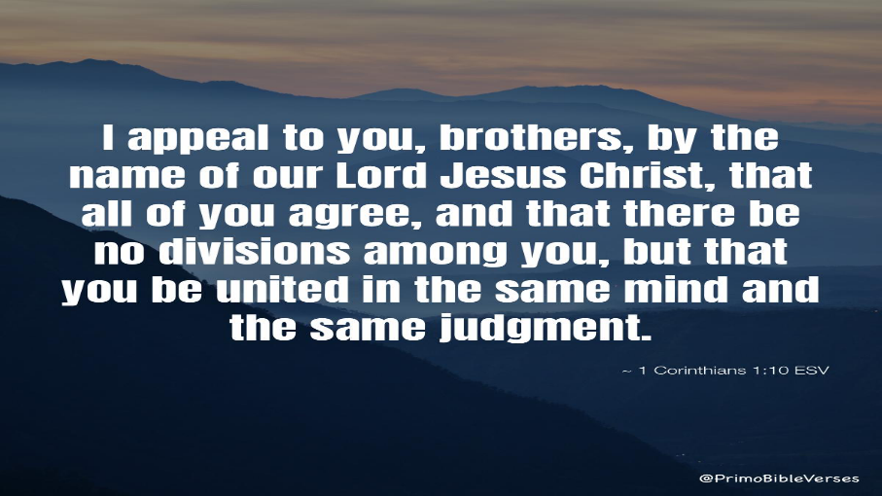
14

Slide 19
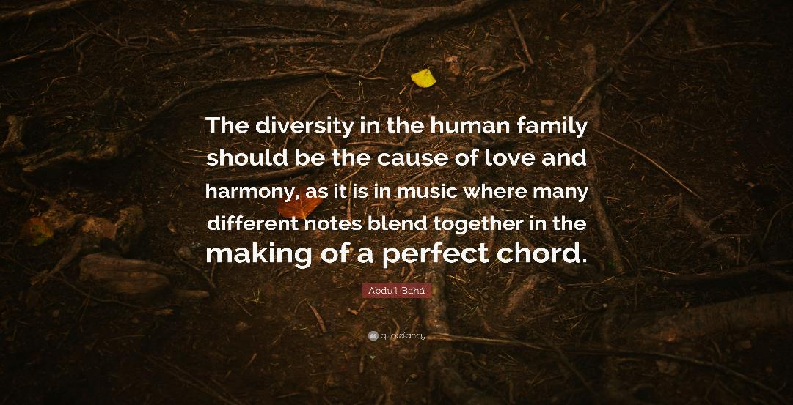
15

Slide 20
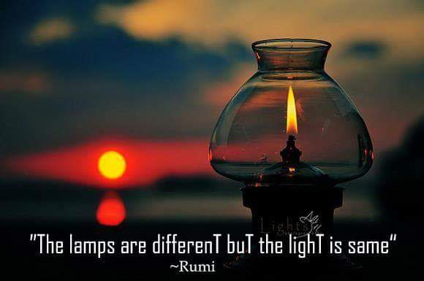
16

Slide 21
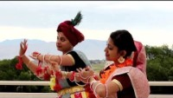
https://www.youtube.com/watch?v=jB1Bgoddzvg
India - Unity in Diversity - A land of 100 Nations

