Slide 1

REFLECTION

Slide 2


Slide 3

1
Say: God sufficeth all things above all things, and nothing in the heavens or in the earth but God sufficeth.
Verily, He is in Himself the Knower, the Sustainer, the Omnipotent.
The Báb

Slide 4
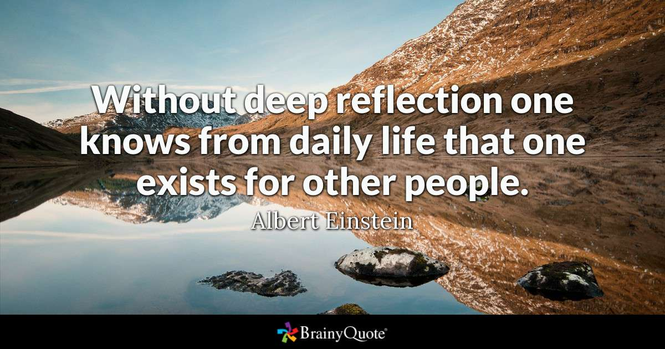
2

Slide 5
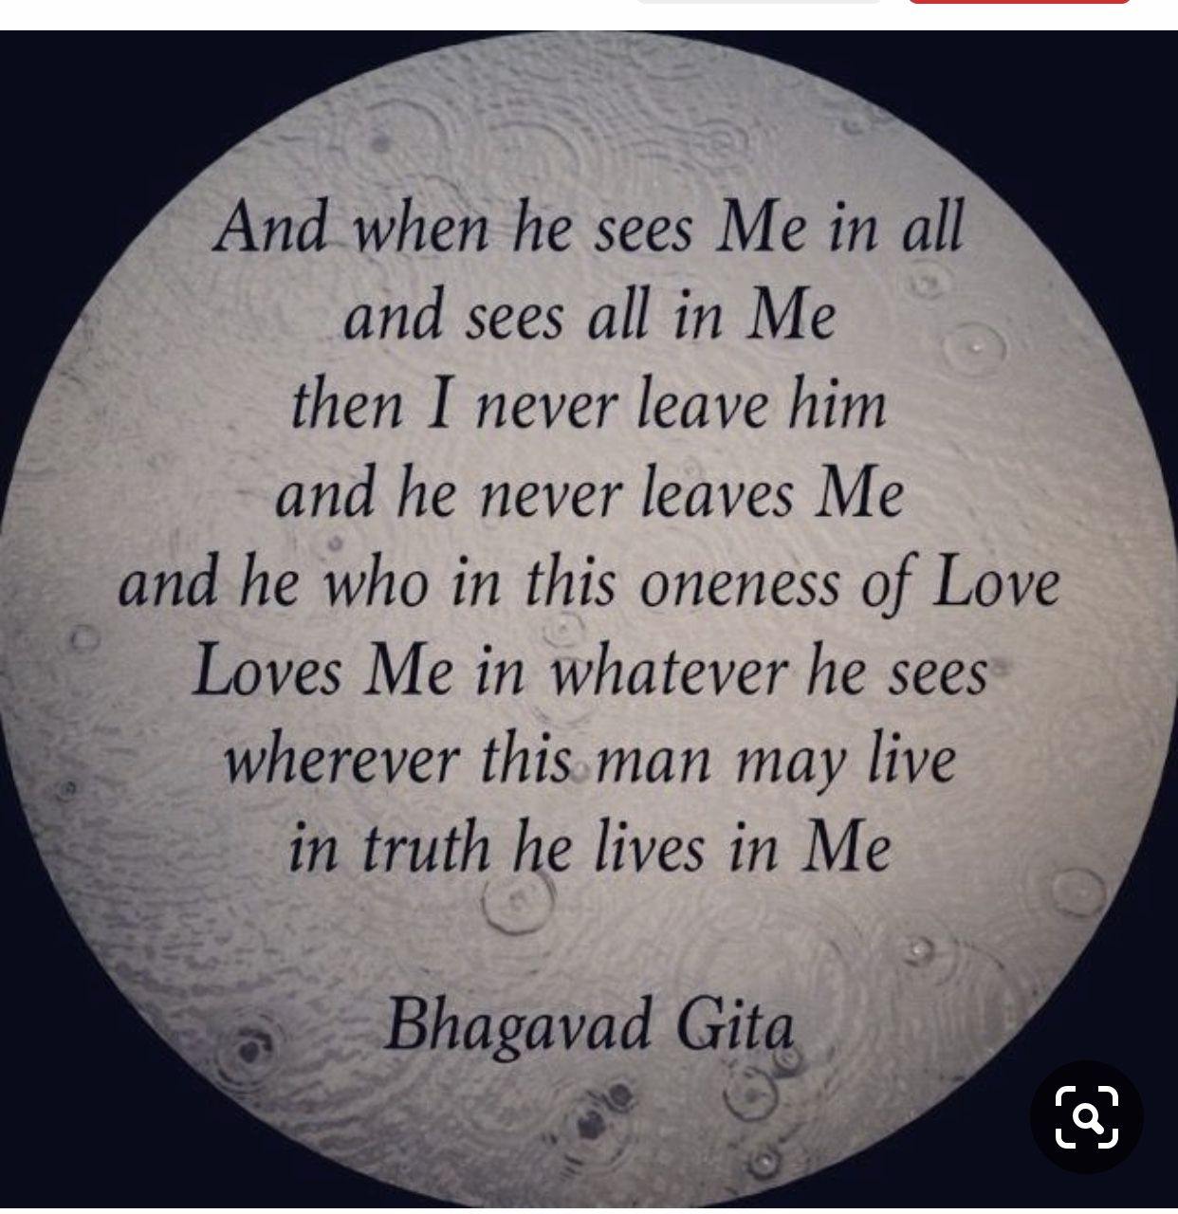
3

Slide 6

4
Bahá’u’lláh says there is a sign (from God) in every phenomenon: the sign of intellect is contemplation and the sign of contemplation is silence, because it is impossible for a man to do two things at one time – he cannot both speak and meditate.
‘Abdu’l-Bahá, Paris Talks, p. 174.

Slide 7
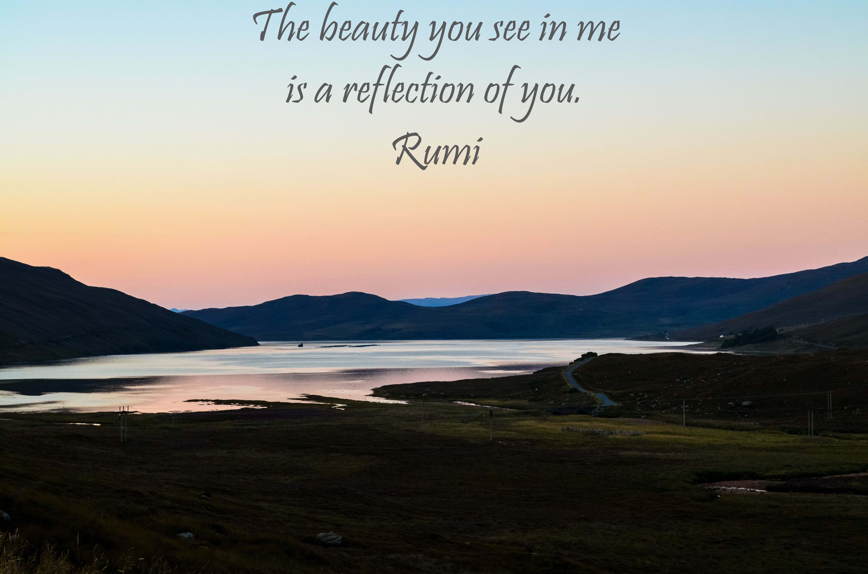
5

Slide 8
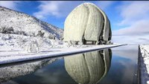

Slide 9

6
O people of Bahá! The source of crafts, sciences and arts is the power of reflection. Make ye every effort that out of this ideal mine there may gleam forth such pearls of wisdom and utterance as will promote the well-being and harmony of all the kindreds of the earth.
Bahá’u’lláh, Tablets of Bahá’u’lláh, p. 72.

Slide 10
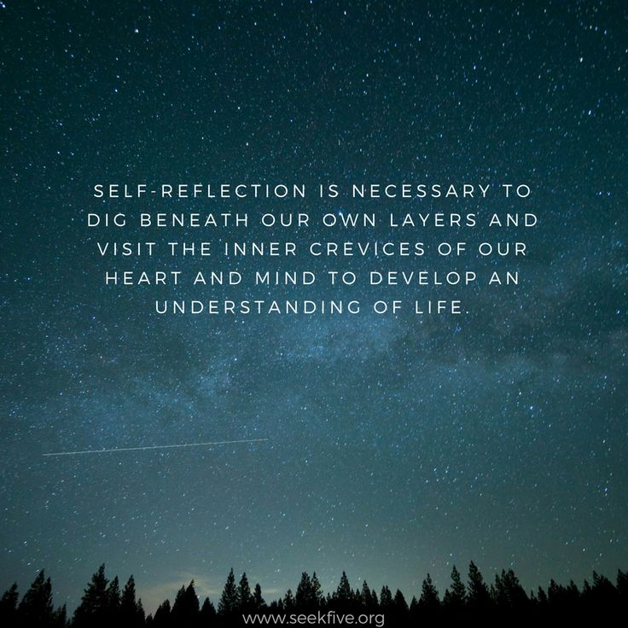
7

Slide 11
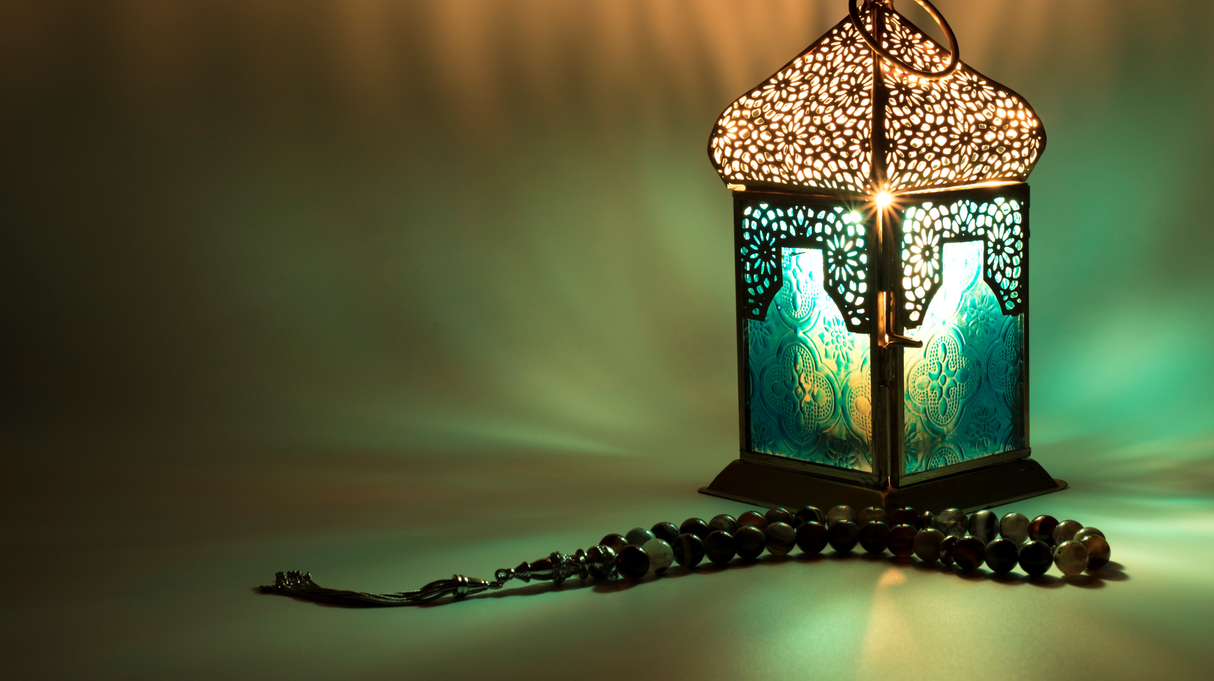
8
It is an axiomatic fact that while you meditate you are speaking with your own spirit. In that state of mind you put certain questions to your spirit and your spirit answers: the light breaks forth and the reality is revealed. You cannot apply the name ‘man’ to any being void of this faculty of meditation; without it he would be a mere animal, lower than the beast.
‘Abdu’l-Bahá, Paris Talks, pp. 174-176.

Slide 12

9

Slide 13

10
Thus it is that one can arrest and suspend (the action of) every faculty except thought and reflection; for a man cannot even by his own volition withhold himself from reflection or thought, nor keep back his musings and imaginings.
‘Abdu’l-Bahá, A Traveler’s Narrative

Slide 14
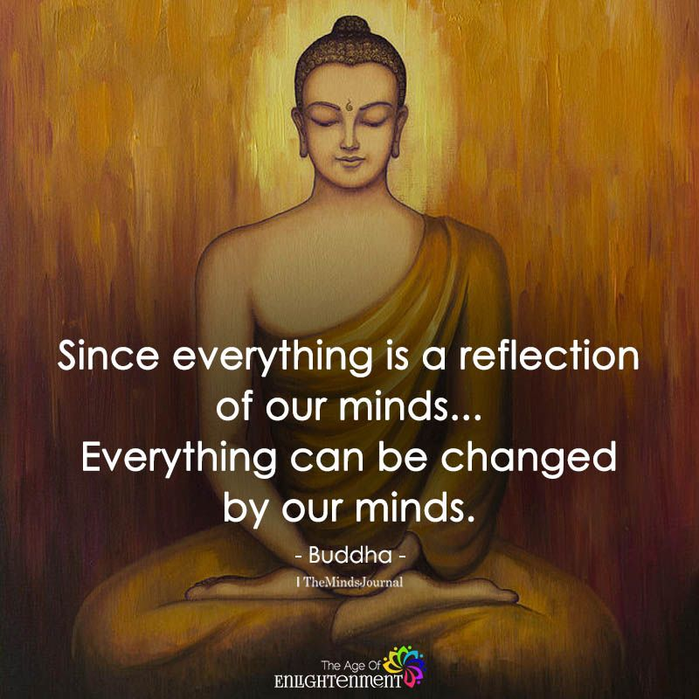
11

Slide 15
