Slide 1

Deeds vs. Words
This Photo by Unknown author is licensed under CC BY-SA-NC.

Slide 2

https://youtu.be/mJtYLLeMe8Q​
Unity Prayer - Omid Master

Slide 3
1
I beseech Thee, O my God, by all the transcendent glory of Thy name, to clothe Thy loved ones in the robe of justice and to illumine their beings with the light of trustworthiness. Thou art the One that hath power to do as He pleaseth and Who holdeth within His grasp the reins of all things, visible and invisible.
- Bahá'u'lláh

Slide 4
2
Say: let truthfulness and courtesy be your adorning. Suffer not yourselves to be deprived of the robe of forbearance and justice, that the sweet savors of holiness may be wafted from your hearts upon all created things. Say: Beware, O people of Bahá, lest ye walk in the ways of them whose words differ from their deeds.
- Bahá'u'lláh, Gleanings, P. 305

Slide 5

3

Slide 6
4
Act in accordance with the counsels of the Lord: that is, rise up in such wise, and with such qualities, as to endow the body of this world with a living soul, and to bring this young child, humanity, to the stage of adulthood.
- 'Abdu'l-Bahá, Selections of the Writings of 'Abdu'l-Bahá, p. 34

Slide 7

5

Slide 8
6
The essence of faith is fewness of words and abundance of deeds; he whose words exceed his deeds, know verily his death is better than his life.
- Bahá'u'lláh, Tablets of Bahá'u'lláh, p. 156

Slide 9
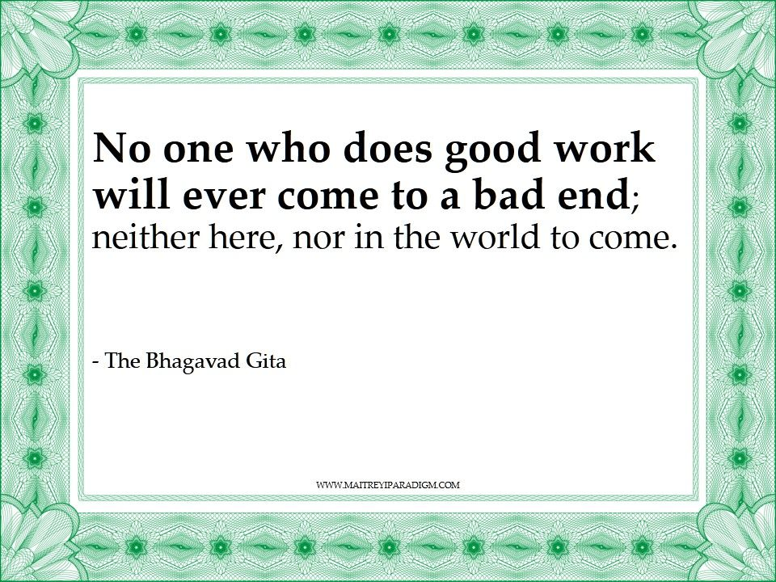
7

Slide 10
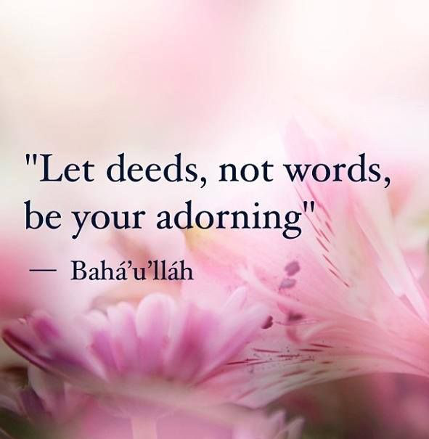
8

Slide 11
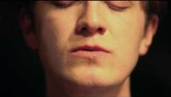
https://www.youtube.com/watch?v=IfH1iMuYKDs
Luke Slott - One Hundred Thousand Veils

Slide 12
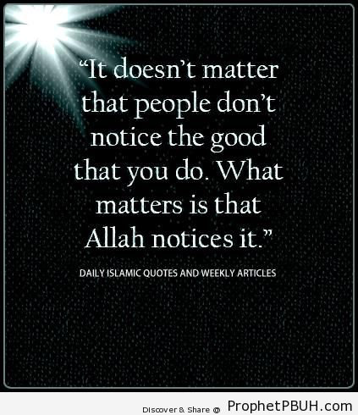
9

Slide 13
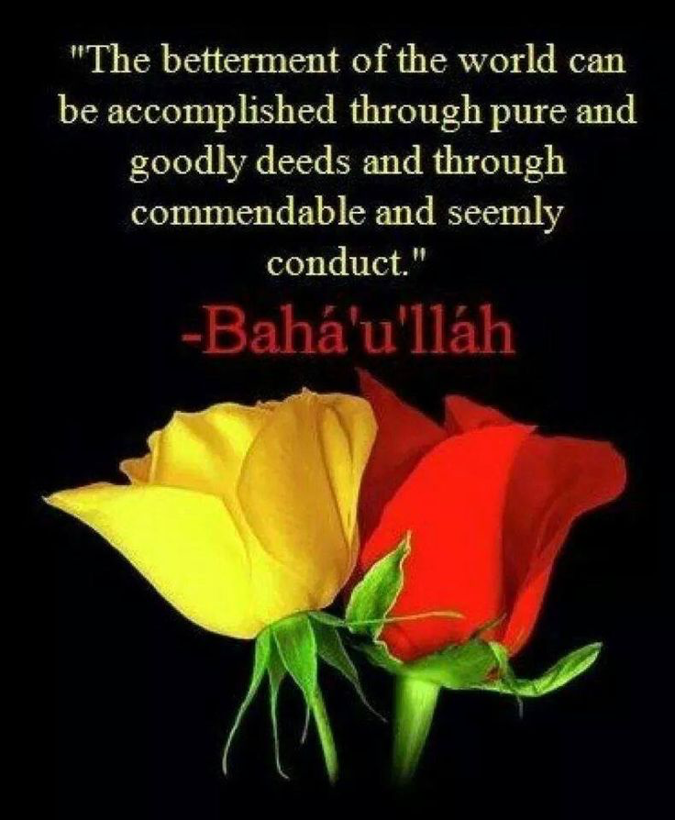
10

Slide 14

11

Slide 15
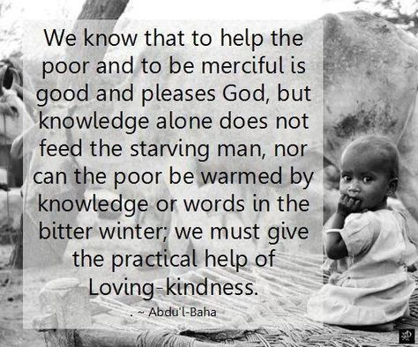
12

Slide 16
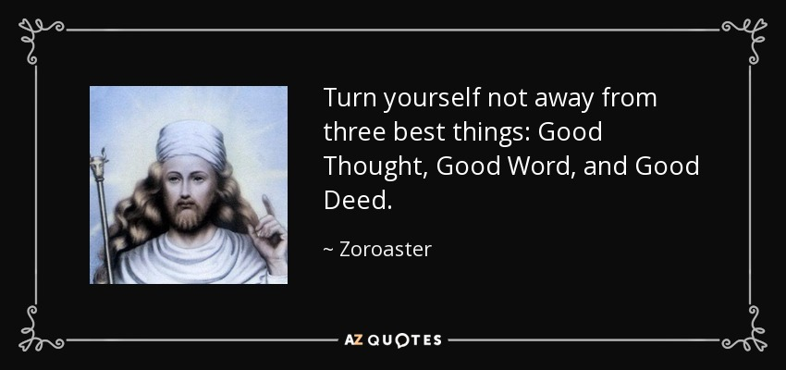
13

Slide 17
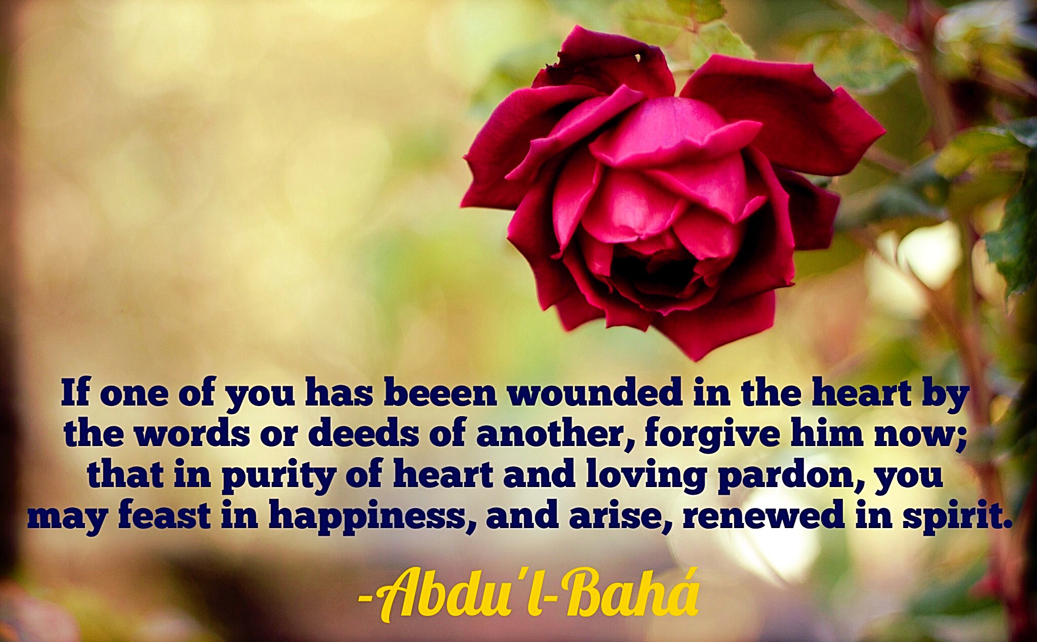
14

Slide 18
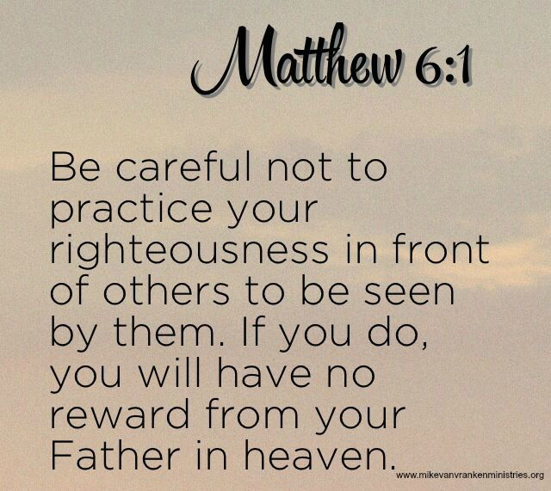
15

Slide 19
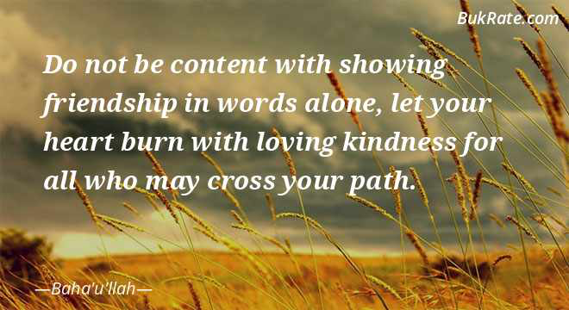
16

Slide 20

17

Slide 21
18
Love ye all religions and all races with a love that is true and
sincere and show that love through deeds.
- 'Abdu'l-Bahá

Slide 22

https://www.youtube.com/watch?v=C-eiIv4n_i8
"Tiny Seed" by Victoria & Willow

