Slide 1
SERVICE

Slide 2
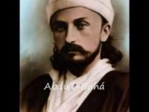

Slide 3
1
Praise be unto Thee, O Lord. Forgive us our sins, have mercy upon us and enable us to return unto Thee. Suffer us not to rely on aught else besides Thee, and vouchsafe unto us, through Thy bounty, that which Thou lovest and desirest and well beseemeth Thee. Exalt the station of them that have truly believed, and forgive them with Thy gracious forgiveness. Verily, Thou art the Help in Peril, the Self-Subsisting.
- The Bàb

Slide 4
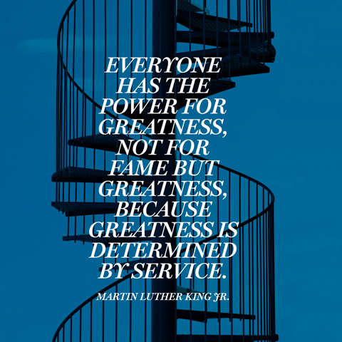
2

Slide 5
3
The liberty that profiteth you is to be found nowhere except in complete servitude unto God, the Eternal Truth. Whoso hath tasted of its sweetness will refuse to barter it for all the dominion of earth and heaven.
Bahá’u’lláh, Gleanings from the Writings of Bahá’u’lláh, p. 335

Slide 6
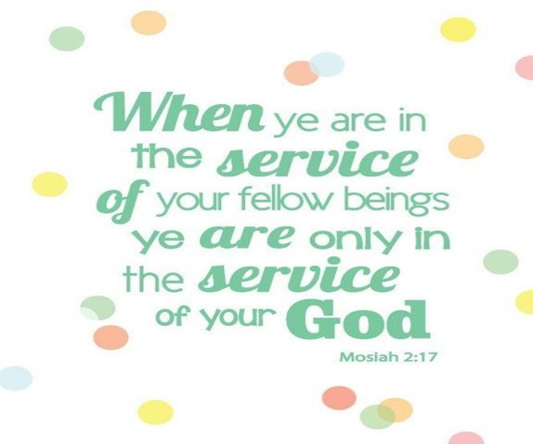
4

Slide 7
5
Briefly, all effort and exertion put forth by man from the fullness of his heart is worship, if it is prompted by the highest motives and the will to do service to humanity: to serve mankind and to minister to the needs of the people. Service is prayer.
- 'Abdu'l-Bahà, Paris Talks, p. 176-77

Slide 8

6

Slide 9
7
The Great Being saith: Blessed and happy is he that ariseth to promote the best interests of the peoples and kindreds of the earth.
- Bahà'u'llàh, Gleanings, p. 250.

Slide 10
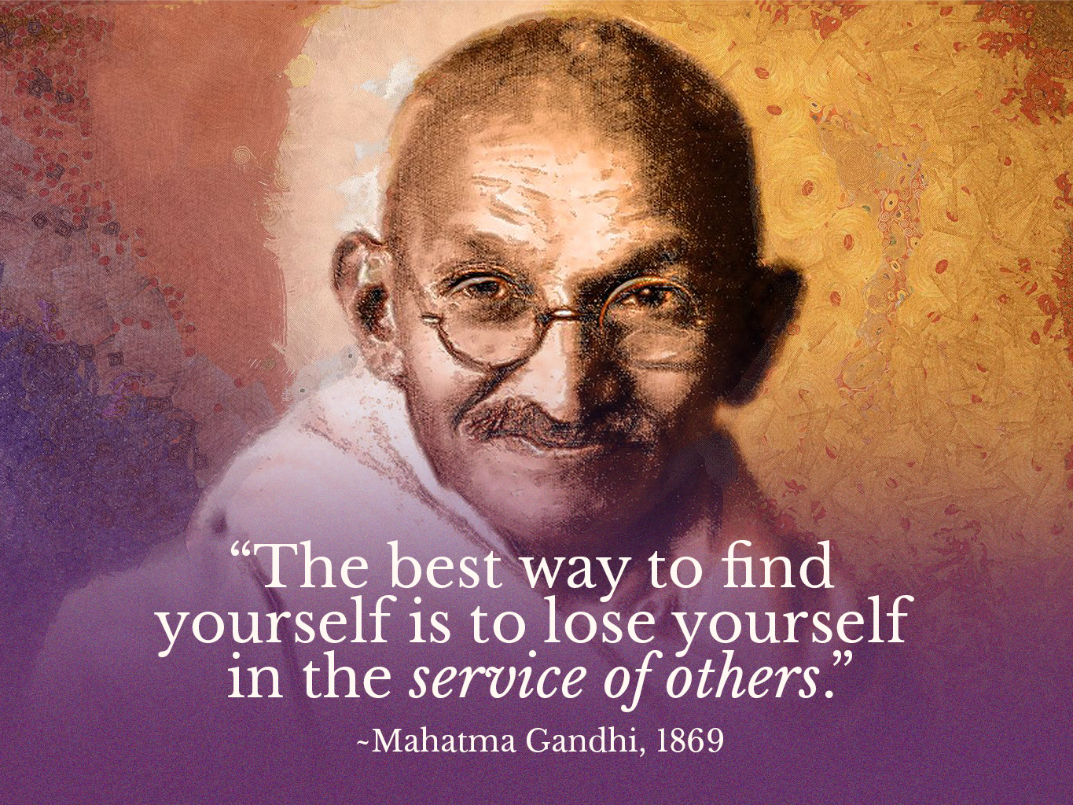
8

Slide 11
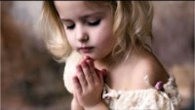
https://www.youtube.com/watch?v=p3Hj9mHxM_8
Strive

Slide 12
9
Wert thou to consider this world, and realize how fleeting are the things that pertain unto it, thou wouldst choose to tread no path except the path of service to the Cause of thy Lord. None would have the power to deter thee from celebrating His praise, though all men should arise to oppose thee.
––Gleanings from the Writings of Baha'u'llah

Slide 13
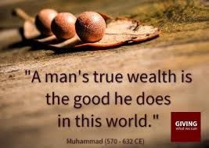
10

Slide 14
11
Love and serve mankind just for the sake of God and not for anything else. The foundation of your love toward humanity must be spiritual faith and Divine assurance.
- ‘Abdu’l-Bahá, Lights of Guidance, p. 213

Slide 15
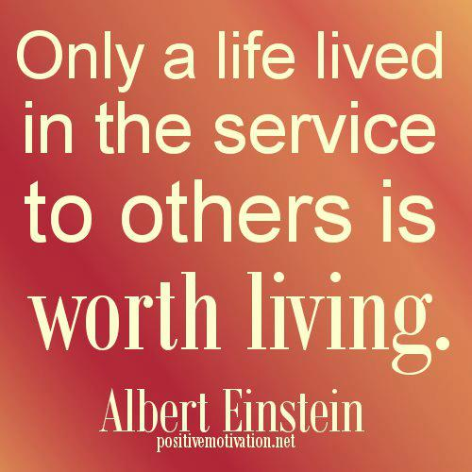
12

Slide 16
13
Cling, O ye people of Bahá, to the cord of servitude unto God, the True One, for thereby your stations shall be made manifest, your names written and preserved, your ranks raised and your memory exalted in the Preserved Tablet. Beware lest the dwellers on earth hinder you from this glorious and exalted station.
- Bahá’u’lláh, The Kitáb-i-Aqdas, p. 62

Slide 17
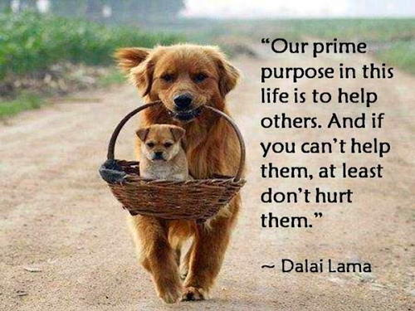
14

Slide 18
15
SERVICE to the friends is service to the Kingdom of God, and consideration shown to the poor is one of the greatest teachings of God.
Selections from the Writings of ‘Abdu’l‑Bahá

Slide 19
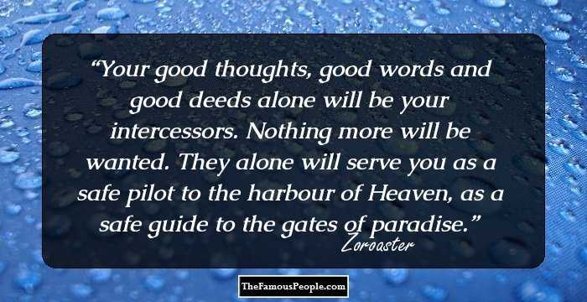
16

Slide 20
17
THE reason why privacy hath been enjoined in moments of devotion is this, that thou mayest give thy best attention to the remembrance of God, that thy heart may at all times be animated with His Spirit, and not be shut out as by a veil from thy Best-Beloved. Let not thy tongue pay lip service in praise of God while thy heart be not attuned to the exalted Summit of Glory, and the Focal Point of communion.
Selections from the Writings of the Báb

Slide 21

https://www.youtube.com/watch?v=Hz3-c_ZmBlE&list=PLEZRZb7taKmh4mO8T0310l_0oXHXKlAus
Amame - leonor dely

