Slide 1

MODERATION

Slide 2
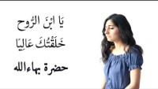
https://www.youtube.com/watch?v=Lc3dDyjyIxI
By Bahá’u’lláh "Noble have I created thee"

Slide 3
1
Say: God sufficeth all things above all things, and nothing in the heavens or the earth but God sufficeth. Verily, He is in Himself the Knower, the Sustainer, the Omnipotent.
- The Báb

Slide 4
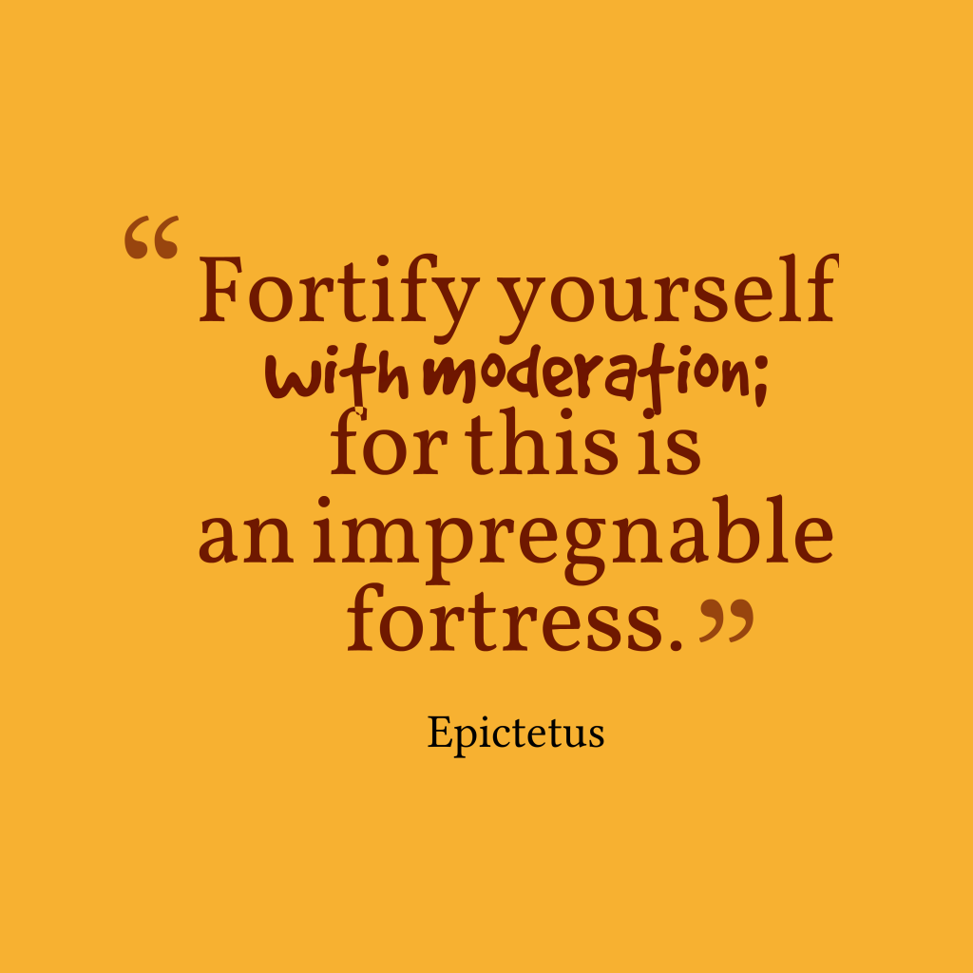
2

Slide 5
3
Human utterance is an essence which aspireth to exert its influence and needeth moderation. As to its influence, this is conditional upon the refinement which in turn is dependent upon hearts which are detached and pure. As to its moderation, this hath to be combined with tact and wisdom as prescribed in the Holy Scriptures and Tablets.
- Bahá'u'lláh, Tablets of Bahá'u'lláh, p. 143.

Slide 6
4
A good character in the sight of God and His chosen ones and the possessors of insight, the most excellent and praiseworthy of all things, but always on condition that its center of emanation should be reason and knowledge and its base should be true moderation.
- Abdu'l-Bahá, The Secret of Divine Civilization, p. 60.

Slide 7
5
Rejoice in the Lord always: and again I say, Rejoice. Let your moderation be known unto all men. The Lord is at hand. Be careful for nothing; but in everything by prayer and supplication with thanksgiving let your requests be made known unto God.
Philippians 4:4-8

Slide 8
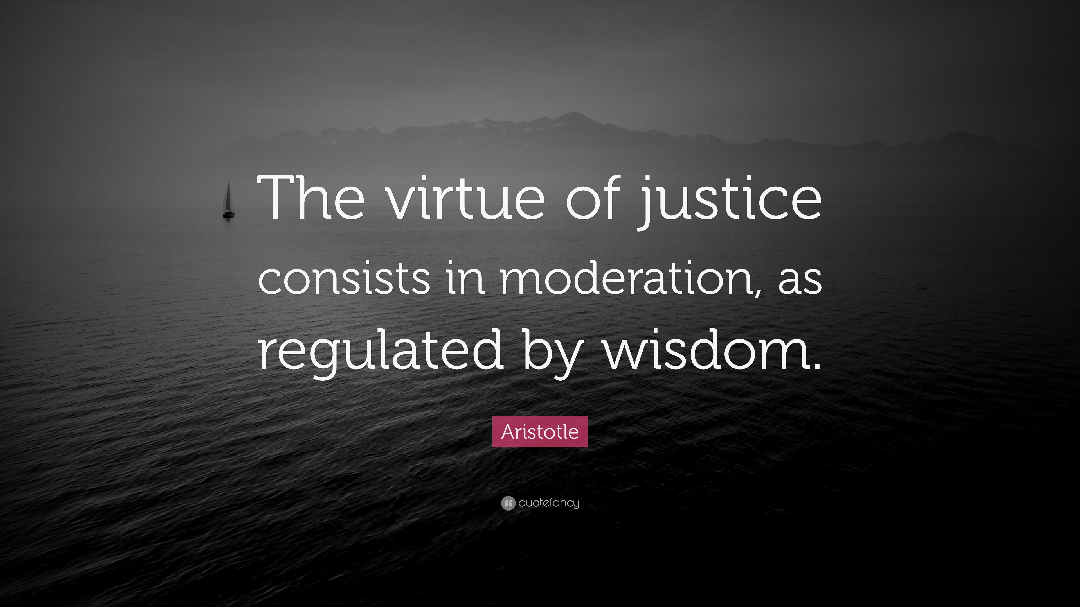
6

Slide 9
7
The civilization, so often vaunted by the learned exponents of arts and sciences, will if allowed to overleap the bounds of moderation, bring great evil upon men.
- Bahá'u'lláh, Gleanings from the Writings of Bahá'u'lláh, p. 342.

Slide 10

https://www.youtube.com/watch?v=09yqtHb-vJM
"Blessings" by Roman Orona

Slide 11
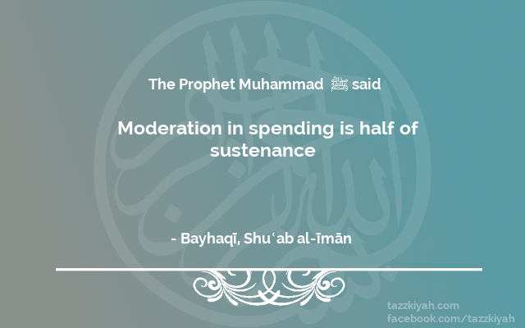
                8

Slide 12
    9
Bahá’u’lláh removed such limitations on one’s apparel and beard. He leaves such matters to the “discretion” of the individual, and at the same time calls upon the believers not to transgress the bounds of propriety and to exercise moderation in all that pertains to dress.
The Kitáb-i-Aqdas

Slide 13
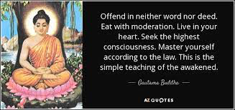
                10

Slide 14
11
In all circumstances they should conduct themselves with moderation.
Bahá’u’lláh, Lights of Guidance, p. 294

Slide 15
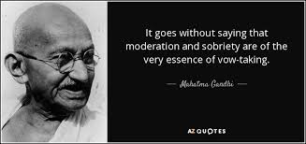
  12

Slide 16
13
Such a chaste and holy life, with its implications of modesty, purity, temperance, decency and clean-mindedness, involves no less than the exercise of moderation in all that pertains to dress, language, amusements, and all artistic and literary avocations. It demands daily vigilance in the control of one's carnal desires and corrupt inclinations.
Shoghi Effendi, Lights of Guidance, p. 364

Slide 17
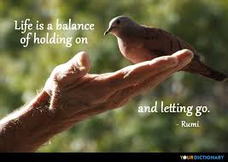
14

Slide 18

https://www.youtube.com/watch?v=LA4nBbxVuns
Baha'i Prayer for America (performed by Remembrance Ensemble)

