Slide 1

Acceptance

Slide 2


Slide 3
1
O Thou Whose tests are a healing medicine to such as are nigh unto Thee, whose sword is the ardent desire of all them that love Thee, Whose dart is the dearest wish of those hearts that yearn after Thee, Whose decree is the sole hope of them that have recognized Thy truth! I implore Thee, by Thy divine sweetness and by the splendors of the glory of Thy face, to send down upon us from Thy retreats on high that which will enable us to draw nigh unto Thee. Set, then, our feet firm, O my God, in Thy Cause, and enlighten our hearts with the effulgence of Thy knowledge, and illumine our breasts with the brightness of Thy Names.
- Bahà'u'llàh

Slide 4

2

Slide 5
3
O MY FRIENDS!
Quench ye the lamp of error, and kindle within your hearts the everlasting torch of divine guidance. For ere long the assayers of mankind shall, in the holy presence of the Adored, accept naught but purest virtue and deeds of stainless holiness.
- Bahà'u'llàh, the Persian Hidden Words, #35.

Slide 6

4

Slide 7
5
Please God, that we avoid the land of denial, and advance into the ocean of acceptance, so that we may perceive, with an eye purged from all conflicting elements, the worlds of unity and diversity, of variation and oneness, of limitations and detachment, and wing our flight unto the highest and innermost sanctuary of the inner meaning of the Word of God.
- Bahà'u'llàh, The Book of Certitude, p. 160.

Slide 8

6

Slide 9
7
Acceptance of the oneness of mankind is the first fundamental prerequisite for reorganization and administration of the world as one country, the home of humankind. Universal acceptance of this spiritual principle is essential to any successful attempt to establish world peace.
The Universal House of Justice-October 1985 – To the Peoples of the World

Slide 10

8

Slide 11

https://www.youtube.com/watch?v=srYcRsN--UI&list=PLePDtgwcyKAScvchcLzY-XZTmP2tdN-EY&index=12
"Blessed is the Spot" by Dominique Sylvester

Slide 12
9
The source of all glory is acceptance of whatsoever the Lord hath bestowed, and contentment with that which God hath ordained.
Tablets of Bahá’u’lláh

Slide 13

10

Slide 14
11
The Lord of the universe hath never raised up a prophet nor hath He sent down a Book unless He hath established His covenant with all men, calling for their acceptance of the next Revelation and of the next Book; inasmuch as the outpourings of His bounty are ceaseless and without limit.
Selections from the Writings of the Báb

Slide 15

12

Slide 16
13
Bahá’u’lláh teaches that religion must be in conformity with science and reason. If belief and teaching are opposed to the analysis of reason and principles of science, they are not worthy of acceptance. This principle has not been revealed in any of the former Books of divine teaching.
Abdu'l-Bahá-The Promulgation of Universal Peace

Slide 17
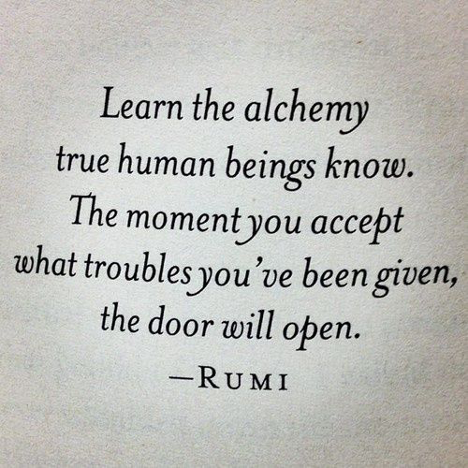
14

Slide 18
15
Nothing whatsoever shall, in this Day, be accepted from you, though ye continue to worship and prostrate yourselves before God throughout the eternity of His dominion. For all things are dependent upon His Will, and the worth of all acts is conditioned upon His acceptance and pleasure. The whole universe is but a handful of clay in His grasp. Unless one recognize God and love Him, his cry shall not be heard by God in this Day. This is of the essence of His Faith, did ye but know it.
Gleanings from the Writings of Bahá’u’lláh

Slide 19
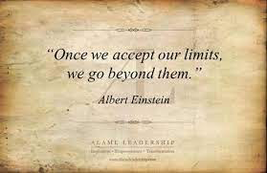
16

Slide 20

https://www.youtube.com/watch?v=_OybDX88-XA
Waves of One Sea - Elika Mahony

