Slide 1
CONTENTMENT

Slide 2


Slide 3
1
We pray to God to graciously assist them that have been led astray to be just and fair-minded, and to make them aware of that whereof they have been heedless. He, in truth, is the All-Bounteous, the Most Generous. Debar not Thy servants, O my Lord, from the door of Thy grace, and drive them not away from the court of Thy presence. Assist them to dispel the mists of idle fancy, and to tear away the veils of vain imaginings and hopes. Thou art, verily, the All-Possessing, the Most High. No God is there but Thee, the Almighty, the Gracious.
- Bahà'u'llàh

Slide 4
2
The source of all good is trust in God, submission unto His command, and contentment with His holy will and pleasure.
- Bahà'u'llàh, Tablets of Bahà'u'llàh, p. 155.

Slide 5

3

Slide 6
4
Verily the most necessary thing is contentment under all circumstances; by this one is preserved from morbid conditions and from lassitude.
- Bahà'u'llàh, Tablet to a Physician, Divine Art of Living, p. 58.

Slide 7
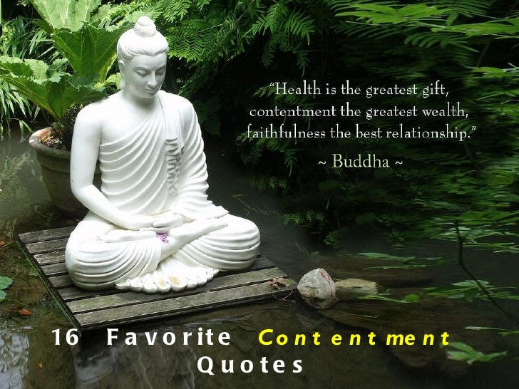
5

Slide 8
6
O SON OF SPIRIT!
Ask not of Me that which We desire not for thee, then be content with what We have ordained for thy sake, for this is that which profiteth thee, if therewith thou dost content thyself.
- Bahà'u'llàh, The Hidden Words (Arabic), #18.

Slide 9

7

Slide 10
O SON OF BEING!
With the hands of power I made thee and with the fingers of strength I created thee; and within thee have I placed the essence of My light. Be thou content with it and seek naught else, for My work is perfect and My command is binding. Question it not, nor have a doubt thereof.
- Baha'u'llah, The Arabic Hidden Words, No. 12
8

Slide 11

https://www.youtube.com/watch?v=qHGhWvXp-Xs
  "Refresh" by Goleta Burriston

Slide 12
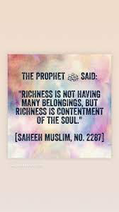
9

Slide 13
Most necessary to thy well-being is contentment (al-qana'at) under all circumstances for through it will the soul be saved from sloth and ill-being.
Bahá’u’lláh, Tablet of Medicine
10

Slide 14

11

Slide 15
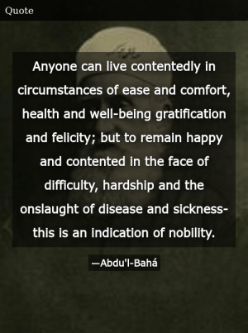
12

Slide 16
13
“But those who realize the Self are always satisfied.
Having found the source of joy and fulfillment, they no longer seek
Happiness from the external world.
They have nothing to gain or lose by any action; neither people nor things can affect their security.”
-The Bhagavad Gita

Slide 17

14

Slide 18
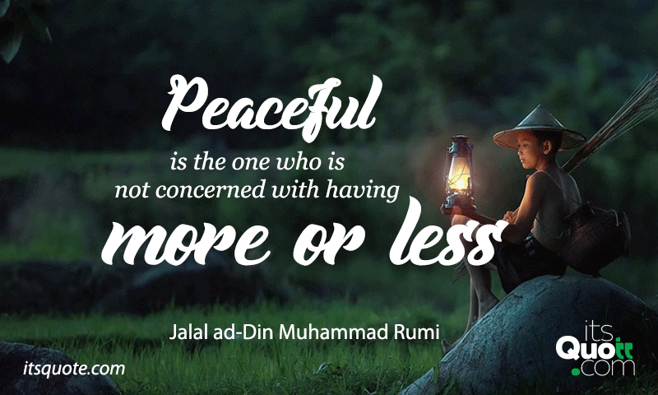
15

Slide 19

16

Slide 20

https://www.youtube.com/watch?v=DIkAVk32P4o
Baha'i Prayer in Hindi - Mangal Mai Hai Vah Sthal (Blessed is the...)

