Slide 1

Trustworthiness

Slide 2
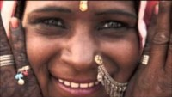
1) https://www.youtube.com/watch?v=YGTxiEw2NKo
Refresh and Gladden my Spirit -Liz Lachmar

Slide 3
1
I beseech Thee, O my God, by all the transcendent glory of Thy Name, to clothe Thy loved ones in the robe of justice and to illumine their beings with the light of trustworthiness. Thou art the One that hath power to do as He pleaseth and Who holdeth within His grasp the reins of all things, visible and invisible.
- Bahá'u'lláh

Slide 4
2
The fourth Taráz concerneth trustworthiness. Verily it is the door of security for all that dwell on earth and a token of glory on the part of the All-Merciful. He who partaketh thereof hath indeed partaken of the treasures of wealth and posterity.
- Bahá'u'lláh, Tablets of Bahá'u'lláh, p.37

Slide 5

3

Slide 6
4
We will now mention unto thee Trustworthiness and the station thereof in the estimation of God, thy Lord, the Lord of the Mighty Throne. One day of days We repaired unto Our Green Island. Upon Our arrival, We beheld its streams flowing, and its trees luxuriant, and the sunlight playing in their midst. Turning our face to the right, We beheld what the pen is powerless to describe; nor can it set forth that which the eye of the Lord of Mankind witnessed in that most sanctified, most sublime, that blest, and most exalted Spot. Turning, then, to the left We gazed on one of the Beauties of the Most Sublime Paradise, standing on a pillar of light, and calling aloud saying: " O inmates of earth and heaven! Behold ye My beauty, and My radiance, and My revelation, and My effulgence. By God, the True One! I am Trustworthiness and the revelation thereof, and the beauty thereof. I will recompense whosoever will cleave unto Me and recognize My rank and station, and hold fast unto My Hem.."
- Bahá'u'lláh, Tablets of Bahá'u'lláh, p.37 & 38.

Slide 7

5

Slide 8
6
Trustworthiness, wisdom and honesty are, of a truth, God's beauteous adornments for His creatures. These fair garments are a befitting vesture for every temple. Happy are those that comprehend, and well is it with them that acquire such virtues.
- Baha’u’llah

Slide 9
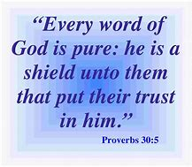
7

Slide 10
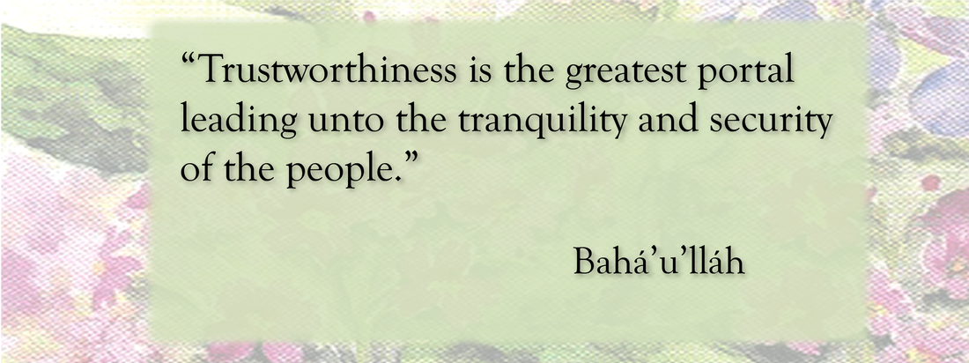
8

Slide 11

https://www.youtube.com/watch?v=7OD_iE6Iq_U
Hal Men Mofarrejen (Contemporary Version), Shadi & Shidan

Slide 12

9

Slide 13
10
O people of Bahá! Trustworthiness is in truth the best of
vestures for your temples and the most glorious crown
for your heads. Take ye fast hold of it at the behest of
Him Who is the Ordainer, the All-Informed.
- Baha’u’llah

Slide 14

11

Slide 15
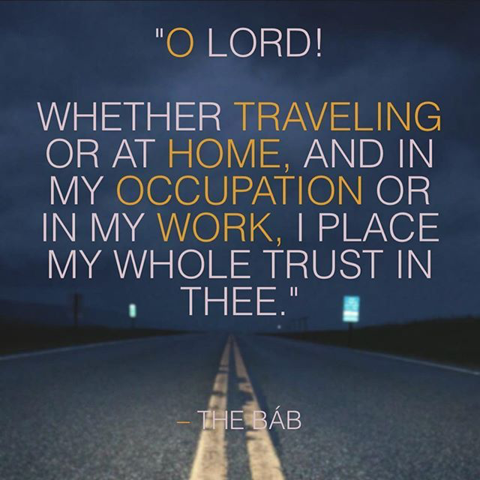
12

Slide 16
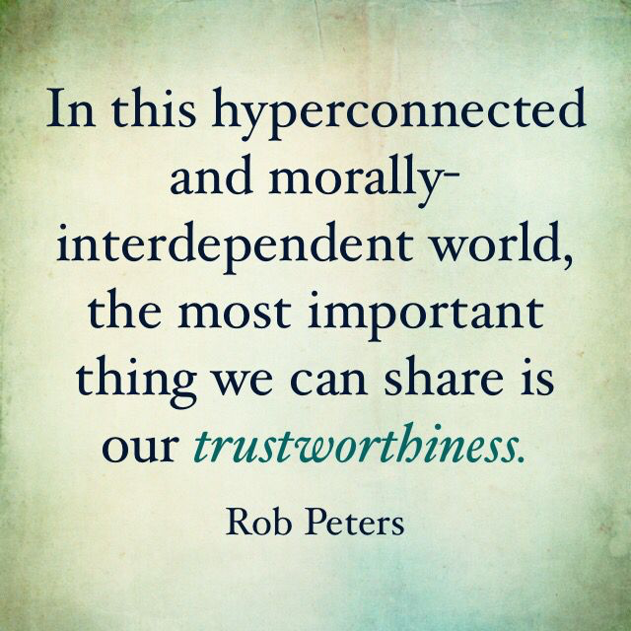
13

Slide 17
14
14
Know thou for a certainty that whoso disbelieveth in God is neither trustworthy nor truthful. This, indeed, is the truth, the undoubted truth.
- Baha’u’llah

Slide 18
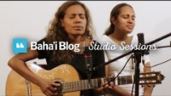
https://www.youtube.com/watch?v=xucCjjTYwwE
"Dis Dieu suffit (Say God Sufficeth)" by Edelo & Emma

