Slide 1

Power

Slide 2


https://youtu.be/nlHpnJBbXEs

Slide 3
1
Praised be Thou, O Lord my God! This is Thy servant who hath quaffed from the hands of Thy grace the wine of Thy tender mercy, and tasted of the savor of Thy love in Thy days. I beseech Thee, by the embodiments of Thy names whom no grief can hinder from rejoicing in Thy love or from gazing on Thy face, and whom all the hosts of the heedless are powerless to cause to turn aside from the path of Thy pleasure, to supply him with the good things Thou dost possess, and to raise him up to such heights that he will regard the world even as a shadow that vanisheth swifter than the twinkling of an eye.
Keep him safe also, O my God, by the power of Thine immeasurable majesty, from all that Thou abhorrest. Thou art, verily, his Lord and the Lord of all worlds.
- Bahá'u'lláh

Slide 4
2
O SON OF BEING!
With the hands of power I made thee and with the fingers of strength I created thee; and within thee have I placed the essence of My light. Be thou content with it and seek naught else, for My work is perfect and My command is binding. Question it not, nor have a doubt thereof.
- Bahá'u'lláh, The Hidden Words, # 12

Slide 5

3

Slide 6
4
So powerful is the light of unity that it can illuminate the whole earth.
- Bahá'u'lláh, Gleanings, p. 288

Slide 7

5

Slide 8
6
All-praise and glory be to God Who, through the power of His might, hath delivered His creation from the nakedness of non-existence, and clothed it with the mantle of life. From among all created things He hath singled out for His special favor the pure, the gem-like reality of man, and invested it with a unique capacity of knowing Him and reflecting the greatness of His glory.
- Bahá'u'lláh, Gleanings, p. 77

Slide 9

7

Slide 10
8
Man, then, is in extreme need of the only Power by which he is able to receive help from the Divine Reality, that Power alone bringing him into contact with the Source of all life.
'Abdu'l-Bahá, Paris Talks

Slide 11

https://youtu.be/qnOBZ32OHss

Slide 12

9

Slide 13
10
in the teaching of Bahá’u’lláh, it is written: “By the Power of the Holy Spirit alone is man able to progress, for the power of man is limited and the Divine Power is boundless.”
'Abdu'l-Bahá, Paris Talks

Slide 14
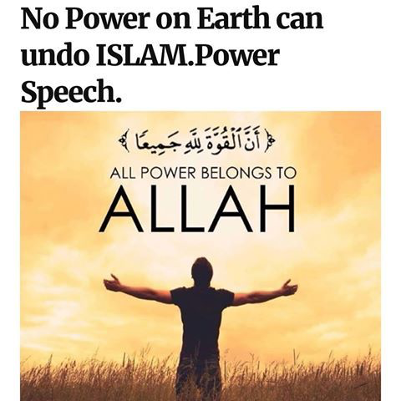
11

Slide 15
12
In the Epistle to the Romans Saint Paul hath written: “Let every soul be subject unto the higher powers. For there is no power but of God; the powers that be are ordained of God. Whosoever therefore resisteth the power, resisteth the ordinance of God.”
Bahá'u'lláh, Epistle to the Son of the Wolf

Slide 16
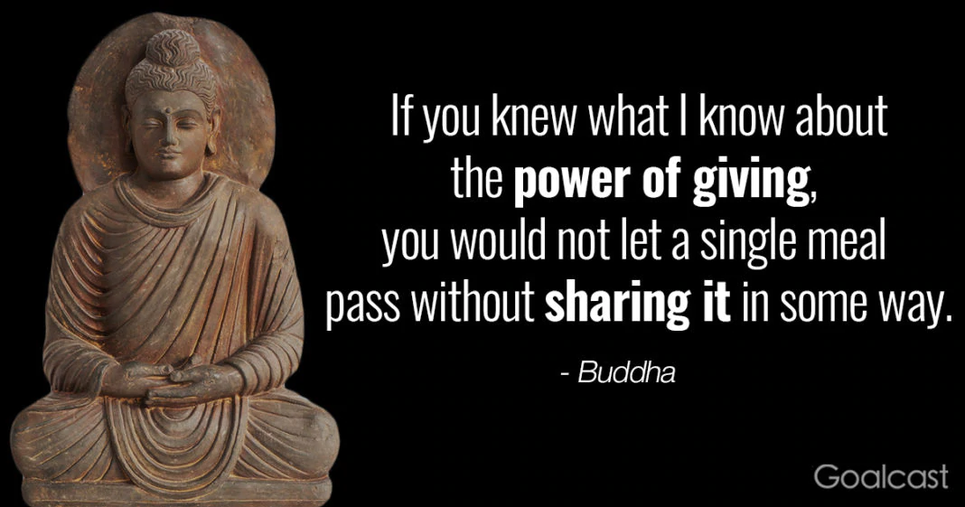
13

Slide 17
14
May the peace of God be with those who have been guided aright through the power of divine guidance.
Selections from the Writings of the Báb

Slide 18
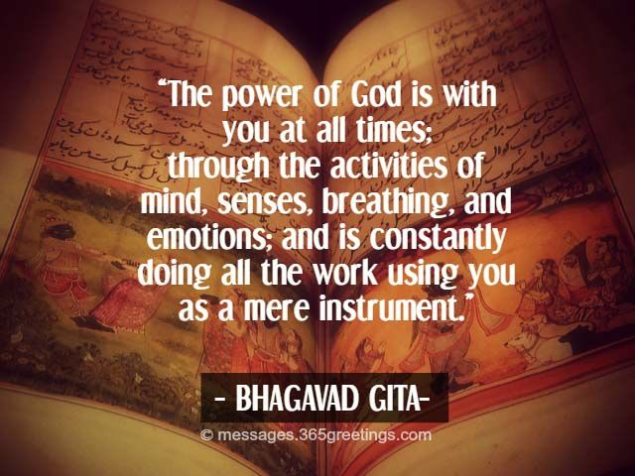
15

Slide 19
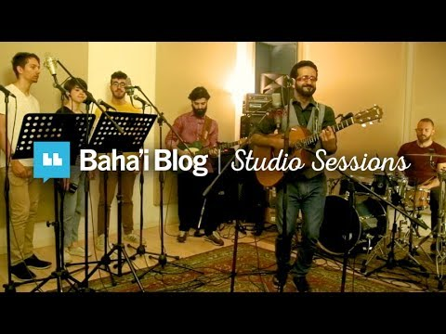

Slide 20

https://www.youtube.com/watch?v=q1VfQ9czSUA
So powerful (Tanto Potente) by Naim

