Slide 1

Mercy

Slide 2
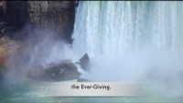
Aid Thou Thy Trusted Servants - Cynthia Magnum
https://youtu.be/bNS3LYfuoU0

Slide 3
1
Praise be unto Thee, O Lord. Forgive us our sins, have mercy upon us and enable us to return unto Thee. Suffer us not to rely on aught else besides Thee, and vouchsafe unto us, through Thy bounty, that which Thou lovest and desirest and well beseemeth Thee. Exalt the station of them that have truly believed, and forgive them with Thy gracious forgiveness. Verily, Thou art the Help in Peril, the Self-Subsisting.
- The Báb

Slide 4
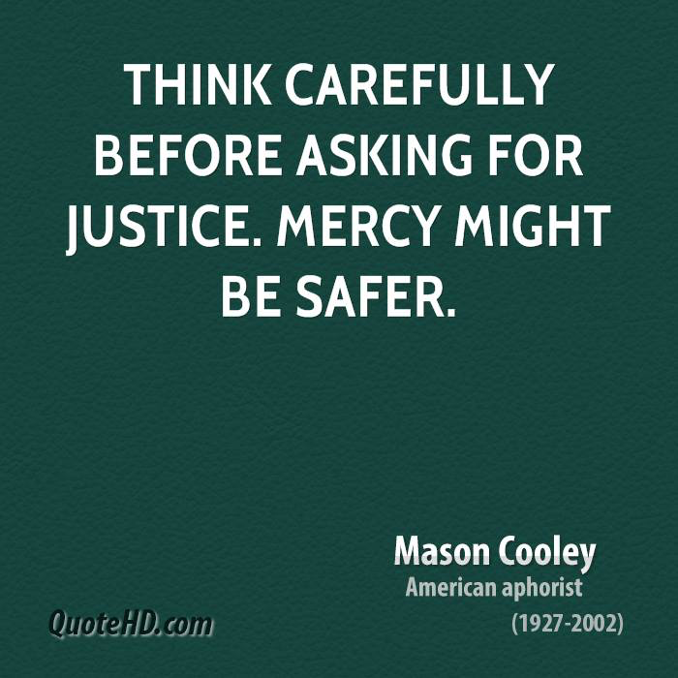
2

Slide 5
3
O SON OF MAN!
My calamity is My providence, outwardly it is fire and vengeance, but inwardly it is light and mercy. Hasten thereunto that thou mayest become an eternal light and an immortal spirit. This is My command unto thee, do thou observe it.
- Bahá'u'lláh, The Hidden Words, Arabic, # 51

Slide 6
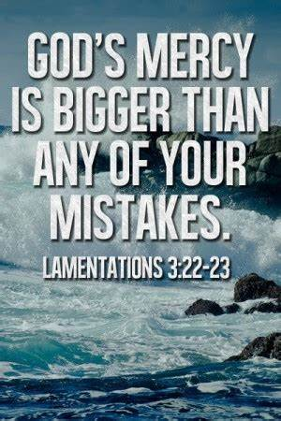
4

Slide 7
5
Briefly, it is not only their fellow human beings that the beloved of God must treat with mercy and compassion, rather must they show forth the utmost loving-kindness to every living creature.
- 'Abdu'l-Bahá, Selections of the Writings of 'Abdu'l-Bahá, p.158

Slide 8
6
It is seemly that the servant should, after each prayer, supplicate God to bestow mercy and forgiveness upon his parents.
- The Báb, Selections from the Writings of The Báb, p. 94

Slide 9
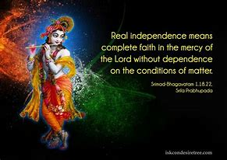
7

Slide 10
8
O son of man! If thine eyes be turned towards mercy, forsake the things that profit thee and cleave unto that which will profit mankind.
- Bahá'u'lláh, Tablets of Bahá'u'lláh, p. 64

Slide 11

https://youtu.be/zXBmkhoD1tM
Rab-e-Rahim par Bharosa (Trust in the All-Merciful Lord)" by Arman, Aria & Gloria

Slide 12
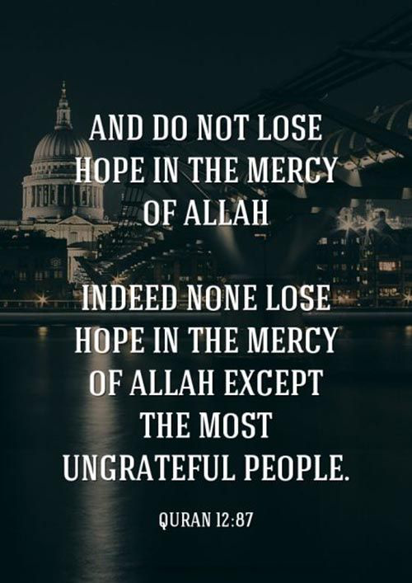
9

Slide 13
10
The greatness of His mercy surpasseth the fury of His wrath, and His grace encompasseth all who have been called into being and been clothed with the robe of life.
Bahá’u’lláh, Gleanings from the Writings of Bahá’u’lláh, p. 130

Slide 14
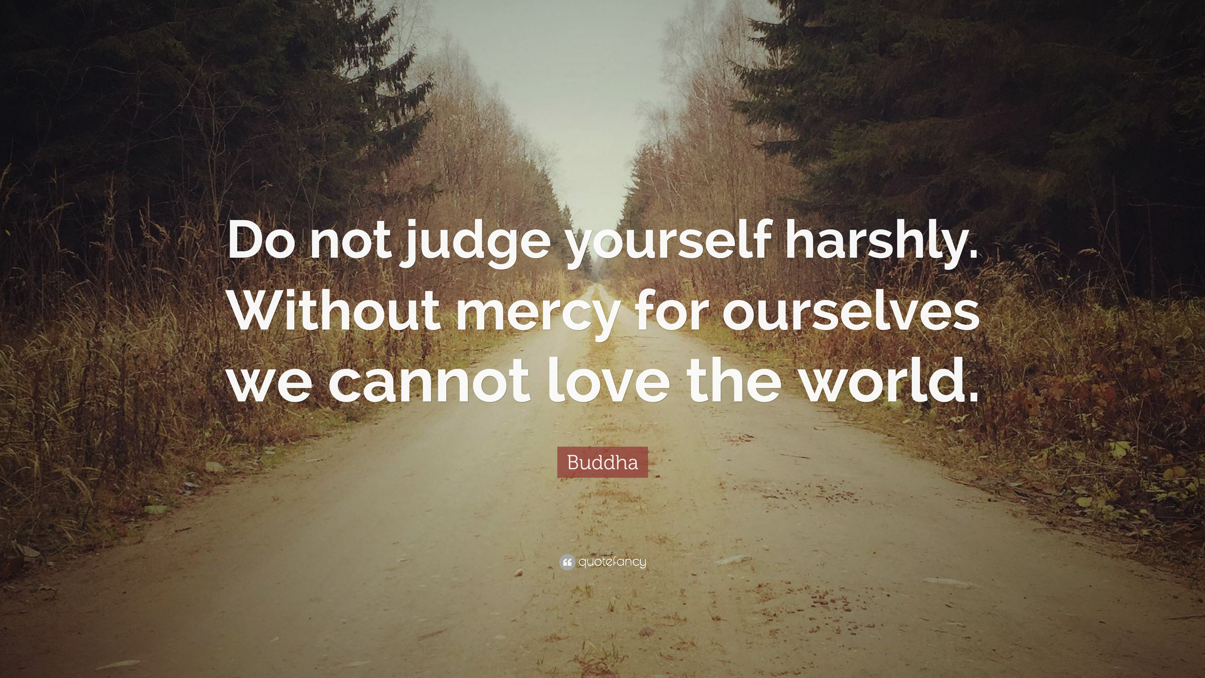
11

Slide 15
12
But we must always remember that our existence and everything we have or ever will have is dependent upon the Mercy of God and His Bounty, and therefore He can accept into His heaven, which is really nearness to Him, even the lowliest if He pleases. We always have the hope of receiving His Mercy if we reach out for it.
Shoghi Effendi, Lights of Guidance, p. 209

Slide 16
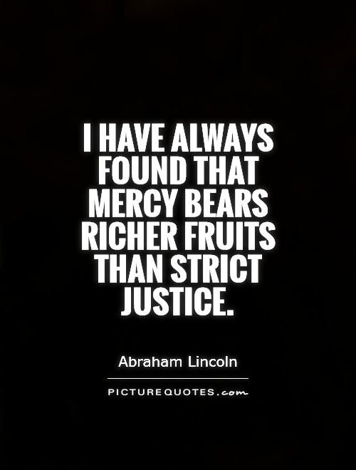
13

Slide 17
14
Oh, friends of God, be living examples of justice! So that by the Mercy of God, the world may see in your actions that you manifest the attributes of justice and mercy.
- 'Abdu'l-Bahá, Paris Talks, Part two: 49

Slide 18
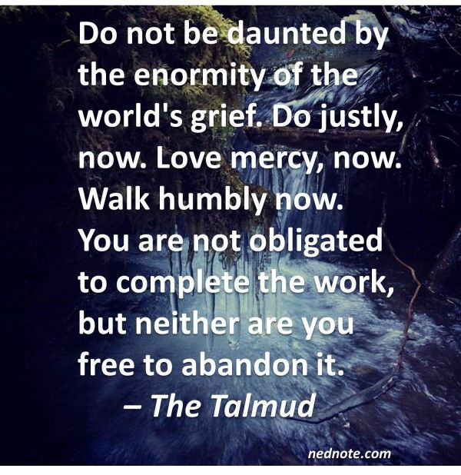
15

Slide 19
16
God is great! God is kind! He does not behold human shortcomings; He does not regard human weaknesses. Man is a creature of His mercy, and to His mercy He summons all.
- 'Abdu'l-Bahá, The Promulgation of Universal Peace

Slide 20

https://youtu.be/PtZwN02b1bg
O Aalok Putra Agyani... Baha'i prayer

