Slide 1

PATIENCE

Slide 2


Slide 3
1
I adjure Thee by Thy might, O my God! Let no harm beset me in times of tests, and in moments of heedlessness guide my steps aright through Thine inspiration. Thou art God, potent art Thou to do what Thou desirest. No one can withstand Thy Will or thwart Thy Purpose.
- The Báb

Slide 4
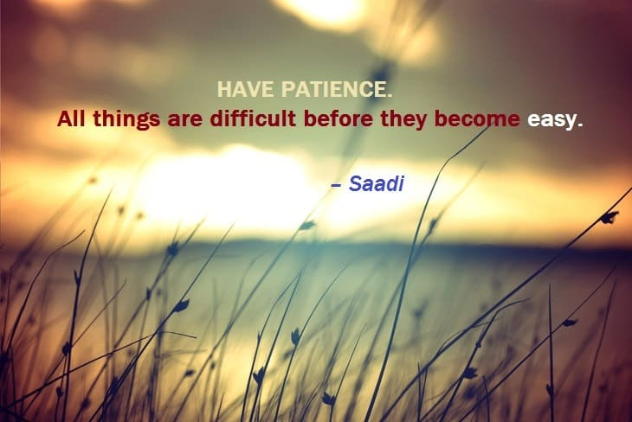
2

Slide 5
3
...be patient in the hour of loss. Adversity is followed by success and rejoicings follow woe.
- Bahá'u'lláh

Slide 6
4
...this earthly life shall come to an end, and everyone shall expire and return unto my Lord God Who will reward with the choicest gifts the deeds of those who endure with patience.
- The Báb

Slide 7
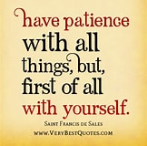
5

Slide 8
6
“Rivers know this: there is no hurry. We shall get there some day.”
― A.A. Milne, Winnie-the-Pooh

Slide 9
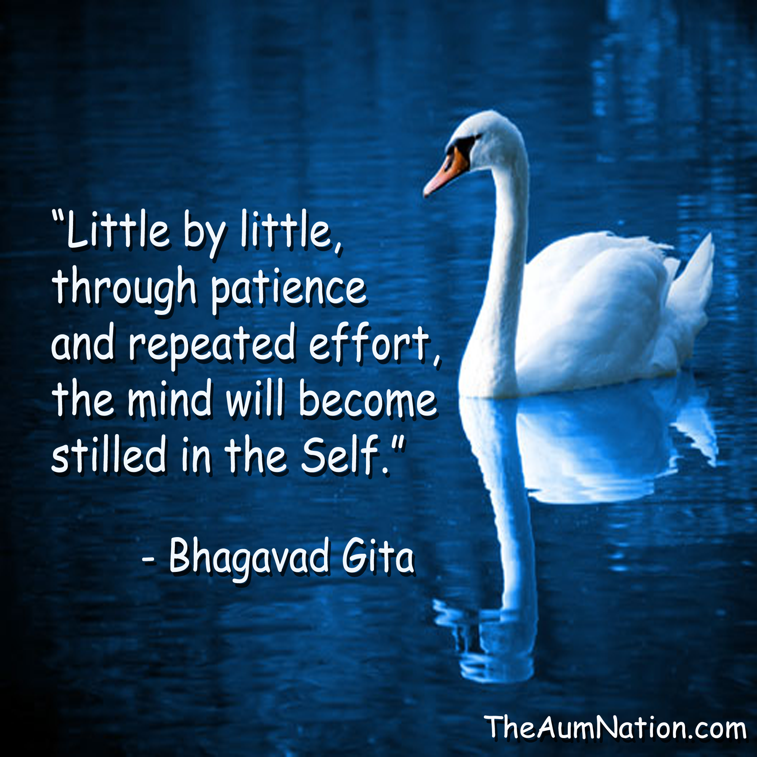
7

Slide 10
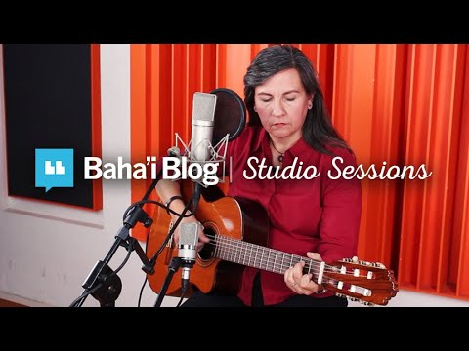

Slide 11
8
The virtues and attributes pertaining unto God are all evident and manifest, and have been mentioned and described in all the heavenly books. Among them are trustworthiness, truthfulness, purity of heart while communing with God, forbearance, resignation to whatever the Almighty hath decreed, contentment with the things His Will hath provided, patience, nay, thankfulness in the midst of tribulation, and complete reliance, in all circumstances, upon Him. These rank, according to the estimate of God, among the highest and most laudable of acts.
- Bahá'u'lláh

Slide 12
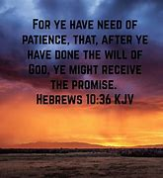
9

Slide 13
10
“Adopt the pace of nature: her secret is patience.” — Ralph Waldo Emerson

Slide 14
11
Be patient under all conditions and place your whole trust and confidence in God.
- Bahá'u'lláh

Slide 15
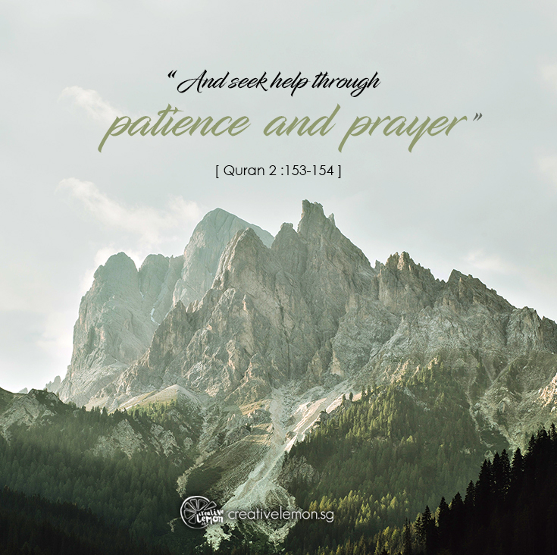
12

Slide 16
13
O God! Recompense those who endure patiently in thy days and strengthen their hearts to walk undeviatingly in the path of Truth.
- The Báb

Slide 17
14
“One minute of patience, ten years of peace.” — Greek proverb

Slide 18

15

Slide 19


