Slide 1

HONOR

Slide 2

1
O my God! O my God! Unite the hearts of Thy servants, and reveal to them Thy great purpose. May they follow Thy commandments and abide in Thy law. Help them, O God, in their endeavor, and grant them strength to serve Thee. O God! Leave them not to themselves, but guide their steps by the light of Thy knowledge, and cheer their hearts by Thy love. Verily, Thou art their helper and their Lord.
- Bahá'u'lláh

Slide 3


Slide 4
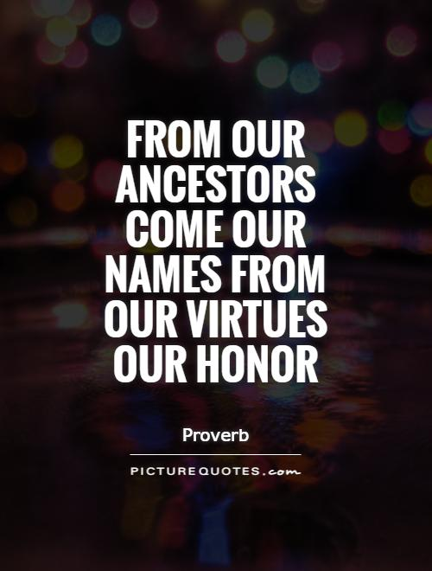
2

Slide 5
3
Praise and thanksgiving be unto Providence that out of all the realities in existence He has chosen the reality of man and has honored it with intellect and wisdom, the two most luminous lights in either world.
- 'Abdu'l-Bahá

Slide 6
4
Then it is clear that the honor and exaltation of man must be something more than material riches. Material comforts are only a branch, but the root of the exaltation of man is the good attributes and virtues which are the adornments of his reality.
- 'Abdu'l-Bahá

Slide 7
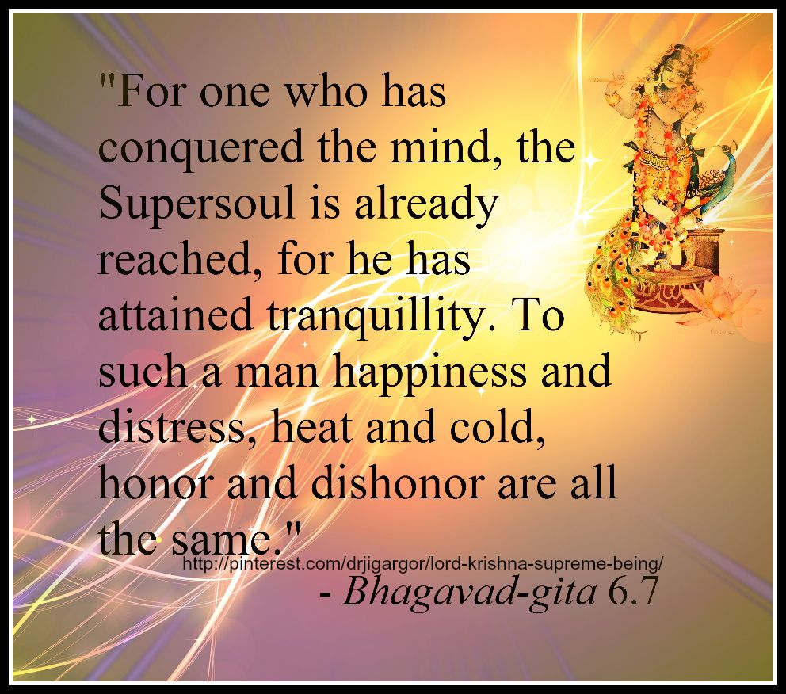
5

Slide 8
6
They who are possessed of riches, however, must have the utmost regard for the poor, for great is the honor destined by God for those poor who are steadfast in patience. By My life! There is no honor, except what God may please to bestow, that can compare to this honor.
- Bahá'u'lláh

Slide 9

7

Slide 10


Slide 11
8
Man is he who forgets his own interests for the sake of others. His own comfort he forfeits for the well-being of all. Nay, rather, his own life must he be willing to forfeit for the life of mankind. Such a man is the honor of the world of humanity. Such a man is the glory of the world of mankind. Such a man is the one who wins eternal bliss. Such a man is near to the threshold of God. Such a man is the very manifestation of eternal happiness.
- 'Abdu'l-Bahá

Slide 12
Be careful to honor your wife, for blessing enters the house only because of the wife.
9
Talmud, Bava Metzia 59a

Slide 13
10
And yet, if we ponder the lessons of history it will become evident that this very sense of honor and dignity is itself one of the bounties deriving from the instructions of the Prophets of God. We also observe in infants the signs of aggression and lawlessness, and that if a child is deprived of a teacher’s instructions his undesirable qualities increase from one moment to the next. It is therefore clear that the emergence of this natural sense of human dignity and honor is the result of education.
- 'Abdu'l-Bahá “The Secret of Divine Civilization”, pp. 97–8) [35]

Slide 14
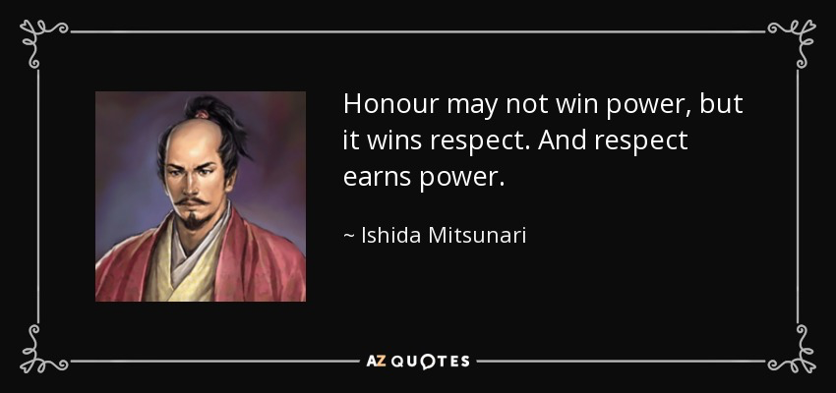
11

Slide 15
12
The greatest bestowal of God in the world of humanity is religion; for assuredly the divine teachings of religion are above all other sources of instruction and development to man. Religion confers upon man eternal life and guides his footsteps in the world of morality. It opens the doors of unending happiness and bestows everlasting honor upon the human kingdom. It has been the basis of all civilization and progress in the history of mankind.
-- `Abdu'l-Bahá, Baha'i World Faith, p. 270

Slide 16
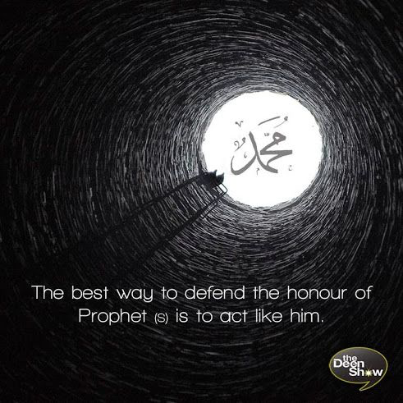
13

Slide 17
14
Thou art God's shadow on earth. Strive, therefore, to act in such a manner as befitteth so eminent, so august a station. If thou dost depart from following the things We have caused to descend upon thee and taught thee, thou wilt, assuredly, be derogating from that great and priceless honor.
-- Gleanings from the Writings of Baha'u'llah, p. 237

Slide 18
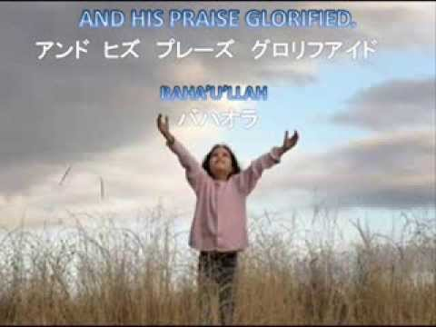

Slide 19
15 https://www.youtube.com/watch?v=InnEhUtjgao
Blessed is the Spot A Baha'i Prayer Bilingual)

