Slide 1

DESTINY

Slide 2

https://youtu.be/WP4eB2ZYawY
Elika Mahoney Infinite Bounty

Slide 3
1
Say: God sufficeth all things above all things, and nothing in the heavens or in the earth but God sufficeth. Verily, He is in Himself the Knower, the Sustainer, the Omnipotent.
- The Bàb

Slide 4
2
O SON OF BEING!
Thy Paradise is My love; thy heavenly home, reunion with Me. Enter therein and tarry not. This is that which hath been destined for thee in Our kingdom above and Our exalted dominion.
- Bahà'u'llàh

Slide 5
3
Nothing can befall us but what God hath destined for us.
- The Qur'àn, 9:51

Slide 6
4
Were man to appreciate the greatness of his station and the loftiness of his destiny he would manifest naught save goodly character, pure deeds, and a seemly and praiseworthy conduct.
- Bahà'u'llah

Slide 7
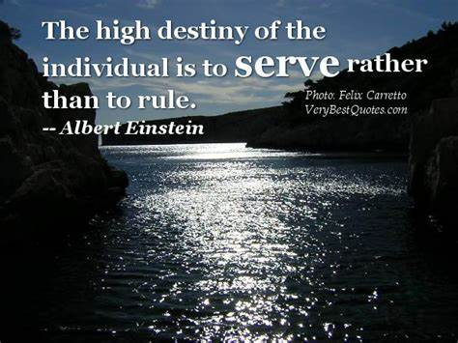
5

Slide 8
6
Concerning the means of livelihood, thou shouldst, while placing thy whole trust in God, engage in some occupation. He will assuredly send down upon thee from the heaven of His favor that which is destined for thee. He is in truth the God of might and power.
- Bahà'u'llah

Slide 9

7

Slide 10
8
Unto each one hath been prescribed a pre-ordained measure, as decreed in God’s mighty and guarded Tablets. All that which ye potentially possess can, however, be manifested only as a result of your own volition. One’s freedom makes every human being responsible for one’s own deeds, for which one will finally “be called to give account”.
- Bahà'u'llàh

Slide 11

2) https://www.youtube.com/watch?v=ybJbr1BsAW0
"Fate che il vostro cuore (Let Your Heart)" by Naim & Friends

Slide 12
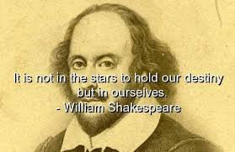
9

Slide 13
10
The events in life are regulated by two kinds of divine decrees: “The one is irrevocable, the other is, as termed by men, impending”. That which is considered irrevocable is not subject to change. All the rest is subject to change through the effect of means and actions. Both decrees are to be obeyed and accepted.
- Bahà'u'llàh

Slide 14

11

Slide 15
12
There are certain things to which man is forced and compelled, such as sleep, death, sickness, decline of power, injuries and misfortunes; these are not subject to the will of man, and he is not responsible for them, for he is compelled to endure them. But in the choice of good and bad actions he is free, and he commits them according to his own will.
-Abdu’l-Baha

Slide 16
13
It is better to live your own destiny imperfectly than
to live an imitation of somebody else’s life with
perfection.
The Bhagavad Gita

Slide 17
14
O friends! Be not careless of the virtues with which ye have been endowed, neither be neglectful of you high destiny. Suffer not your labors to be wasted through the vain imaginations which certain hearts have devised.
- Bahà'u'llàh

Slide 18
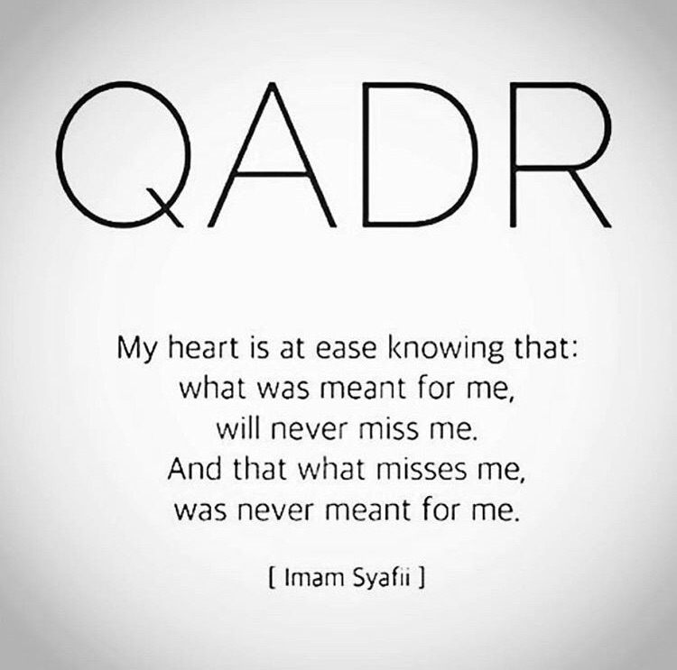
15

Slide 19
16
“ Watch your thoughts, they become your words
Watch your words, they become your actions
Watch your actions, they become your habits
Watch your habits, they become your character
Watch your character, for it will become your destiny”
Oral Torah to Hillel the Elder (30 B.C.-10 A.D.)

Slide 20

https://www.youtube.com/watch?v=m7PnPPEUw70&list=PL28EE2079BEB7B253
Be The Change You Want To See

