Slide 1


FAITH

Slide 2


Elika Mahoney This is Faith,
Poem by Ruhiyyih Khanum
https://youtu.be/krTH_Z2D-WA

Slide 3
1
Create in me a pure heart, O my God, and renew a tranquil conscience within me, O my Hope! Through the spirit of power confirm Thou me in Thy Cause, O my Best-Beloved, and by the light of Thy glory reveal unto me Thy path, O Thou the Goal of my desire! Through the power of Thy transcendent might lift me up unto the heaven of Thy holiness, O Source of my being, and by the breezes of Thine eternity gladden me, O Thou Who art my God! Let Thine everlasting melodies breathe tranquility on me, O my Companion, and let the riches of Thine ancient countenance deliver me from all except Thee, O my Master, and let the tidings of the revelation of Thine incorruptible Essence bring me joy, O Thou Who art the most manifest of the manifest and the hidden of the hidden!
- Baha'u'llàh

Slide 4
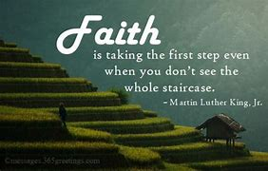
2

Slide 5
3
The first sign of faith is love. The message of the holy, divine Manifestations is love; the radiance of the world is due to love; the well-being and happiness of the world depend upon it. Therefore, I admonish you that you must strive throughout the human world to diffuse the light of love.
- 'Abdu'l-Bahà

Slide 6
4
The essence of faith is fewness of words and abundance of deeds; he whose words exceed his deeds, know verily his death is better than his life.
- Baha'u'llàh

Slide 7

5

Slide 8
6
Just as the conception of faith existed from the beginning that hath no beginning, and will endure till the end that hath no end, in like manner will the true believer eternally live and endure. His spirit will everlastingly circle round the Will of God. He will last as long as God, Himself, will last.
- Baha'u'llàh

Slide 9
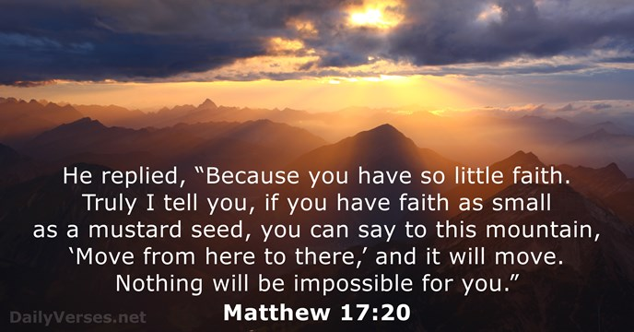
7

Slide 10
8
How vast the number of people who are well versed in every science, yet it is their adherence to the holy Word of God which will determine their faith, inasmuch as the fruit of every science is none other than the knowledge of divine precepts and submission unto His good-pleasure.
- The Bàb

Slide 11
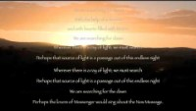
https://www.youtube.com/watch?v=OmXDJCN3q4M
Search for Dawn; The Music and Arrest of Bahai Muiscian , Behnam Rohani Fard

Slide 12
9
O my Lord! Suffer me to be detached from aught else save Thee, to hold fast to the hem of Thy bounty, to be wholly devoted to Thy Faith, to remain fast and firm in Thy love and to observe what Thou hast prescribed in Thy Book.
Verily, Thou art the Powerful, the Mighty, the Omnipotent.
—‘Abdu’l‑Bahá

Slide 13
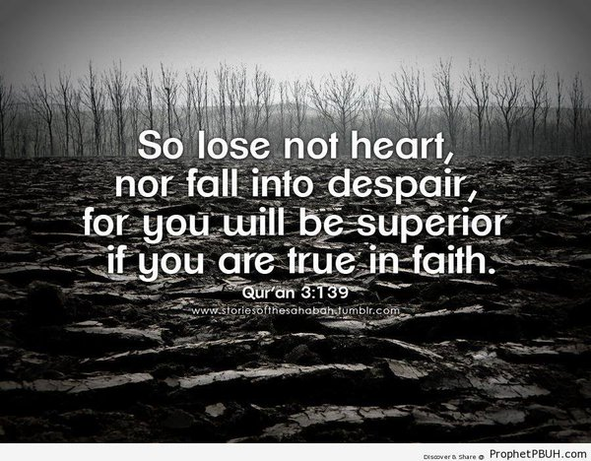
10

Slide 14
11
Question: Will you state the tenets of your faith?
Answer: First, investigate reality. Man must leave imitation and seek reality. The contemporaneous religious beliefs differ because of their allegiance to dogma. It is necessary, therefore, to abandon imitations and seek their fundamental reality.
—‘Abdu’l‑Bahá

Slide 15
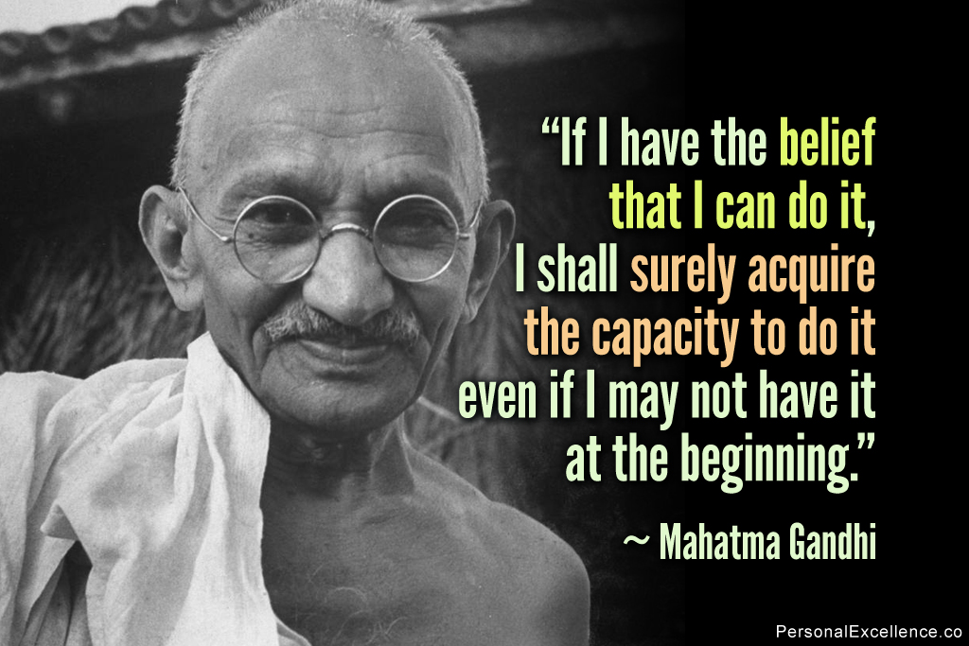
12

Slide 16
13
Regard not the all-sufficing power of God as an idle fancy. It is that genuine faith which thou cherishest for the Manifestation of God in every Dispensation. It is such faith which sufficeth above all the things that exist on the earth, whereas no created thing on earth besides faith would suffice thee. If thou art not a believer, the Tree of divine Truth would condemn thee to extinction. If thou art a believer, thy faith shall be sufficient for thee above all things that exist on earth, even though thou possess nothing.
Selections from the Writings of the Báb

Slide 17
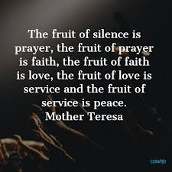
14

Slide 18
15
The teachings and ordinances of the divine religions are of two kinds. The first are spiritual and essential in nature—such as faith in God, faith in Christ, faith in Moses, faith in Abraham, faith in Muḥammad, the love of God and the oneness of the world of humanity. These divine principles shall be spread throughout the world.
—‘Abdu’l‑Bahá

Slide 19

16

Slide 20
17
The second kind of ordinances and teachings concern the outer conditions and transactions of the world of mankind. They are the nonessential, accidental or temporary laws of human affairs which are subject to change and transformation according to the exigencies of time and place.
—‘Abdu’l‑Bahá

Slide 21

18

Slide 22

https://www.youtube.com/watch?v=yHxngWnDkGI
"Ojalá (O that I could travel)" by Lydia & Eduardo

