Slide 1
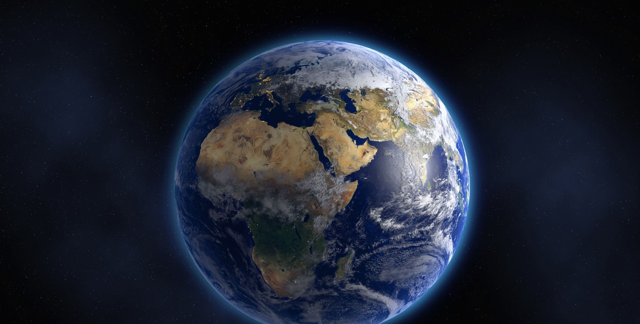
DETACHMENT

Slide 2

https://www.youtube.com/watch?v=XbJsBXX8qtM

Slide 3
1
Say: God sufficeth all things above all things, and nothing in the heavens or in the earth but God sufficeth. Verily, He is in Himself the Knower, the Sustainer, the Omnipotent.
- The Báb

Slide 4

2

Slide 5
3
O Thou kind Lord! Grant that this youth may attain unto that which is the highest aspiration of the holy ones. Endow him with the wings of Thy strengthening grace—wings of detachment and divine aid—that he may soar thereby into the atmosphere of Thy tender mercy, be able to partake of Thy celestial bestowals, may become a sign of divine guidance and a standard of the Concourse on high. Thou art the Potent, the Powerful, the Seeing, the Hearing.
—‘Abdu’l‑Bahá

Slide 6

4

Slide 7
5
O peoples of the earth! God, the Eternal Truth, is My witness that streams of fresh and soft-flowing waters have gushed from the rocks through the sweetness of the words uttered by your Lord, the Unconstrained; and still ye slumber. Cast away that which ye possess, and, on the wings of detachment, soar beyond all created things. Thus biddeth you the Lord of creation, the movement of Whose Pen hath revolutionized the soul of mankind.
-Bahá'u'lláh

Slide 8

6

Slide 9
7
The essence of detachment is for man to turn his face towards the courts of the Lord, to enter His Presence, behold His Countenance, and stand as witness before Him.
-Bahá'u'lláh

Slide 10

8

Slide 11

https://www.youtube.com/watch?v=j5adHvlaH0U
La Nueva Primavera - Amigos de Sudamérica (The New Spring - Friends in South America)

Slide 12
9
Our greatest efforts must be directed towards detachment from the things of the world; we must strive to become more spiritual, more luminous, to follow the counsel of the Divine Teaching, to serve the cause of unity and true equality, to be merciful, to reflect the love of the Highest on all men, so that the light of the Spirit will be apparent in all our deeds, to the end that all humanity shall be united, the stormy sea thereof calmed, and all rough waves disappear from of the surface of life's ocean henceforth unruffled and peaceful.
- 'Abdu'l-Bahá

Slide 13

10

Slide 14
11
Until man is born again from the world of nature, that is to say, becomes detached from the world of nature, he is essentially an animal, and it is the teachings of God which convert this animal into a human soul.
- 'Abdu'l-Bahá

Slide 15

12

Slide 16
15
13
Consider a pearl which shineth by virtue of its inherent nature. If it be covered with silk, its luster and beauty will be concealed. Likewise, man’s distinction lieth in the excellence of his conduct and in the pursuit of that which beseemeth his station, not in childish play and pastimes. Know that thy true adornment consisteth in the love of God and in thy detachment from all save Him, and not in the luxuries thou dost possess. Abandon them unto those who seek after them and turn unto God, He Who causeth the rivers to flow.
-Bahá'u'lláh

Slide 17

14

Slide 18
15
Our greatest efforts must be directed towards detachment from the things of the world; we must strive to become more spiritual, more luminous, to follow the counsel of the Divine Teaching, to serve the cause of unity and true equality, to be merciful, to reflect the love of the Highest on all men, so that the light of the Spirit shall be apparent in all our deeds, to the end that all humanity shall be united, the stormy sea thereof calmed, and all rough waves disappear from off the surface of life’s ocean henceforth unruffled and peaceful.
—‘Abdu’l‑Bahá

Slide 19

16

Slide 20

https://www.youtube.com/watch?v=X_mciMKeIgU
Shadi & Shidan Toloui-Wallace, Detachment

