Slide 1

JOY

Slide 2

https://www.youtube.com/watch?v=LA4nBbxVuns
Baha’i Prayer for America

Slide 3
1
Remove not, O Lord, the festal board that hath been spread in Thy Name, and extinguish not the burning flame that hath been kindled by Thine unquenchable fire. Withhold not from the flowing that living water of Thine that murmureth with the melody of Thy glory and Thy remembrance, and deprive not Thy servants from the fragrance of Thy sweet savors breathing forth the perfume of Thy love.
Lord! Turn the distressing cares of Thy holy ones into ease, their hardship into comfort, their abasement into glory, their sorrow into blissful joy, O Thou that holdest in Thy grasp the reins of all mankind!
Thou art, verily, the One, the Single, the Mighty, the All-Knowing, the All-Wise.
- 'Abdu'l-Bahá

Slide 4
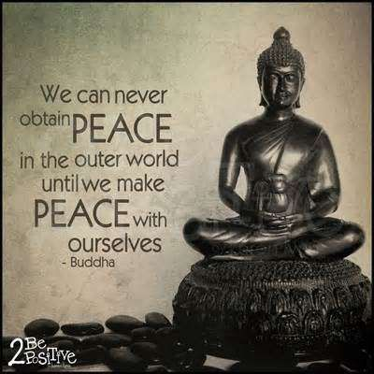
2

Slide 5
3
O Son of Being!
With the joyful tidings of light I hail thee: rejoice! To the court of holiness I summon thee; abide therein that thou mayest live in peace for evermore.
- Bahá'u'lláh

Slide 6
4
Joy gives us wings! In times of joy our strength is more vital, our intellect keener, and our understanding less clouded. We seem better able to cope with the world and to find our sphere of usefulnesss. But when sadness visits us we become weak, our strength leaves us, our comprehension is dim and our intelligence veiled.
-'Abdu'l-Bahá

Slide 7
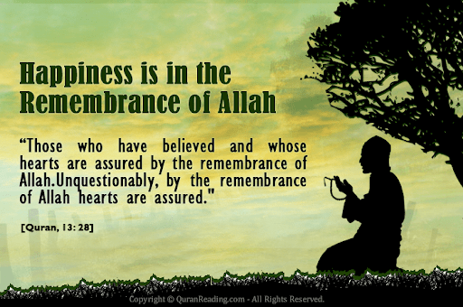
5

Slide 8
6
..the honor of the human kingdom is the attainment of spiritual happiness in the human world, the acquisition of the knowledge and love of God. The honor allotted to man is the acquisition of the supreme virtues of the human world. This is his real happiness and felicity. But if material happiness and spiritual felicity be conjoined, it will be "delight upon delight", as the Arabs say.
-'Abdu'l-Bahá

Slide 9

7

Slide 10

https://youtu.be/PszP5FjiVQ4
Junior youth sing “Let Your Heart Burn”

Slide 11
8
Turn all of your thoughts toward bringing joy to hearts. Beware! Beware! lest you offend any heart. Assist the world of humanity as much as possible. Be the source of consolation to every sad one, assist every weak one, be helpful to every indigent one, care for every sick one, be the cause of glorification to every lowly one, and shelter those who are overshadowed by fear.
In brief, let each one of you be as a lamp shining forth with the light of the virtues of the world of humanity.
- 'Abdu'l-Bahá

Slide 12
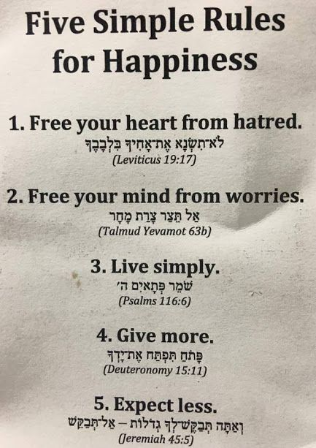
9

Slide 13
10
It is quite apparent to the seeing mind that a man’s spirit is something very different from his physical body. The spirit is changeless, indestructible. The progress and development of the soul, the joy and sorrow of the soul, are independent of the physical body. If we are caused joy or pain by a friend, if a love prove true or false, it is the soul that is affected. If our dear ones are far from us it is the soul that grieves, and the grief or trouble of the soul may react on the body. Thus, when the spirit is fed with holy virtues, then is the body joyous; if the soul falls into sin, the body is in torment! When we find truth, constancy, fidelity, and love, we are happy; but if we meet with lying, faithlessness, and deceit, we are miserable.
- 'Abdu'l-Bahá

Slide 14
11
In truth, knowledge is a veritable treasure for man, and a source of glory, of bounty, of joy, of exaltation, of cheer and gladness unto him. Happy the man that cleaveth unto it, and woe betide the heedless.
- Bahá'u'lláh

Slide 15
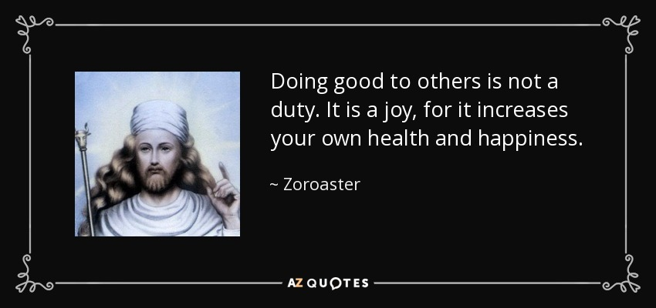
12

Slide 16
13
O SON OF THE SUPREME!
I have made death a messenger of joy to thee. Wherefore dost thou grieve?
I made the light to shed on thee its splendor. Why dost thou veil thyself therefrom?
- Bahá'u'lláh

Slide 17
14
Rejoice always, pray continually,
give thanks in all circumstances;
for this is God’s will for you in Christ Jesus.
1 Thessalonians 5:16-18

Slide 18

https://www.youtube.com/watch?v=voC0Op8oiGw
Bengali Baha’i song

