Slide 1

PRAYER

Slide 2
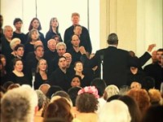
https://youtu.be/5MJfmCilk74

Slide 3
1
Glory be to Thee, O Lord my God! Make manifest the rivers of Thy sovereign might, that the waters of Thy Unity may flow through the inmost realities of all things, in such wise that the banner of Thine unfailing guidance may be raised aloft in the kingdom of Thy command and the stars of Thy divine splendor may shine brightly in the heaven of Thy majesty.
Potent art Thou to do what pleaseth Thee. Thou, verily, art the Help in Peril, the Self-Subsisting.
- Bahá'u'lláh

Slide 4
2
DYNAMICS OF PRAYER FOR SOLVING PROBLEMS
1st step:
Pray and meditate about it. Use the prayers of the Manifestations as they have the greatest power. Then remain in the silence of contemplation for a few minutes.
2nd step:
Arrive at a decision and hold this. This decision is usually born during the contemplation. It may seem almost impossible of accomplishment but if it seems to be an answer to a prayer or a way of solving the problem, then immediately take the next step.

Slide 5
3
DYNAMICS OF PRAYER FOR SOLVING PROBLEMS
3rd step:
Have determination to carry the decision through. Many fail here. The decision, budding into determination, is blighted and instead becomes a wish or a vague longing. When determination is born, immediately take the next step.
4th step:
Have faith and confidence that the power will flow through you, the right way will appear, the door will open, the right thought, the right message, the right principle, or the right book will be given to you. Have confidence and the right thing will come to your need. Then, as your rise from prayer, take at once the 5th step.

Slide 6
4
DYNAMICS OF PRAYER FOR SOLVING PROBLEMS
5th step:
Act as though it had been all answered. Then act with tireless, ceaseless energy. And as you act, you, yourself, will become a magnet, which will attract more power to your being, until you become an unobstructed channel for the Divine power to flow through you.
- Shoghi Effendi (Pilgrim’s Notes)

Slide 7
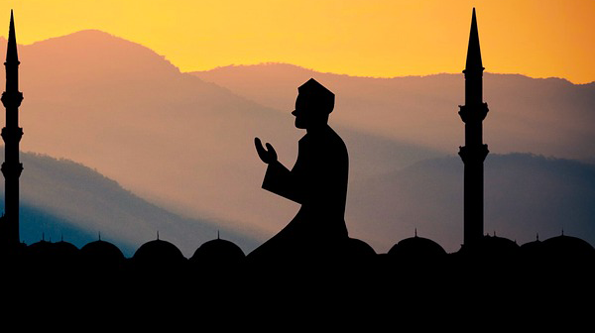
5
“Celebrate the praises of your Lord, and pray for His Forgiveness. Indeed He is ever ready to show Mercy.”
The Quran 110:03

Slide 8
6
Intone, O My servant, the verses of God that have been received by thee, as intoned by them who have drawn nigh unto Him, that the sweetness of thy melody may kindle thine own soul, and attract the hearts of all men. Whoso reciteth, in the privacy of his chamber, the verses revealed by God, the scattering angels of the Almighty shall scatter abroad the fragrance of the words uttered by his mouth, and shall cause the heart of every righteous man to throb. Though he may, at first, remain unaware of its effect, yet the virtue of the grace vouchsafed unto him must needs sooner or later exercise its influence upon his soul. Thus have the mysteries of the Revelation of God been decreed by virtue of the Will of Him Who is the Source of power and wisdom.
- Bahá'u'lláh

Slide 9
7
The most acceptable prayer is the one offered with the utmost spirituality and radiance; its prolongation hath not been and is not beloved by God. The more detached and purer the prayer, the more acceptable is it in the presence of God.
- The Báb

Slide 10
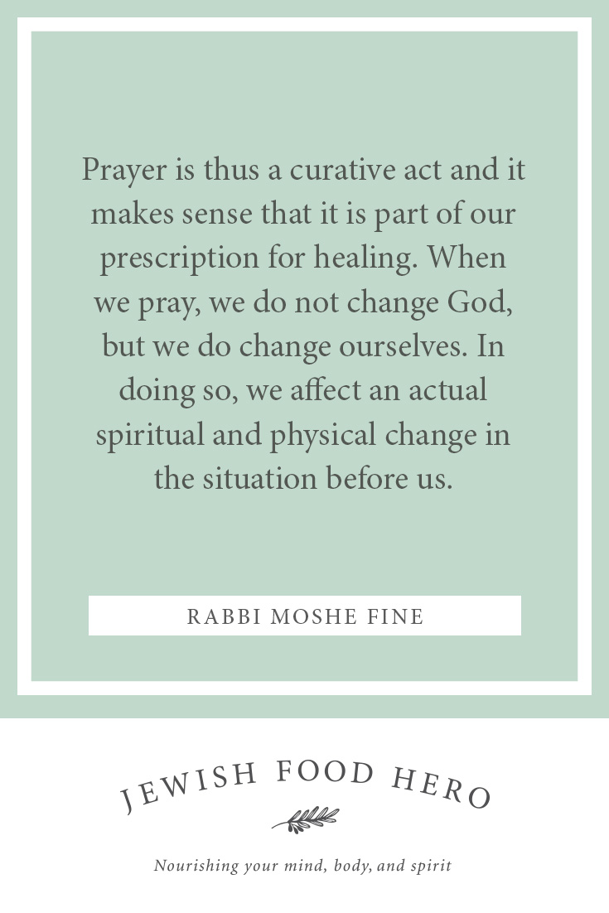
8
8

Slide 11

https://www.youtube.com/watch?v=eaZuJJTfYUI&list=PLF336DCAA7EFF09AB&index=7
"Intone" - Nabil M.

Slide 12
9
The wisdom of prayer is this: That it causeth a connection between the servant and the True One, because in that state man with all heart and soul turneth his face towards His Highness the Almighty, seeking His association and desiring His love and compassion.
- 'Abdu'l-Bahá

Slide 13
10
“There is nothing sweeter in the world of existence than prayer. Man must live in a state of prayer. The most blessed condition is the condition of prayer and supplication. Prayer is conversation with God. The greatest attainment or the sweetest state is none other than conversation with God. It creates spirituality, creates mindfulness and celestial feelings, begets new attractions of the Kingdom and engenders susceptibilities of the higher intelligence.”
‘Abdu’l‑Bahá

Slide 14
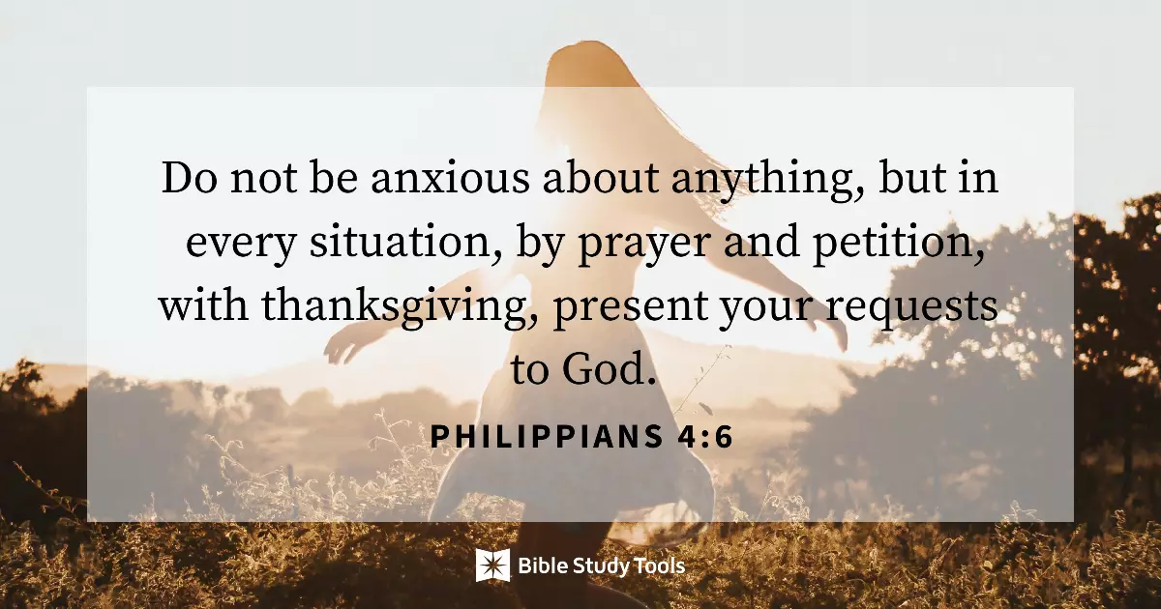
11

Slide 15
12
O Son of Light! Forget all save Me and commune with My spirit. This is the essence of My command, therefore, turn unto it.
- Bahá'u'lláh

Slide 16
13
“Should Prayer take the form of action?”
‘Abdu’l‑Bahá: “Yes: In the Bahá’í Cause arts, sciences and all crafts are (counted as) worship. The man who makes a piece of notepaper to the best of his ability, conscientiously, concentrating all his forces on perfecting it, is giving praise to God. Briefly, all effort and exertion put forth by man from the fullness of his heart is worship, if it is prompted by the highest motives and the will to do service to humanity. This is worship: to serve mankind and to minister to the needs of the people. Service is prayer. A physician ministering to the sick, gently, tenderly, free from prejudice and believing in the solidarity of the human race, he is giving praise.”
Paris Talks by ‘Abdu’l‑Bahá

Slide 17
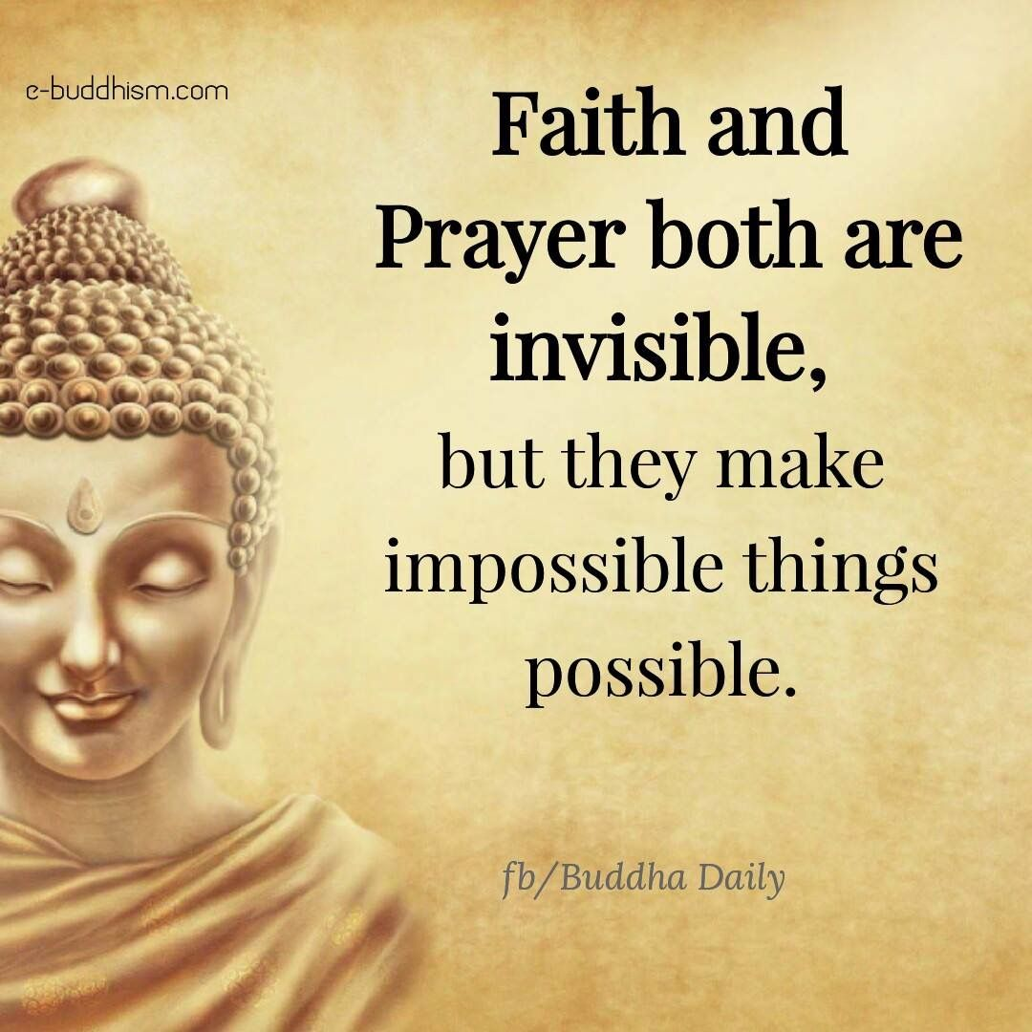
14

Slide 18
15
“In the highest prayer, men pray only for the love of God, not because they fear Him or hell, or hope for bounty or heaven … When a man falls in love with a human being, it is impossible for him to keep from mentioning the name of his beloved. How much more difficult it is to keep from mentioning the Name of God when one has come to love Him. … The spiritual man finds no delight in anything save in commemoration of God.”
“If one friend loves another, is it not natural that he should wish to say so? Though he knows that that friend is aware of his love, does he still not wish to tell him of it?
… It is true that God knows the wishes of all hearts; but the impulse to pray is a natural one, springing from man’s love of God.”
‘Abdu’l‑Bahá

Slide 19

https://www.youtube.com/watch?v=fh10F3xw4x4&list=PLeKEuVXQmYcR0xvBLzCfZ3Nigdcpeuvo1&index=32
Blessed is the spot

