Slide 1

Healing
and
Empathy

Slide 2

https://www.youtube.com/watch?v=nlHpnJBbXEs
What a Power is Love by Shireen and Carmel Zein

Slide 3
1
Thy name is my healing, O my God, and remembrance of Thee is my remedy. Nearness to Thee is my hope, and love for Thee is my companion. Thy mercy to me is my healing and my succor in both this world and the world to come. Thou, verily, art the All-Bountiful, the All-Knowing, the All-Wise.
- Bahá'u'lláh

Slide 4
2
We exhort the loved ones of God to observe justice and fairness, and to do that which would prompt the friends of God to evince tender mercy and compassion towards each other.
- Bahá'u'lláh

Slide 5
3
“So whatever you wish that others would do to you, do also to them, for this is the Law and the Prophets.
Matthew 7:12
Therefore, as God’s chosen people, holy and dearly loved, clothe yourselves with compassion, kindness, humility, gentleness and patience.
Colossians 3:12

Slide 6
4
O handmaid of God! The prayers which were revealed to ask for healing apply both to physical and spiritual healing. Recite them, then, to heal both the soul and the body. If healing is right for the patient, it will certainly be granted; but for some ailing persons, healing would only be the cause of other ills, and therefore wisdom doth not permit an affirmative answer to the prayer.
O handmaid of God! The power of the Holy Spirit healeth both physical and spiritual ailments.
- 'Abdu'l-Bahá

Slide 7
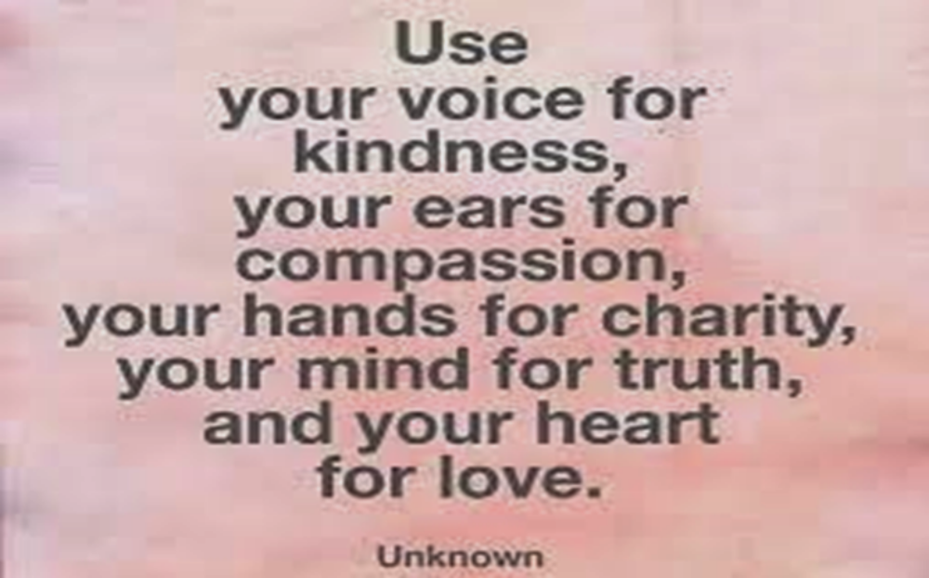
5

Slide 8
6
Universal benefits derive from the grace of the Divine religions; for they lead their true followers to sincerity of intent, to high purpose, to purity and spotless honor, to surpassing kindness and compassion.
- 'Abdu'l-Bahá

Slide 9
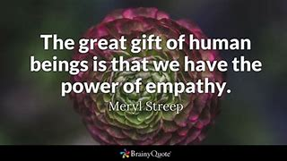
7

Slide 10
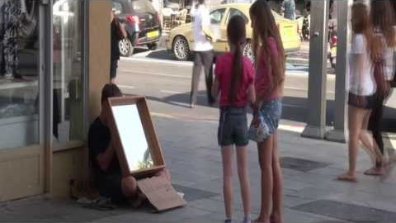
https://www.youtube.com/watch?v=lm63hCncehU
Empathy - Global Empathy Mirror Experiment

Slide 11
8
As to the fact that man must entirely forget himself, by this is meant that he should arise in the mystery of sacrifice and that is the disappearance of mortal sentiments and the extinction of blamable morals which constitute the temporal gloom and not that the physical health should be changed into weakness and debility.
- 'Abdu'l-Bahá

Slide 12
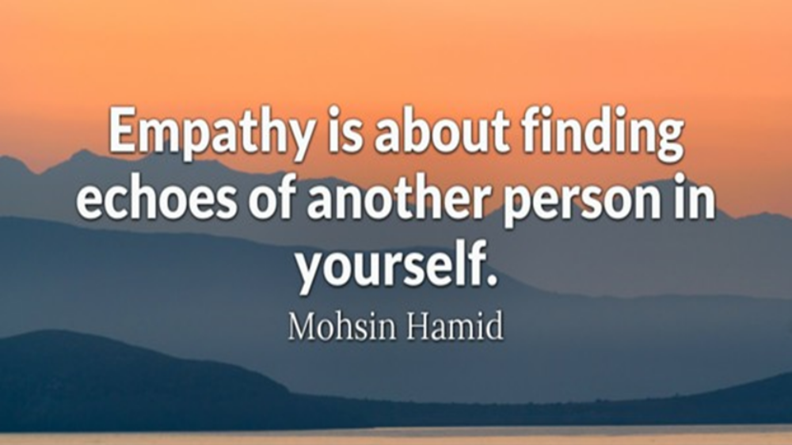
9

Slide 13
10
When our thoughts are filled with the bitterness of this world, let us turn our eyes to the sweetness of God’s compassion and He will send us heavenly calm! If we are imprisoned in the material world, our spirit can soar into the Heavens and we shall be free indeed!
Paris Talks by Abdu’l‑Bahá

Slide 14
11
Acts of kindness are greater than charity since they can be done for both the rich and poor… Charity can only be done with one’s money, while acts of loving-kindness can be performed both personally and with one’s money.
- Rambam (Hilchos Aivel 14:1)
The Sages taught...One who judges another favorably is himself judged favorably.
(Talmud Shabbat 127b)

Slide 15
12
O YE beloved of the Lord! The Kingdom of God is founded upon equity and justice, and also upon mercy, compassion, and kindness to every living soul. Strive ye then with all your heart to treat compassionately all humankind—except for those who have some selfish, private motive, or some disease of the soul. Kindness cannot be shown the tyrant, the deceiver, or the thief, because, far from awakening them to the error of their ways, it maketh them to continue in their perversity as before.
Selections from the Writings of ‘Abdu’l‑Bahá

Slide 16
13
Indeed, Allah enjoins justice, and the doing of good to others; and giving like kindred; and forbids indecency, and manifest evil, and wrongful transgression. He admonished you that you may take heed. (Al Quran 16:91)
And as for those who strive in Our path — We will surely guide them in Our ways. And Indeed, Allah is with those who are of service to others. (Al Quran 29:70)

Slide 17
14
The Almighty hath not created in man the claws and teeth of ferocious animals, nay rather hath the human form been fashioned and set with the most comely attributes and adorned with the most perfect virtues. The honor of this creation and the worthiness of this garment therefore require man to have love and affinity for his own kind, nay rather, to act towards all living creatures with justice and equity.
Selections from the Writings of ‘Abdu’l‑Bahá

Slide 18

https://www.youtube.com/watch?v=TxVoo0iUVDA&list=PLXiLK324PRwU93Mk_NDvZR-sk4FexlTkV&index=3
Michael Jackson - Man In The Mirror (lyrics) HQ Sound

