Slide 1

https://youtu.be/-sUnMMFOZE4
My light is in Thee, by Oisin & Bahiyyih Devine

Slide 2
1
O my God, my Master, the Goal of my desire! This, Thy servant, seeketh to sleep in the shelter of Thy mercy, and to repose beneath the canopy of Thy grace, imploring Thy care and Thy protection.
I beg of Thee, O my Lord, by Thine eye that sleepeth not, to guard mine eyes from beholding aught beside Thee. Strengthen, then, their vision that they may discern Thy signs, and behold the Horizon of Thy Revelation. Thou art He before the revelations of Whose omnipotence the quintessence of power hath trembled.
No God is there but Thee, the Almighty, the All-Subduing, the Unconditioned.
- Bahà'u'llàh

Slide 3
2
The Lord of the universe hath never raised up a prophet nor hath He sent down a Book unless He hath established His covenant with all men, calling for their acceptance of the next Revelation and of the next Book; inasmuch as the outpourings of His bounty are ceaseless and without limit.
- The Bàb

Slide 4
3
It’s not the strongest of the species that survive, nor the most intelligent, but the ones most responsive to change.
Charles Darwin

Slide 5
4
Know thou assuredly that the essence of all the Prophets of God is one and the same. Their unity is absolute. God, the Creator, saith: There is no distinction whatsoever among the Bearers of My Message. They all have but one purpose; their secret is the same secret. To prefer one in honor to another, to exalt certain ones above the rest, is in no wise to be permitted.
- Bahà'u'llàh

Slide 6
5
True knowledge, therefore is the knowledge of God, and this is none other than the recognition of His Manifestation in each Dispensation. Nor is there any wealth save in poverty in all save God and sanctity form aught else but Him.
- The Bàb

Slide 7
6
As the body of man needeth a garment to clothe it, so the body of mankind must needs be adorned with the mantle of justice and wisdom. Its robe is the Revelation vouchsafed unto it by God. Whenever this robe hath fulfilled its purpose, the Almighty will assuredly renew it. For every age requireth a fresh measure of the light of God. Every Divine Revelation hath been sent down in a manner that befitted the circumstances of the age in which it hath appeared.
- Bahà'u'llàh

Slide 8
7
True knowledge, therefore is the knowledge of God, and this is none other than the recognition of His Manifestation in each Dispensation. Nor is there any wealth save in poverty in all save God and sanctity from aught else but Him.
- The Bàb

Slide 9
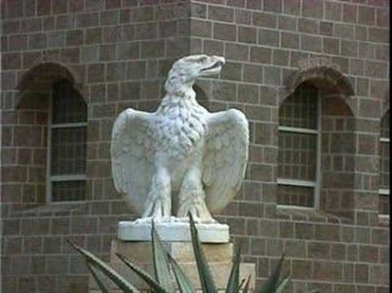
https://www.youtube.com/watch?v=rpjF7lsHQmY&list=PLByb-X3bkjRCGJ2-w83yJSU9ROc6a8MAs&index=2
Tú eres...

Slide 10
8
Among the bounties of God is revelation. Hence revelation is progressive and continuous. It never ceases. It is necessary that the reality of Divinity with all its perfections and attributes should become resplendent in the human world. The reality of Divinity is like an endless ocean. Revelation may be likened to the rain. Can you imagine the cessation of rain? Ever on the face of the earth somewhere rain is pouring down. Briefly, the world of existence is progressive. It is subject to development and growth.
The Promulgation of Universal Peace, Abdu’l-Baha

Slide 11
9
Education is a progressive discovery of our own ignorance.
Will Durant

Slide 12
10
Just as the organic evolution of mankind has been slow and gradual, and involved successively the unification of the family, the tribe, the city-state, and the nation, so has the light vouchsafed by the Revelation of God, at various stages in the evolution of religion, and reflected in the successive Dispensations of the past, been slow and progressive. Indeed the measure of Divine Revelation, in every age, has been adapted to, and commensurate with, the degree of social progress achieved in that age by a constantly evolving humanity.
The Promised Day is Come, Shoghi Effendi

Slide 13
11
CONTEMPLATE with thine inward eye the chain of successive Revelations that hath linked the Manifestation of Adam with that of the Báb. I testify before God that each one of these Manifestations hath been sent down through the operation of the Divine Will and Purpose, that each hath been the bearer of a specific Message, that each hath been entrusted with a divinely revealed Book and been commissioned to unravel the mysteries of a mighty Tablet.
Gleanings-Bahà'u'llàh

Slide 14
We must recognize the sun, no matter from what dawning point it may shine forth, be it Mosaic, Abrahamic or any personal point of orientation whatever, for we are lovers of sunlight and not of orientation. We are lovers of illumination and not of lamps and candles. We are seekers for water, no matter from what rock it may gush forth. We are in need of fruit in whatsoever orchard it may be ripened. We long for rain; it matters not which cloud pours it down. We must not be fettered. If we renounce these fetters, we shall agree, for all are seekers of reality.
‘Abdu’l-Bahá, The Promulgation of Universal Peace
12

Slide 15
13
A nation that continues year after year to spend more money on military defense than on programs of social uplift is approaching spiritual death.
Dr. Luther King Jr.

Slide 16

https://www.youtube.com/watch?v=X3BO2nxLu_w
Progressive Revelation - All Religions are One

