Slide 1

Decency

Slide 2

13
https://www.youtube.com/watch?v=SDKTOJdUXXg

Slide 3
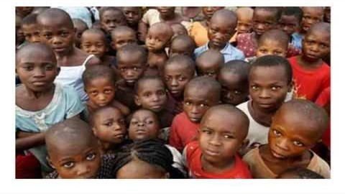
https://www.youtube.com/watch?v=Ghn9wDklaFw
Decency by ArthurFreds

Slide 4
1
O Lord! Verily, we are weak; make us mighty. We are poor; assist us from the treasury of Thy munificence. We are dead; resuscitate us through the breath of the Holy Spirit. We lack patience in tests and in long-suffering; permit us to attain the lights of oneness.
- 'Abdu'l-Bahà

Slide 5
2
..for this day the most necessary duty is to purify your morals, to correct your manners, and to improve your deeds. The beloved of the Merciful must appear with such morals and habits among the creatures that the fragrant odour of the garden of sanctity may perfume all the horizons and may quicken all the dead souls, because the Manifestation of Divinity and the dawning of the infinite lights of the Invisible is intended for the education of souls and the refinement of the morals of all in existence, so that some blessed souls may be delivered from the gloomy world of brutality and characterized with attributes to adorn the being of man.
- 'Abdu'l-Bahà, Tablets of 'Abdu'l-Bahà, p.373

Slide 6
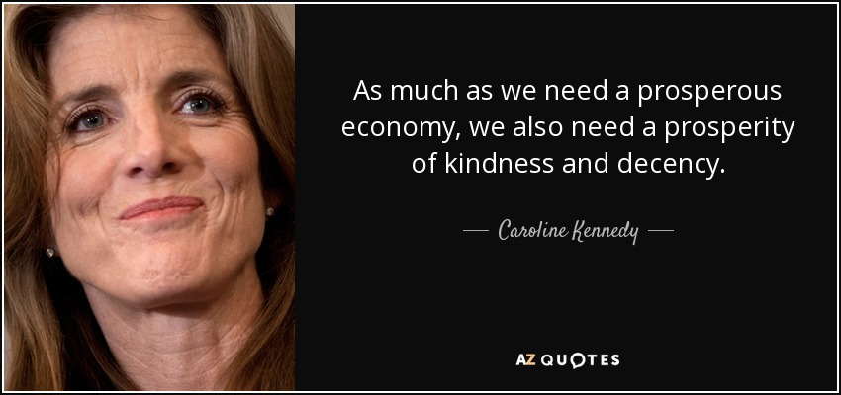
3

Slide 7
4
Uplift your magnanimity and soar high toward the apex of heaven – so that your blessed hearts may become illumined more and more, day by day, through the Rays of the Sun of Reality...
- 'Abdu'l-Bahà

Slide 8
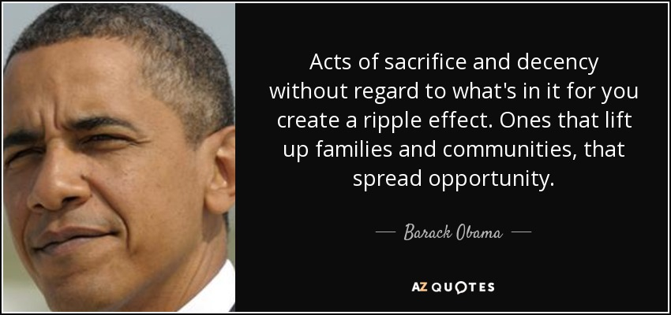
5

Slide 9
6
Such a chaste and holy life, with its implications of modesty, purity, temperance, decency and clean-mindedness, involves no less than the exercise of moderation in all that pertains to dress, language, amusements, and all artistic and literary avocations. It demands daily vigilance in the control of one's carnal desires and corrupt inclinations.
Shoghi Effendi, Lights of Guidance, p. 364

Slide 10

7

Slide 11
8
Let us walk with decency, as in the daylight: not in carousing and drunkenness; not in sexual impurity and promiscuity; not in quarreling and jealousy.
Romans, 13:13

Slide 12

14
https://www.youtube.com/watch?v=aBZ574mQ3TU

Slide 13
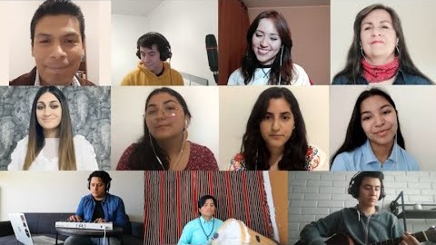
https://www.youtube.com/watch?v=j5adHvlaH0U
La Nueva Primavera - Amigos de Sudamérica (The New Spring - Friends in South America)

Slide 14
9
The perversion of human nature, the degradation of human conduct, the corruption and dissolution of human institutions, reveal themselves, under such circumstances, in their worst and most revolting aspects. Human character is debased, confidence is shaken, the nerves of discipline are relaxed, the voice of human conscience is stilled, the sense of decency and shame is obscured, conceptions of duty, of solidarity, of reciprocity and loyalty are distorted, and the very feeling of peacefulness, of joy and of hope is gradually extinguished.
The World Order of Bahà'u'llàh

Slide 15
10
Let integrity and uprightness distinguish all thine acts. Be a home for the stranger, a balm to the suffering, a tower of strength for the fugitive.
- Bahà'u'llàh

Slide 16
11
No wonder, therefore, that when, as a result of human perversity, the light of religion is quenched in men’s hearts, and the divinely appointed Robe, designed to adorn the human temple, is deliberately discarded, a deplorable decline in the fortunes of humanity immediately sets in, bringing in its wake all the evils which a wayward soul is capable of revealing.
The World Order of Bahà'u'llàh

Slide 17
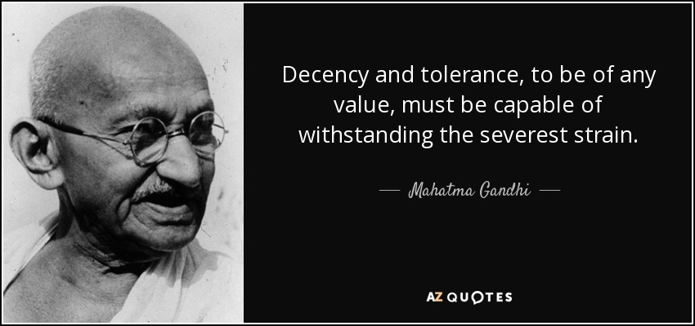
12

Slide 18
13
In Judaism, the realm of morality is not restricted to deed but rather includes man’s inner world of consciousness: thoughts, emotions, intentions, attitudes, motives. All are to a degree subject to man’s control and qualify for moral judgement. Thus the Bible warns against coveting (Exodus 20:14;Deuteronomy 5:18), against hating one’s brother (Leviticus 19:17), against “hardening one’s heart” (Deuteronomy 15:9,10), while the rabbis inveighed against envy, desire, and anger (Mishnah Avot 2:11) and noted that “thinking about transgression may be worse than transgression itself” (Babylonian Talmud, Yoma29a).

Slide 19

14

Slide 20

https://www.youtube.com/watch?v=mFBWXApTcFk
STRIVE Bahai Music Video

