Slide 1
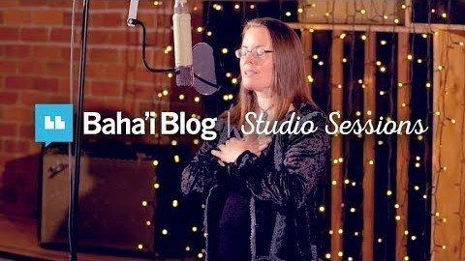
1) https://www.youtube.com/watch?v=LUV1zFXTBAg
“Educate these children” By Claire McGrail

Slide 2
1
O Lord my God! Assist Thy loved ones to be firm in Thy Faith, to walk in Thy ways, to be steadfast in Thy Cause. Give them Thy grace to withstand the onslaught of self and passion, to follow the light of divine guidance. Thou art the Powerful, the Gracious, the Self-Subsisting, the Bestower, the Compassionate, the Almighty, the All-Powerful.
- 'Abdu'l-Bahà

Slide 3
2
Even death is not feared by one who has lived wisely.
- Buddha

Slide 4
3
O ye loved ones of God! Drink your fill from the wellspring of wisdom, and soar ye in the atmosphere of wisdom, and speak forth with wisdom and eloquence. Thus biddeth your Lord, the Almighty, the All-Knowing.
- Bahà'u'llàh

Slide 5
4
O brother! Kindle with the oil of wisdom the lamp of the spirit within the innermost chamber of thy heart, and guard it with the globe of understanding, that the breath of the infidel may extinguish not its flame nor dim its brightness. Thus have We illuminated the heavens of utterance with the splendours of the Sun of divine wisdom and understanding, that thy heart may find peace, that thou mayest be of those who, on the wings of certitude, have soared unto the heaven of the love of their Lord, the All-Merciful.
- Bahà'u'llàh

Slide 6
5
Know that wisdom is such to your soul; if you find it, there will be a future, and your hope will not be cut off.
-Proverbs 24:14

Slide 7
6
Above all else, the greatest gift and most wondrous blessing hath ever been and will continue to be Wisdom. It is man's unfailing Protector. It aideth him and strengtheneth him. Wisdom is God's Emissary and the Revealer of His Name the Omniscient. Through it the loftiness of man's station is made manifest and evident.
- Bahà'u'llàh

Slide 8
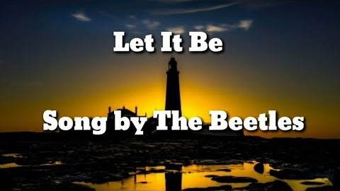
https://www.youtube.com/watch?v=rVTt32YFbcs
The Beatles-Let it be

Slide 9
7
The Role of Knowledge
Knowledge is one of the wondrous gifts of God. It is incumbent upon everyone to acquire it. Such arts and material means as are now manifest have been achieved by virtue of His knowledge and wisdom which have been revealed in Epistles and Tablets through His Most Exalted Pen—a Pen out of whose treasury pearls of wisdom and utterance and the arts and crafts of the world are brought to light.
-Bahà'u'llàh

Slide 10
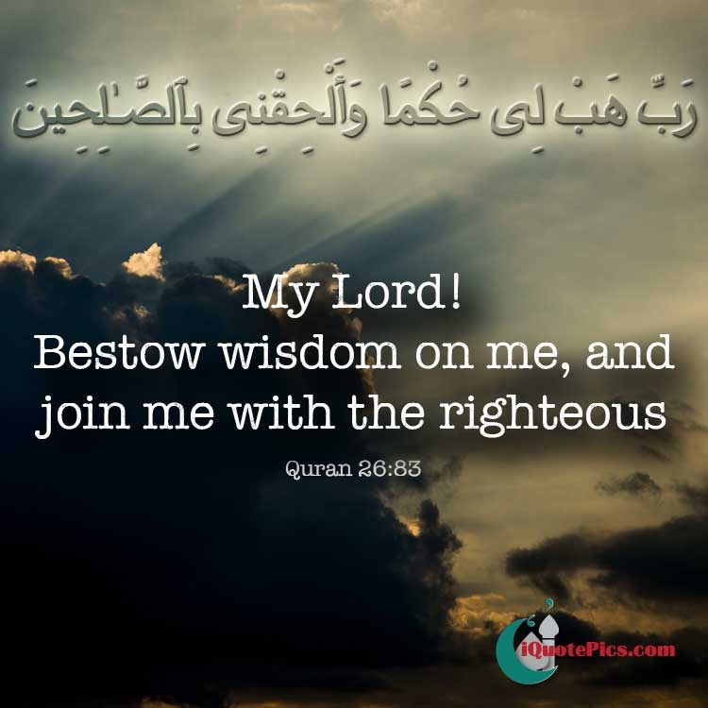
8

Slide 11
9
His wisdom does not sanction what we wish. We pray, O God! Make me wealthy! If this prayer were universally answered, human affairs would be at a standstill. There would be none left to work in the streets, none to till the soil, none to build, none to run the trains. Therefore, it is evident that it would not be well for us if all prayers were answered. The affairs of the world would be interfered with, energies crippled and progress hindered. But whatever we ask for which is in accord with divine wisdom, God will answer. Assuredly!
- 'Abdu'l-Bahà

Slide 12
10
Money and mansions are not the only wealth.
Hoard the wealth of the Spirit.
Character is wealth; good conduct is wealth;
And spiritual wisdom is wealth.
Atharva Veda

Slide 13
11
Take heed, O concourse of the rulers of the world! There is no force on earth that can equal in its conquering power the force of and wisdom. I, verily, affirm that there is not, and hath never been, a host more mighty than that of and wisdom. Blessed is the king who marcheth with the ensign of wisdom unfurled before him, and the battalions of massed in his rear.
-Bahà'u'llàh

Slide 14
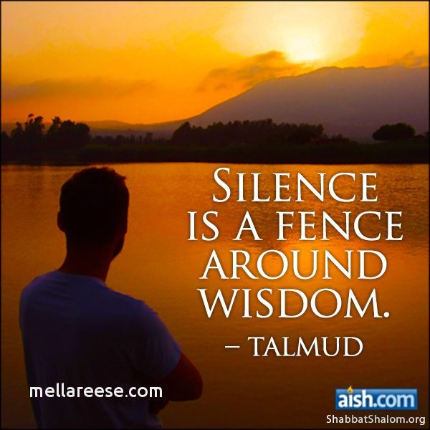
12

Slide 15
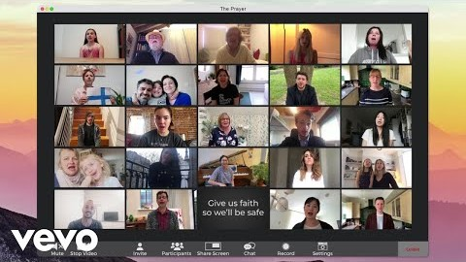
https://youtu.be/nexnnrYyTmc
Andrea Bocelli & Celine Dion-The Prayer

