Slide 1
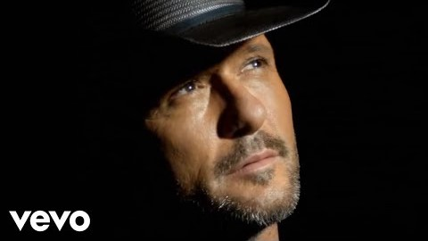
https://www.youtube.com/watch?v=awzNHuGqoMc
Tim McGraw - Humble And Kind (Official Video)

Slide 2
1
O my Lord! Make Thy beauty to be my food, and Thy presence my drink, and Thy pleasure my hope, and praise of Thee my action, and remembrance of Thee my companion, and the power of Thy sovereignty my succorer, and Thy habitation my home and my dwelling-place the seat Thou hast sanctified from the limitations imposed upon them who are shut out as by a veil from Thee.
Thou art, verily, the Almighty, the All-Glorious, the Most Powerful.
-- Bahá'u’lláh

Slide 3
2
Beseech ye the one true God to grant that ye may taste the savor of such deeds as are performed in His path, and partake of the sweetness of such humility and submissiveness as are shown for His sake. Forget your own selves, and turn your eyes toward your neighbor. Bend your energies to whatever may foster the education of men. Nothing is, or can ever be, hidden form God. If ye follow in His way, His incalculable and imperishable blessings will be showered upon you.
- Bahá'u’lláh

Slide 4
3
I Love the man who has no expectation,
Is pure and skilled, indifferent,
Who has no worries, and gives up
All (selfish) enterprise, wrapt up in (bhakta) Me.
- Bhagavad-Gita

Slide 5
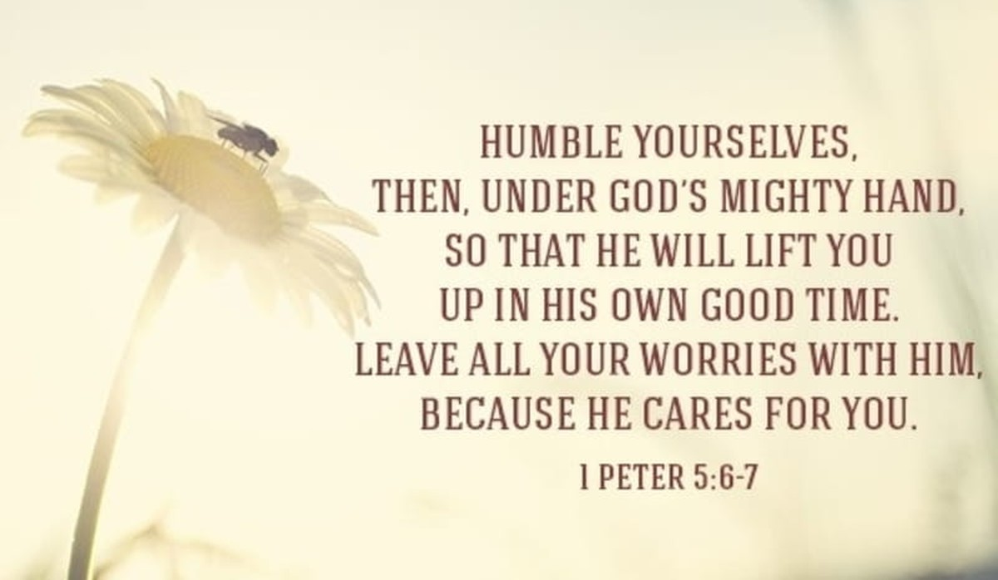
4

Slide 6
5
Evanescence or Humility. That is to say, man must become evanescent in God. Must forget his own selfish conditions that he may thus arise to the station of sacrifice. It should be to such a degree that if he sleep, it should not be for pleasure, but to rest the body in order to do better, to speak better, to explain more beautifully, to serve the servants of God and prove the truths. When he remains awake, he should seek to be attentive, serve the Cause of God and sacrifice his own stations for those of God. When he attains this station, the confirmations of the Holy Spirit will surely reach him, and man with this power can withstand all who inhabit the earth.
- 'Abdu'l-Bahá

Slide 7
6
The third leaf of the Most Exalted Paradise is this: O son of man! If thine eyes be turned towards mercy, forsake the things that profit thee and cleave unto that which will profit mankind. And if thine eyes be turned towards justice, choose thou for thy neighbour that which thou choosest for thyself. Humility exalteth man to the heaven of glory and power, while pride abaseth him to the depths of wretchedness and degradation.
- Bahá'u’lláh

Slide 8
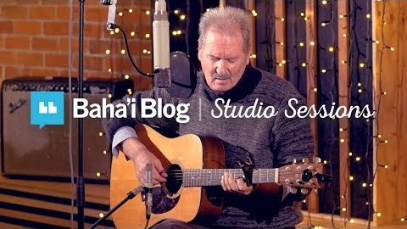
In this Baha’i Blog Studio Session, we’re in Auckland, New Zealand with Grant Hindin-Miller who sings “Humble Thyself” from the Writings of Baha’u’llah.
You can also watch the recording of this song on Baha’i Blog’s YouTube channel here:
https://www.youtube.com/watch?v=kkYNUIHXV_Y
This song was filmed and recorded in Auckland, New Zealand, September 2017.
Here is the quotation used for the lyrics below followed by the quotation and chords:
“O Son of Man! Humble thyself before Me, that I may graciously visit thee. Arise for the triumph of My cause, that while yet on earth thou mayest obtain the victory.
O Son of the Throne! Thy hearing is My hearing, hear thou therewith. Thy sight is My sight, do thou see therewith, that in thine inmost soul thou mayest testify unto My exalted sanctity, and I within Myself may bear witness unto an exalted station for thee” -Baha’u’llah

Slide 9
7
Beware that ye swell not with pride before God, and disdainfully reject His loved ones. Defer ye humbly to the faithful, they that have believed in God and in His signs, whose hearts witness to His unity, whose tongues proclaim His oneness and who speak not except by His leave. Thus do We exhort you with justice, and warn you with truth, that perchance ye may be awakened.
- Bahá'u'lláh

Slide 10
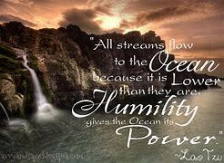
8

Slide 11
9
O SON OF MAN!
Wert thou to speed through the immensity of space and traverse the expanse of heaven, yet thou wouldst find no rest save in submission to Our command and humbleness before Our Face.
- Bahá'u’lláh

Slide 12
10
O ye that have minds to know! Raise up your suppliant hands to the heaven of the one God and humble yourselves and be lowly before Him, and thank Him for this supreme endowment, and implore Him to succor us until, in this present age godlike impulses may radiate from the conscience of mankind, and this divinely kindled fire which has been entrusted to the human heart may never die away.
- 'Abdu'l-Bahá

Slide 13

11

Slide 14
12
O my friend, look upon thyself: hadst thou not become a father nor begotten a son, neither wouldst thou have heard these sayings. Now forget them all, that thou mayest learn from the Master of Love in the schoolhouse of oneness, and return to God and forsake the inner land of unreality for thy true station, and dwell within the shadow of the tree of knowledge.
O thou dear one! Impoverish thyself, that thou mayest enter the high court of riches; and humble thy body, that thou mayest drink from the river of glory, and attain to the full meaning of the poems whereof thou hadst asked.
- Bahá'u'lláh

Slide 15
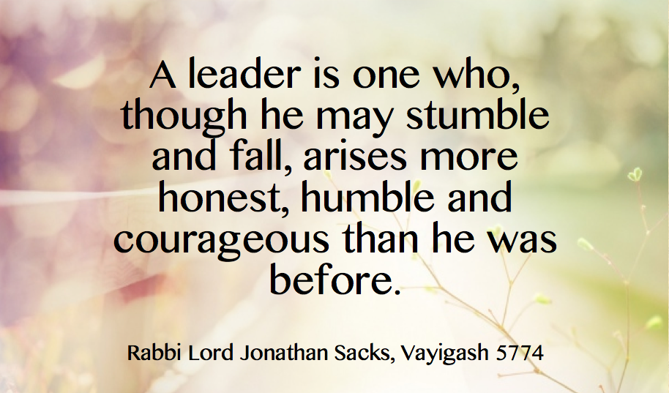
13

Slide 16
14
O SON OF MAN!
Humble thyself before Me, that I may graciously visit thee. Arise for the triumph of My cause, that while yet on earth thou mayest obtain the victory.
- Bahá’u’lláh

Slide 17
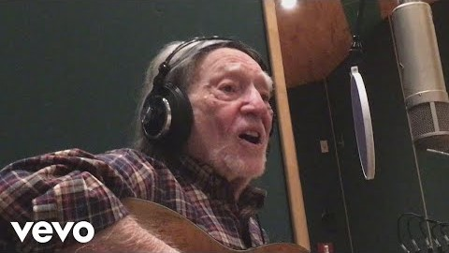
https://www.youtube.com/watch?v=qdZ5wY9XxdA
Willie Nelson-It’s hard to be humble

