Slide 1
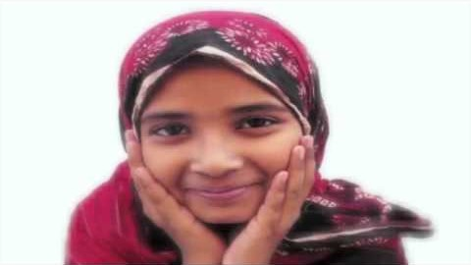
https://www.youtube.com/watch?v=ket4_3ClYBw&t=39s
Fountain of generosity

Slide 2
1
Lord! Pitiful are we. Grant us Thy favor; poor, bestow upon us a share from the ocean of Thy wealth; needy, do Thou satisfy us; abased, give us Thy glory. The fowls of the air and the beasts of the field receive their meat each day from Thee, and all beings partake of Thy care and loving kindness.
Deprive not his feeble one of Thy wondrous grace and vouchsafe by Thy might unto this helpless soul Thy bounty.
Give us our daily bread, and grant Thine increase in the necessities of life, that we may be dependent on none other but Thee, may commune wholly with Thee, may walk in Thy ways and declare Thy mysteries. Thou art the Almighty and the Loving and the Provider of all mankind.
- Abdu'l-Bahà

Slide 3
2
One of Bahà'u'llà's teachings is the adjustment of means of livelihood in human society. Under this adjustment there can be no extremes in human conditions as regards wealth and sustenance. For the community needs financier, farmer, merchant and laborer just as an army must be composed of commander, officers and privates. Each in his station in the social fabric must be competent; each in his function according to ability; but justness of opportunity for all...When the laws he has instituted are carried out there will be no millionaires possible in the community and likewise no extremely poor.
- 'Abdu'l-Bahà

Slide 4
3
Overcoming poverty is not a gesture of charity. It is an act of justice.
– Nelson Mandela

Slide 5
4
The rich should extend assistance to the poor, they should expend their substance for the poor, but of their own free will, and not because of the poor gained this end by force. For the harvest of force is turmoil and the ruin of the social order. On the other hand, voluntary sharing, the freely-chosen expending of one's substance, leadeth to society's comfort and peace. It lighteth up the world; it bestoweth honor upon humankind.
- 'Abdu'l-Bahà

Slide 6
5
They who are possessed of riches, however, must have the utmost regard for the poor, for great is the honor destined by God for those poor who are steadfast in patience. By My life! There is no honor, except what God may please to bestow, that can compare to this honor. Great is the blessedness awaiting the poor that endure patiently and conceal their sufferings, and well is it with the rich who bestow their riches on the needy and prefer them before themselves.
- Bahà'u'llàh

Slide 7
6
O SON OF SPIRIT!
Vaunt not thyself over the poor, for I lead him on his way and behold thee in thy evil plight and confound thee for evermore.
- Bahà'u'llàh

Slide 8
7
There must be special laws made, dealing with these extremes of riches and of want. The members of the Government should consider the laws of God when they are framing plans for the ruling of the people. The general rights of mankind must be guarded and preserved.
The government of the countries should conform to the Divine Law which gives equal justice to all. This is the only way in which the deplorable superfluity of great wealth and miserable, demoralizing, degrading poverty can be abolished. Not until this is done will the Law of God be obeyed.
- 'Abdu'l-Bahà

Slide 9

https://www.youtube.com/watch?v=wIOWM0SdE2c
Be generous in prosperity

Slide 10
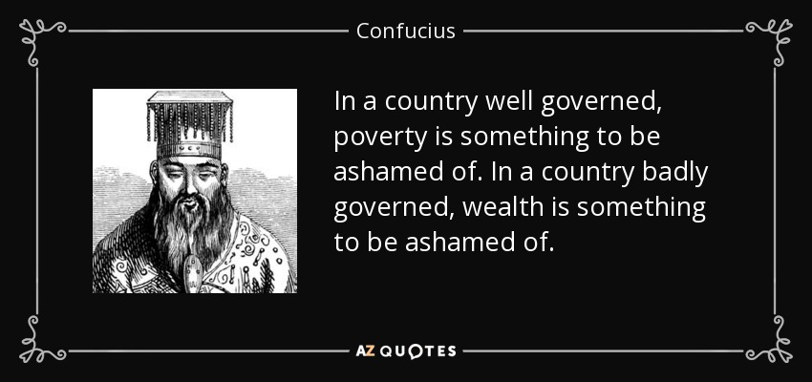
8

Slide 11
9
Although the body politic is one family, yet, because of lack of harmonious relations some members are comfortable and some in direst misery; some members are satisfied and some are hungry; some members are clothed in most costly garments and some families are in need of food and shelter. Why? Because this family lacks the necessary reciprocity and symmetry. This household is not well arranged. This household is not living under perfect law. All the laws which are legislated do not ensure happiness. They do not provide comfort. Therefore, a law must be given to this family by means of which all the members of this family will enjoy equal well-being and happiness.
- 'Abdu'l-Bahà

Slide 12
10
The inordinate disparity between rich and poor, a source of acute suffering, keeps the world in a state of instability, virtually on the brink of war. Few societies have dealt effectively with this situation. The solution calls for the combined application of spiritual, moral and practical approaches. A fresh look at the problem is required, entailing consultation with experts from a wide spectrum of disciplines, devoid of economic and ideological polemics, and involving the people directly affected in the decisions that must urgently be made. It is an issue that is bound up not only with the necessity for eliminating extremes of wealth and poverty but also with those spiritual verities the understanding of which can produce a new universal attitude. Fostering such an attitude is itself a major part of the solution.
The Universal of House of Justice/Oct 1985 to the people of the World

Slide 13
11
And the first effulgence which hath dawned from the horizon of the Mother Book is that man should know his own self and recognize that which leadeth unto loftiness or lowliness, glory or abasement, wealth or poverty. Having attained the stage of fulfillment and reached his maturity, man standeth in need of wealth, and such wealth as he acquireth through crafts or professions is commendable and praiseworthy in the estimation of men of wisdom, and especially in the eyes of servants who dedicate themselves to the education of the world and to the edification of its peoples.
Bahà'u'llàh, Tarazat (Ornaments)

Slide 14
12
It should not be imagined that the writer’s earlier remarks constitute a denunciation of wealth or a commendation of poverty. Wealth is praiseworthy in the highest degree, if it is acquired by an individual’s own efforts and the grace of God, in commerce, agriculture, art and industry, and if it be expended for philanthropic purposes. Above all, if a judicious and resourceful individual should initiate measures which would universally enrich the masses of the people, there could be no undertaking greater than this, and it would rank in the sight of God as the supreme achievement, for such a benefactor would supply the needs and insure the comfort and well-being of a great multitude.
- 'Abdu'l-Bahà, Secret of Divine Civilization

Slide 15
13
Wealth is most commendable, provided the entire population is wealthy. If, however, a few have inordinate riches while the rest are impoverished, and no fruit or benefit accrues from that wealth, then it is only a liability to its possessor. If, on the other hand, it is expended for the promotion of knowledge, the founding of elementary and other schools, the encouragement of art and industry, the training of orphans and the poor—in brief, if it is dedicated to the welfare of society—its possessor will stand out before God and man as the most excellent of all who live on earth and will be accounted as one of the people of paradise.
- 'Abdu'l-Bahà, Secret of Divine Civilization

Slide 16
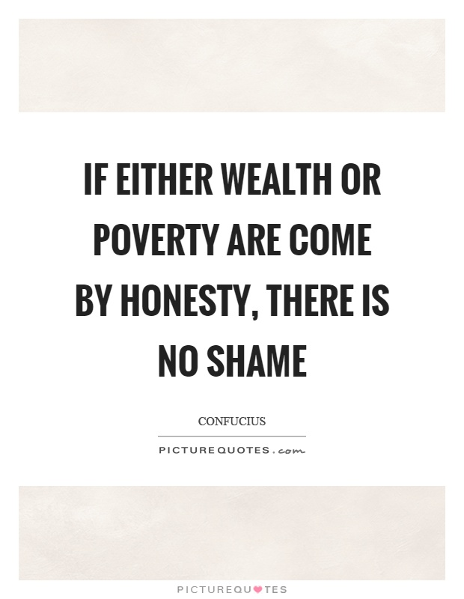
14

Slide 17
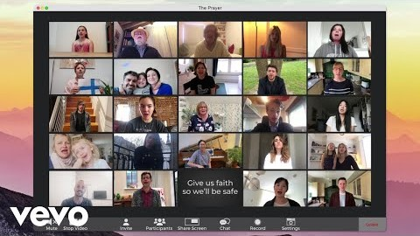
https://www.youtube.com/watch?v=nexnnrYyTmc&list=PL0rWveI9b4vQfC6V72ydiEwTS6iHBHXOJ
Andrea Bocelli & Celine Dion-The Prayer

