Slide 1

1
Glory be to Thee, O God, for Thy manifestation of love to mankind! O Thou Who art our Life and Light, guide Thy servants in Thy way, and make us rich in Thee and free from all save Thee.
O God, teach us Thy Oneness and give us a realization of Thy Unity, that we may see no one save Thee. Thou art the Merciful and the Giver of bounty!
O God, create in the hearts of Thy beloved the fire of Thy love, that it may consume the thought of everything save Thee.
Reveal to us, O God, Thine exalted eternity – that Thou hast ever been and wilt ever be, and that there is no God save Thee. Verily, in Thee will we find comfort and strength.
- Bahà'u'llàh

Slide 2
2
And among the teachings of Bahà'u'llàh is the equality of women and men. The world of humanity has two wings – one is women and the other men. Not until both wings are equally developed can the bird fly. Should one wing remain weak, flight is impossible. Not until the world of women becomes equal to the world of men in the acquisition of virtues and perfections, can success and prosperity be attained as they ought to be.
- 'Abdu'l-Bahà

Slide 3
3
The first duty of the beloved of God and the maid-servants of the Merciful is this: They must strive by all possible means to educate both sexes, male and female; girls like boys; there is no difference whatsoever between them.
- 'Abdu'l-Bahà

Slide 4
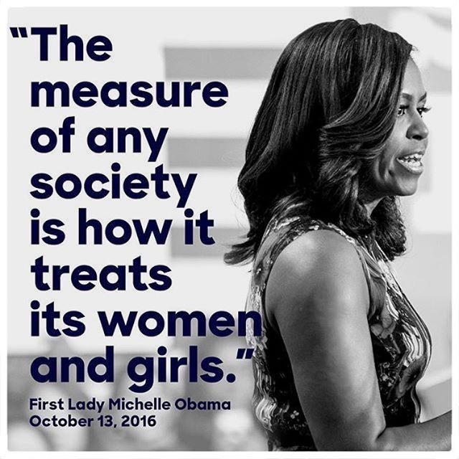

Slide 5
4
It has been objected by some that woman is not equally capable with man and that she is deficient by creation. This is pure imagination. The difference in capability between man and woman is due entirely to opportunity and education. Heretofore woman has been denied the right and privilege of equal development. If equal opportunity be granted her there is no doubt she would be the peer of man. History will evidence this...
- 'Abdu'l-Bahà

Slide 6
5
If the mother is educated then her children will be well taught. When the mother is wise, then will the children be led into the path of wisdom. If the mother be religious she will show her children how they should love God. If the mother is moral she guides her little ones into the ways of uprightness... Therefore, surely, God is not pleased that so important an instrument as woman should suffer from want of training in order to attain the perfections desirable and necessary for her great life's work! Divine Justice demands that the rights of both sexes should be equally respected since neither is superior to the other in the eyes of Heaven.
- 'Abdu'l-Bahà

Slide 7
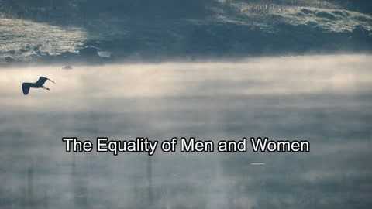
https://www.youtube.com/watch?v=p1iuJus4vY8

Slide 8


Slide 9
The equality of men and women is not a Western construct but a universal spiritual truth—a statement about human nature—that was promulgated by Bahá’u’lláh nearly one hundred and fifty years ago in His native Iran. That women should enjoy equal rights with men is a requirement of justice. It is a principle consonant with the highest standard of purity and sanctity, whose application strengthens family life and is essential to the regeneration and progress of any nation. Indeed, peace in the world and the advancement of civilization depend on its realization.
Universal House of Justice/20 June 2008

Slide 10
Equality between men and women is conducive to the abolition of warfare for the reason that women will never be willing to sanction it. Mothers will not give their sons as sacrifices upon the battlefield after twenty years of anxiety and loving devotion in rearing them from infancy, no matter what cause they are called upon to defend. There is no doubt that when women obtain equality of rights, war will entirely cease among mankind.
- 'Abdu'l-Bahà- The Promulgation of Universal Peace

Slide 11
Equality between men and women does not, indeed physiologically it cannot, mean identity of function. In some things women excel men, in others men are better than women, while in very many things the difference in sex is of no effect at all. The differences are most apparent in family life. The capacity for motherhood has many far-reaching effects. For example, because of this, daughters receive preference in education over sons.
The Universal House of Justice / 28 April 1974

Slide 12
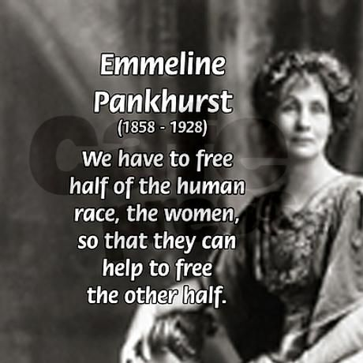

Slide 13
Know thou, O handmaid, that in the sight of Bahá, women are accounted the same as men, and God hath created all humankind in His own image, and after His own likeness. That is, men and women alike are the revealers of His names and attributes, and from the spiritual viewpoint there is no difference between them. Whosoever draweth nearer to God, that one is the most favored, whether man or woman. How many a handmaid, ardent and devoted, hath, within the sheltering shade of Bahá, proved superior to the men, and surpassed the famous of the earth.
Selections from the Writings of 'Abdu'l-Bahà

Slide 14
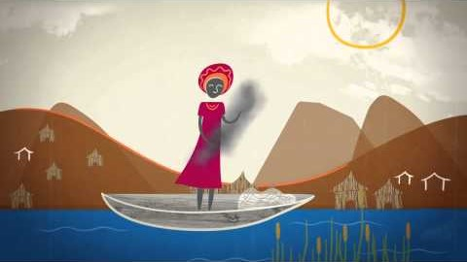
https://www.youtube.com/watch?v=4viXOGvvu0Y

