Slide 1

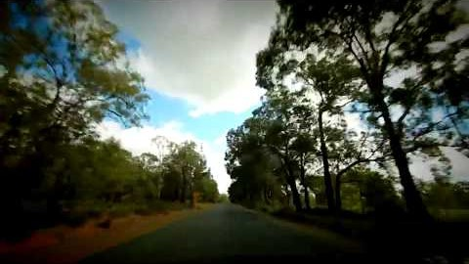
https://www.youtube.com/watch?v=Cg7Kt3zTLuE
Blessed is the spot-Chant by Baha’i choir

Slide 2
1
Lord! Pitiful are we, grant us thy favor; poor, bestow upon us a share from the ocean of Thy wealth; needy, do Thou satisfy us; abased, give us thy glory. The fowls of the air and the beasts of the field receive their meat each day from Thee, and all beings partake of Thy care and loving-kindness. Deprive not this feeble one of Thy wondrous grace and vouchsafe by Thy might unto this helpless soul Thy bounty.
Give us our daily bread, and grant Thine increase in the necessities of life, that we may be dependent on none other but Thee, may commune wholly with Thee, may walk in Thy ways and declare Thy mysteries. Thou art the Almighty and the Loving and the Provider of all mankind.
- ’Abdu’l-Bahá

Slide 3
2
And it is he who created the night and day, and the sun and the moon.
- Qur'an, 21:33

Slide 4
3
Behold, there is an intermediary necessary between the sun and the earth; the sun does not descend to the earth, neither does the earth ascend to the sun. This contact is made by the rays of the sun which bring light and warmth and heat.
The Holy Spirit is the Light from the Sun of Truth bringing, by its infinite power, life and illumination to all mankind, flooding all souls with Divine Radiance, conveying the blessings of God’s Mercy to the whole world. The earth, without the medium of the warmth and light of the rays of the sun, could receive no benefits from the sun.
- ‘Abdu’l-Bahá, Paris Talks

Slide 5
4
Therefore it is manifest and evident that man, although in body a part of nature, nevertheless in spirit possesses a power transcending nature; for if he were simply a part of nature and limited to material laws he could possess only the things which nature embodies. God has conferred upon and added to man a distinctive power, the faculty of intellectual investigation into the secrets of creation, the acquisition of higher knowledge, the greatest virtue of which is scientific enlightenment.
- ‘Abdu’l-Bahá, Foundations of World Unity, p. 49

Slide 6
5
The Three Great Mysteries; air to a bird, water to a fish, mankind to himself.
- Hindu Proverb

Slide 7
6
When one tugs at a single thing in nature, he finds it attached to the rest of the world.
- John Muir

Slide 8
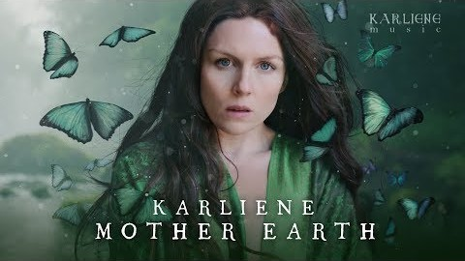
https://www.youtube.com/watch?v=caIo1UGSDgw
Karliene-Mother earth

Slide 9
7
The excellency, the adornment and the perfection of the earth is to be verdant and fertile through the bounty of the clouds of springtime. Plants grow; flowers and fragrant herbs spring up; fruit bearing trees become full of blossoms and bring forth fresh and new fruit. Gardens become beautiful and meadows adorned; mountains and plains are clad in a green robe, and gardens, fields, villages and cities are decorated. This is the prosperity of the mineral world.
- ‘Abdu’l-Bahá, Some Answered Questions, p. 78

Slide 10
8
Train your children from their earliest days, to be infinitely tender and loving to animals. If an animal be sick, let the children try to heal it, if it be hungry, let them feed it, if thirsty, let them quench its thirst, if weary, let them see that it rests.
- ‘Abdu’l-Bahá, Selections from the Writings of ‘Abdu’l-Bahá, p. 159

Slide 11
9
Say: Nature in its essence is the embodiment of My Name, the Maker, the Creator. Its manifestations are diversified by varying causes, and in this diversity there are signs for men of discernment. Nature is God’s Will and is its expression in and through the contingent world.
- Bahá’u’lláh, Tablets of Bahá’u’lláh, p. 142

Slide 12
10
Consider how all other phenomenal existence and beings are captives of nature. The sun, that colossal center of our solar system, the giant stars and planets, the towering mountains, the earth itself and its kingdoms of life lower than the human—all are captives of nature except man. No other created thing can deviate in the slightest degree from obedience to natural law.
- ’Abdu’l-Bahá, The Promulgation of Universal Peace

Slide 13
11
The sun in its glory and greatness millions of miles away is held prisoner in its orbit of universal revolution, captive of universal natural control. Man is the ruler of nature. According to natural law and limitation he should remain upon the earth, but behold how he violates this command and soars above the mountains in airplanes. He sails in ships upon the surface of the ocean and dives into its depths in submarines. Man makes nature his servant;
- ’Abdu’l-Bahá, The Promulgation of Universal Peace

Slide 14
12
O God! Educate these children. These children are the plants of Thine orchard, the flowers of Thy meadow, the roses of Thy garden. Let Thy rain fall upon them; let the Sun of Reality shine upon them with Thy love. Let Thy breeze refresh them in order that they may be trained, grow and develop, and appear in the utmost beauty. Thou art the Giver. Thou art the Compassionate.
—‘Abdu’l-Bahá

Slide 15
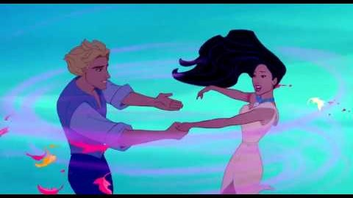
https://www.youtube.com/watch?v=HvvZ1TEQRB8
Pocahontas - Colors of the Wind (Disney Song)

