Slide 1


Science and Religion in Harmony - Bahai Faith
https://www.youtube.com/watch?v=8if1FWvMhrY

Slide 2
1
O Thou loving Provider! These souls have hearkened to the summons of the Kingdom, and have gazed upon the glory of the Sun of Truth. They have risen upward to the refreshing skies of love; they are enamored of Thy nature, and they worship Thy beauty. Unto Thee have they turned themselves, speaking together of Thee, seeking out Thy dwelling, and thirsting for the waterbrooks of Thy heavenly realm.
Thou art the Giver, the Bestower, the Ever-Loving.
- 'Abdu'l-Bahà

Slide 3
2
There is no contradiction between true religion and science. When a religion is opposed to science it becomes mere superstition: that which is contrary to knowledge is ignorance.
- 'Abdu'l-Bahà

Slide 4
3
Much of the discord and disunion of the world is created by these man-made oppositions and contradictions. If religion were in harmony with science and they walked together, much of the hatred and bitterness now bringing misery to the human race would be at an end.
- 'Abdu'l-Bahà

Slide 5
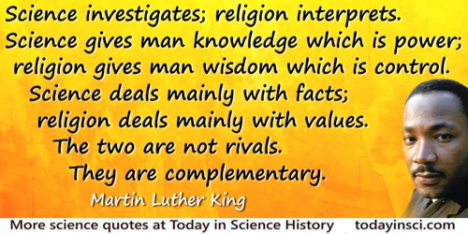
4

Slide 6
5
Consider what it is that singles man out from among created beings, and makes of him a creature apart. Is it not his reasoning power, his intelligence? Shall he not make use of these in his study of religion? I say unto you: weigh carefully in the balance of reason and science everything that is presented to you as religion. If it passes this test, then accept it, for it is truth! If, however, it does not so conform, then reject it, for it is ignorance!
- 'Abdu'l-Bahà

Slide 7
6
Put all your beliefs into harmony with science: there can be no opposition, for truth is one. When religion, shorn of its superstitions, traditions, and unintelligent dogmas, shows its conformity with science, then will there be a great unifying, cleansing force in the world which will sweep before it all wars, disagreements, discords and struggles-and then will mankind be united in the power of the Love of God.
- 'Abdu'l-Bahà

Slide 8
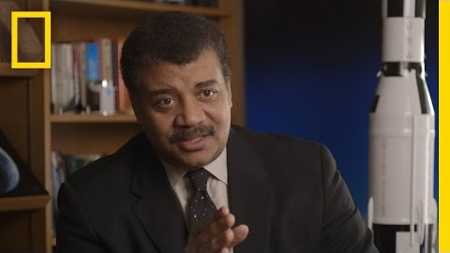
The Intersection of Science and Religion | StarTalk
https://www.youtube.com/watch?v=qAQL9gRmq34

Slide 9
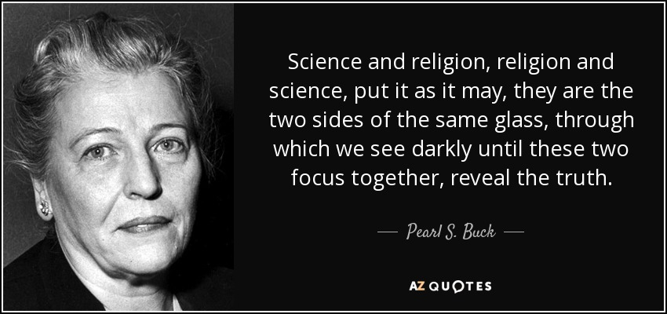
7

Slide 10
8
How vast the number of people who are well versed in every science, yet it is their adherence to the holy Word of God which will determine their faith, inasmuch as the fruit of every science is none other than the knowledge of divine precepts and submission unto His good-pleasure.
- The Bàb

Slide 11
9
The principle of the harmony of science and religion means not only that religious teachings should be studied with the light of reason and evidence as well as of faith and inspiration, but also that everything in this creation, all aspects of human life and knowledge, should be studied in the light of revelation as well as in that of purely rational investigation.
Universal House of Justice, Jan 3, 1979

Slide 12
10
If statements and teachings of religion are found to be unreasonable and contrary to science, they are outcomes of superstition and imagination.
That which is found to be real and conformable to reason must be accepted, and whatever science and reason cannot support must be rejected as imitation and not reality. Then differences of belief will disappear. All will become as one family, one people, and the same susceptibility to the divine bounty and education will be witnessed among mankind.
- 'Abdu'l-Bahà- The Promulgation of Universal Peace

Slide 13
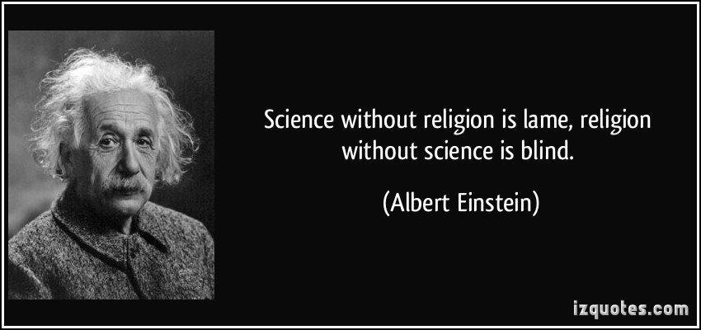
11

Slide 14
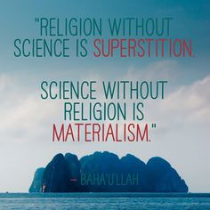
12

Slide 15

Music: Abdu'l-Baha
https://www.youtube.com/watch?v=aBZ574mQ3TU

