Slide 1

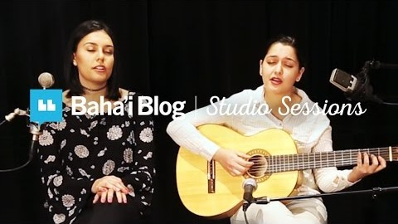
https://youtu.be/qnOBZ32OHss

Slide 2
1
O my God! O my God! Unite the hearts of thy servants, and reveal to them Thy great purpose. May they follow Thy commandments and abide in Thy law. Help them, O God, in their endeavor, and grant them strength to serve Thee. O God! Leave them not to themselves, but guide their steps by the light of Thy knowledge, and cheer their hearts by Thy love. Verily, Thou art their Helper and their Lord.
- Bahà'u'llàh

Slide 3
2
“I learned that courage was not the absence of fear, but the triumph over it. The brave man is not he who does not feel afraid, but he who conquers that fear.”
― Nelson Mandela

Slide 4
3
Take Courage! God never forsakes His children who strive and work and pray!
- 'Abdu'l-Bahà

Slide 5
4
Life is an adventure...Dare it
Life is a beauty...Praise it
Life is a challenge...Meet it
- Bhagavad Gita

Slide 6
5
...their agitation was turned into peace, their doubt into certitude, their timidity into courage. Such is the potency of the Divine Elixir, which swift as the twinkling of an eye, transmuteth the souls of men!
- Bahà'u'llàh

Slide 7
6
The source of courage and power is the promotion of the Word of God, and steadfastness in His love.
- Bahà'u'llàh

Slide 8
7
Be strong and of good courage, do not fear or be afraid of them.
For the Lord your God, He is the One who goes with you.
- Deuteronomy 31:16

Slide 9
8
In the Cause of Bahá’u’lláh there have been women who were superior to men in illumination, intellect, divine virtues and devotion to God. Among them was Qurratu’l-‘Ayn. When she spoke, she was listened to reverently by the most learned men. They were most respectful in her presence, and none dared to contradict her. Among the Bahá’í women in Persia today there are Rúḥu’lláh and others who are gifted with knowledge, invincible steadfastness, courage, virtue and power of will. They are superior to men and well-known throughout Persia.
'Abdu'l-Bahà- The Promulgation of Universal Peace

Slide 10
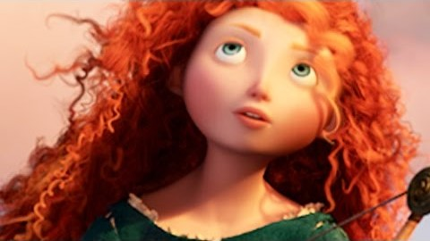
https://www.youtube.com/watch?v=NvR9YOpDG4A
Brave | Touch the Sky | Disney Sing-Along

Slide 11
9
Verily, after every difficulty, there is relief.
- Qur'an

Slide 12
10
“Don’t be satisfied with stories, how things have gone with others. Unfold your own myth.”
― Rumi, The Essential Rumi

Slide 13
11
Other attributes of perfection are to fear God, to love God by loving His servants, to exercise mildness and forbearance and calm, to be sincere, amenable, clement and compassionate; to have resolution and courage, trustworthiness and energy, to strive and struggle, to be generous, loyal, without malice, to have zeal and a sense of honor, to be high-minded and magnanimous, and to have regard for the rights of others.
'Abdu'l-Bahà- The Secret of Divine Civilization

Slide 14
12
strive as much as ye can to turn wholly toward the Kingdom, that ye may acquire innate courage and ideal power.
Selections from the Writings of ‘Abdu’l‑Bahá

Slide 15
13
“The only tyrant I accept in this world is the ‘still small voice’ within me. And even though I have to face the prospect of being a minority of one, I humbly believe I have the courage to be in such a hopeless minority.”
― Mahatma Gandhi

Slide 16
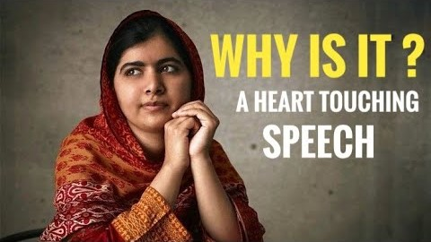
Best Speech Ever | Malala Yousafzai Speech | Why Is It - Powerful Speech
https://www.youtube.com/watch?v=12bN7P7-GvA

