Slide 1
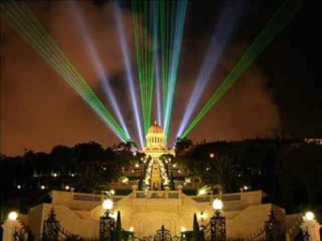
We are one
By Dan Seals
https://www.youtube.com/watch?v=NRwyAwfuZiU

Slide 2
1
I implore Thee, O my Lord, by Thy name the splendors of which have encompassed the earth and the heavens, to enable me so to surrender my will to what Thou hast decreed in Thy Tablets, that I may cease to discover within me any desire except what Thou dist desire through the power of Thy sovereignty, and any will save what Thou dist destine for me by Thy will.
Bahà'u'llàh, Prayers and Meditations, p. 241

Slide 3
2
The source of all good is trust in God, submission unto His command, and contentment with His holy will and pleasure.
Bahà'u'llàh, Tablets of Bahà'u'llàh, p. 155

Slide 4
3
O friends! Prefer not your will to Mine, never desire that which I have not desired for you, and approach me not with lifeless hearts, defiled with worldly desires and cravings.
Bahà'u'llàh, The Hidden Words, p. 28

Slide 5
4
O Son of Earth! Wouldst thou have Me, seek none other than Me; and wouldst thou gaze upon My beauty, close thine eyes to the world and all that is therein; for My will and the will of another than Me, even as fire and water, cannot dwell together in one heart.
Bahà'u'llàh, The Hidden Words, p. 33

Slide 6
5
If thou wouldst hearken to my words, release thyself from the fetters of whatsoever cometh to pass. Nay, rather, under all conditions thank thou thy loving Lord, and yield up thine affairs unto His Will that worketh as He pleaseth. This verily is better for thee than all else, in either world.
'Abdu'l-Bahà, Selections from the Writings of 'Abdu'l-Bahà, p. 178

Slide 7
6
Affliction beat upon this captive like the heavy rains of spring, and the victories of the malevolent swept down in a relentless flood, and still 'Abdu'l-Bahà remained happy and relied on the grace of the All-Merciful. That pain, that anguish, was a paradise of delights, those chains were the necklace of a king on a throne in heaven. Content with God's will, utterly resigned, my heart surrendered to whatever fate had in store, I was happy. For a boon companion, I had great joy.
'Abdu'l-Bahà, Selections from the Writings of 'Abdu'l-Bahà, p. 226

Slide 8
7
O thou who art turning thy face towards God! Close thine eyes to all things else, and open them to the realm of the All-Glorious. Ask whatsoever thou wishest of Him alone; seek whatsoever thou seekest from Him alone. With a look He granteth a hundred thousand hopes, with a glance He healeth a hundred thousand incurable ills, with a glimpse He layeth balm on every wound, with a nod He freeth the hearts from the shackles of grief. He doeth as He doeth, and what recourse have we? He carrieth out His Will, He ordaineth what He pleaseth. Then better for thee to bow down thy head in submission, and put thy trust in the All-Merciful Lord.
– 'Abdu'l-Bahá

Slide 9
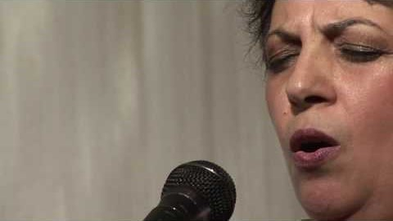
When sorrow comes
By Shadi Toloui-Wallace and Shidan Toloui- Wallace
https://www.youtube.com/watch?v=UdkvhFgCoMk

Slide 10
8
The dissociation of the Bábí Faith from every form of political activity and from all secret associations and factions; the emphasis placed on the principle of non-violence; the necessity of strict obedience to established authority; the ban imposed on all forms of sedition, on back-biting, retaliation, and dispute; the stress laid on godliness, kindliness, humility and piety, on honesty and truthfulness, chastity and fidelity, on justice, toleration, sociability, amity and concord, on the acquisition of arts and sciences, on self-sacrifice and detachment, on patience, steadfastness and resignation to the will of God—all these constitute the salient features of a code of ethical conduct to which the books, treatises and epistles, revealed during those years, by the indefatigable pen of Bahá’u’lláh, unmistakably bear witness.
Shoghi Effendi, God Passes By

Slide 11
9
Incline your ears to the counsels which this Servant giveth you for the sake of God. He, verily, asketh no recompense from you and is resigned to what God hath ordained for Him, and is entirely submissive to God’s Will. The days of your life are far spent, O people, and your end is fast approaching. Put away, therefore, the things ye have devised and to which ye cleave, and take firm hold on the precepts of God, that haply ye may attain that which He hath purposed for you, and be of them that pursue a right course. Delight not yourselves in the things of the world and its vain ornaments, neither set your hopes on them. Let your reliance be on the remembrance of God, the Most Exalted, the Most Great.
Bahá’u’lláh, The Summons of the Lord of Hosts

Slide 12
10
O Thou beloved of my heart and soul! I have no refuge save Thee. I raise no voice at dawn save in Thy commemoration and praise. Thy love encompasseth me and Thy grace is perfect. My hope is in Thee. O God, give me a new life at every instant and bestow upon me the breaths of the Holy Spirit at every moment, in order that I may remain steadfast in Thy love, attain unto great felicity, perceive the manifest light and be in the state of utmost tranquillity and submissiveness. Verily, Thou art the Giver, the Forgiver, the Compassionate.
—‘Abdu’l-Bahá

Slide 13
11
The purpose of the one true God in manifesting Himself is to summon all mankind to truthfulness and sincerity, to piety and trustworthiness, to resignation and submissiveness to the Will of God, to forbearance and kindliness, to uprightness and wisdom. His object is to array every man with the mantle of a saintly character, and to adorn him with the ornament of holy and goodly deeds.
Say: Have mercy on yourselves and on your fellowmen, and suffer not the Cause of God—a Cause which is immeasurably exalted above the inmost essence of sanctity—to be sullied with the stain of your idle fancies, your unseemly and corrupt imaginations.
Gleanings from the Writings of Bahá’u’lláh

Slide 14

Prayer in Hindi
https://www.youtube.com/watch?v=DIkAVk32P4o&list=PLeKEuVXQmYcSZMsIW4dwyaw5rJaQg7lhW&index=4

