Slide 1
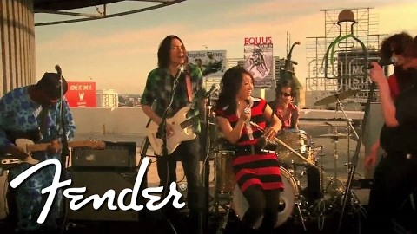
https://www.youtube.com/watch?v=GZSJDQTK1cM
Citizen of the World by Pangea/Fender

Slide 2
1
My God, Whom I worship and adore! I bear witness unto Thy unity and Thy oneness, and acknowledge Thy gifts, both in the past and in the present. Thou art the All-Bountiful, the overflowing showers of Whose mercy have rained down upon high and low alike, and the splendors of Whose grace have been shed over both the obedient and the rebellious.
O God of mercy, before Whose door the quintessence of mercy hath bowed down, and round the sanctuary of Whose Cause loving-kindness, in its inmost spirit, hath circled, we beseech Thee entreating Thine ancient grace, and seeking Thy present favor, that Thou mayest have mercy upon all who are the manifestations of the world of being, and deny not the outpourings of Thy grace in Thy days.
All are but poor and needy, and Thou, verily, art the All-Possessing, the All-Subduing, the All-Powerful.
- Bahà'u'llàh

Slide 3
2
In the day of the revelation of Him Whom God shall make manifest all that dwell on earth will be equal in His estimation.
- Bahà'u'llàh

Slide 4
3
This is what God announceth to his servants who believe and do the things that are right. SAY: for this ask I no wage of you, save the love of my kin. And whoever shall have won the merit of a good deed, we will increase good to him therewith; for God is forgiving, grateful.
- Qur'àn

Slide 5
4
The second teaching of Bahà'u'llàh is the oneness of the world of humanity. Every human creature is the servant of God. All have been created and reared by the power and favor of God; all have been blessed with the bounties of the same Sun of divine truth; all have quaffed from the fountain of the infinite mercy of God; and all in His estimation and love are equal as servants. He is beneficent and kind to all. Therefore, no one should glorify himself over another; no one should manifest pride or superiority toward another; no one should look upon another with scorn and contempt; and no one should deprive or oppress a fellow creature. All must be considered as submerged in the ocean of God's mercy. We must associate with all humanity in gentleness and kindliness. We must love al with love of the heart.
- 'Abdu'l-Bahà

Slide 6
5
Today I am most happy, for I see here a gathering of the servants of God, I see the white and colored people together. In the estimation of God there is no distinction of color; all are one in the color and beauty of servitude to Him. Color is not important; the heart is all-important.
-'Abdu'l-Bahà

Slide 7
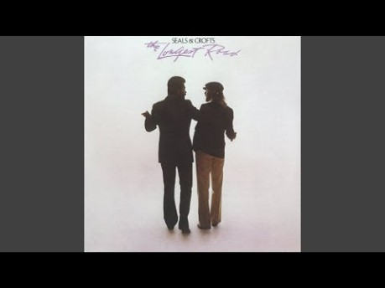
https://www.youtube.com/watch?v=wnit1lx7c34&feature=youtu.be
One Planet, One People, Please
By Seals & Crofts

Slide 8
6
When once a man can see that (all) the diversity
Of contingent beings abides in One (alone),
And from That alone they radiate,
Then to Brahman he attains.
- Bhagavad-Gita

Slide 9
7
We work and pray for the unity of mankind, that all the races of the earth may become one race, all the countries one country, and that all hearts may beat as one heart, working together for perfect unity and brotherhood
Praise be to God that our efforts are sincere and that our hearts are turned to the Kingdom. Our greatest longing is that the truth may be established in the world, and in this hope we draw near to one another in love and affection. Each and all are whole-hearted and selfless, willing to sacrifice all personal ambition to the grand ideal towards which they strive: Brotherly love and peace and union amongst men!
-'Abdu'l-Bahà

Slide 10
8
“Bahá’u’lláh has proclaimed the oneness of the world of humanity. He has caused various nations and divergent creeds to unite. He has declared that difference of race and color is like the variegated beauty of flowers in a garden. If you enter a garden, you will see yellow, white, blue, red flowers in profusion and beauty --each radiant within itself and although different from the others, lending its own charm to them. Racial difference in the human kingdom is similar. If all the flowers in a garden were of the same color, the effect would be monotonous and wearying to the eye. Therefore, Bahá’u’lláh hath said that the various races of humankind lend a composite harmony and beauty of color to the whole. Let all associate, therefore, in this great human garden even as flowers grow and blend together side by side without discord or disagreement between them.”
-‘Abdu’l-Bahá, The Promulgation of Universal Peace, p. 68-69

Slide 11
9
You will not enter paradise until you have faith and you will not complete your faith until you love one another.
Prophet Mohammad

Slide 12
10
It is certain that the greatest of instrumentalities for achieving the advancement and the glory of man, the supreme agency for the enlightenment and the redemption of the world, is love and fellowship and unity among all the members of the human race. Nothing can be effected in the world, not even conceivably, without unity and agreement, and the perfect means for engendering fellowship and union is true religion. “Hadst Thou spent all the riches of the earth, Thou couldst not have united their hearts; but God hath united them
-‘Abdu’l-Bahá-The Secret of Divine Civilization

Slide 13
11
Today the world of humanity is in need of international unity and conciliation. To establish these great fundamental principles a propelling power is needed. It is self-evident that the unity of the human world and the Most Great Peace cannot be accomplished through material means. They cannot be established through political power, for the political interests of nations are various and the policies of peoples are divergent and conflicting. They cannot be founded through racial or patriotic power, for these are human powers, selfish and weak. The very nature of racial differences and patriotic prejudices prevents the realization of this unity and agreement. Therefore, it is evidenced that the promotion of the oneness of the kingdom of humanity, which is the essence of the teachings of all the Manifestations of God, is impossible except through the divine power and breaths of the Holy Spirit. Other powers are too weak and are incapable of accomplishing this.
-‘Abdu’l-Bahá

Slide 14
12
An eye for eye only ends up making the whole world blind.
"Love is the strongest force the world possesses.”
You must not lose faith in humanity. Humanity is an ocean; if a few drops of the ocean are dirty, the ocean does not become dirty.
Our greatest ability as humans is not to change the world; but to change ourselves.
In a gentle way, you can shake the world.
First they ignore you, then they laugh at you, then they fight you, then you win.

Slide 15
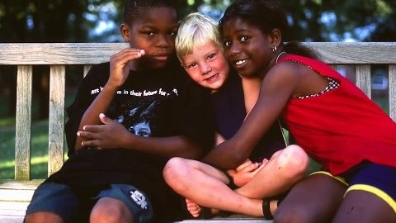
https://www.youtube.com/watch?v=vOrr5xdvm_A&t=70s
One Family-Red Grammer
By Tammy Kita

