Slide 1

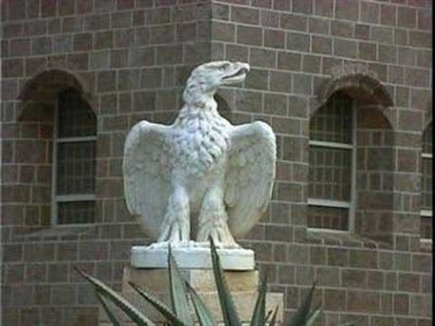
https://www.youtube.com/watch?v=rpjF7lsHQmY&list=PLEZRZb7taKmh4mO8T0310l_0oXHXKlAus&index=3
Tu Eres

Slide 2
1
O Lord my God! Assist Thy loved ones to be firm in Thy Faith, to walk in Thy ways, to be steadfast in Thy Cause. Give them Thy grace to withstand the onslaught of self and passion, to follow the light of divine guidance. Thou art the Powerful, the Gracious, the Self-Subsisting, the Bestower, the Compassionate, the Almighty, the All-Bountiful.
- 'Abdu'l-Bahá

Slide 3
2
The world is in great turmoil and the minds of its people are in a state of utter confusion. We entreat the Almighty that He may graciously illuminate them with the glory of His Justice, and enable them to discover that which will be profitable unto them at all times and under all conditions.
- Bahá'ulláh

Slide 4
3
O son of man! If thine eyes be turned towards mercy, forsake the things that profit thee and cleave unto that which will profit mankind. And if thine eyes be turned towards justice, choose thou for thy neighbour that which thou choosest for thyself. Humility exalteth man to the heaven of glory and power, whilst pride abaseth him to the depths of wretchedness and degradation.
- Bahá'ulláh, Tablets of Bahá'u'lláh, p.64

Slide 5
4
The light of men is Justice. Quench it not with the contrary winds of oppression and tyranny. The purpose of justice is the appearance of unity among men. The ocean of divine wisdom surgeth within this exalted word, while the books of the world cannot contain its inner significance. Were mankind to be adorned with this raiment, they would behold the day-star of utterance, 'On that day God will satisfy everyone out of His Abundance,' (Qur'án 4:129) shining resplendent above the horizon of the world.
- Bahá'u'lláh, Tablets of Bahá'ulláh, p. 66-67

Slide 6
5
Whoso cleaveth to justice, can, under no circumstances, transgress the limits of moderation. He discerneth the truth in all things, through the guidance of Him who is the All-Seeing. The civilization, so often vaunted by the learned exponents of arts and sciences, will, if allowed to overlap the bounds of moderation, bring great evil upon men.
- Bahá'u'lláh, Gleanings from the Writings of Bahá'u'lláh, p.342

Slide 7

https://www.youtube.com/watch?v=UGusoQqpoSY
Ahdieh, Baha’u’llah

Slide 8
6
“The best beloved of all things in My sight is Justice; turn not away therefrom if thou desirest Me, and neglect it not that I may confide in thee. By its aid thou shalt see with thine own eyes and not through the eyes of others, and shalt know of thine own knowledge and not through the knowledge of thy neighbor. Ponder this in thy heart; how it behooveth thee to be. Verily justice is My gift to thee and the sign of My loving-kindness. Set it then before thine eyes.
-Bahá’u’lláh, The Arabic Hidden Words

Slide 9
7
Oh, friends of God, be living examples of justice! So that by the Mercy of God, the world may see in your actions that you manifest the attributes of justice and mercy.
“Justice is not limited, it is a universal quality. Its operation must be carried out in all classes, from the highest to the lowest. Justice must be sacred, and the rights of all the people must be considered. Desire for others only that which you desire for yourselves. Then shall we rejoice in the Sun of Justice, which shines from the Horizon of God.”
-‘Abdu’l-Bahá, Paris Talks, p. 159-160

Slide 10
8
Know thou, of a truth,” He significantly affirms, “these great oppressions that have befallen the world are preparing it for the advent of the Most Great Justice.” “Say,” He again asserts, “He hath appeared with that Justice wherewith mankind hath been adorned, and yet the people are, for the most part, asleep.”
Shoghi Effendi-The Advent of Divine Justice

Slide 11
9
The light of men is Justice,” He moreover states, “Quench it not with the contrary winds of oppression and tyranny. The purpose of justice is the appearance of unity among men.” “No radiance,” He declares, “can compare with that of justice. The organization of the world and the tranquillity of mankind depend upon it.” “O people of God!” He exclaims, “That which traineth the world is Justice, for it is upheld by two pillars, reward and punishment. These two pillars are the sources of life to the world.” “Justice and equity,” is yet another assertion, “are two guardians for the protection of man.
Shoghi Effendi-The Advent of Divine Justice

Slide 12
10
Say: “O God, my God! Attire mine head with the crown of justice, and my temple with the ornament of equity. Thou, verily, art the Possessor of all gifts and bounties.
- Bahá'ulláh, Epistle to the Son of the Wolf

Slide 13
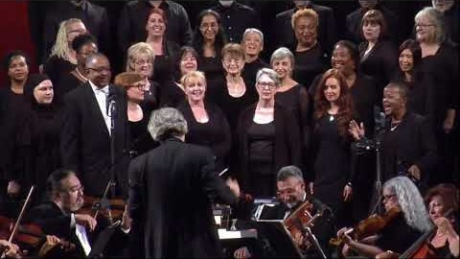
https://www.youtube.com/watch?v=4dg2yxh40CY
In this Day Baha’u’llah

