Slide 1

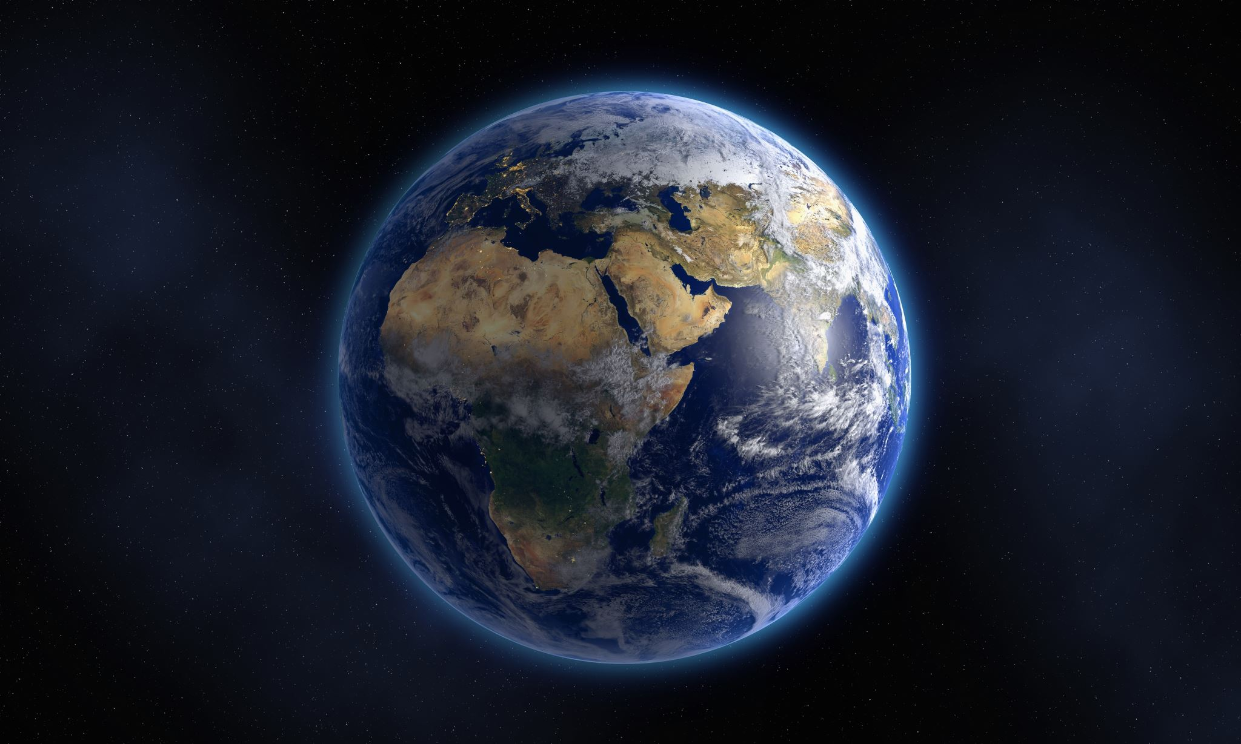
Music

Slide 2
1.
O my God! O my God! Unite the hearts of Thy servants, and reveal to them thy great purpose. May they follow Thy commandments and abide in Thy law. Help them, O God, in their endeavor, and grant them strength to serve Thee. O God! Leave them not to themselves, but guide their steps by the light of Thy knowledge, and cheer their hearts by Thy love. Verily, Thou art their Helper and their Lord. - Bahá'u'lláh

Slide 3
2.
Unity to be real must stand the severest strain without breaking. - Mahatma Gandi

Slide 4
3.
O ye beloved of God! When the winds blow severely, rains fall fiercely, the lightning flashes, the thunder roars, the bolt descends and storms of trial become severe, grieve not; for after this storm, verily, the divine spring will arrive, the hills and fields will become verdant, the expanses of grain will joyfully wave, the earth will become covered with blossoms, the trees will be clothed with green garments and adorned with blossoms and fruits. Thus blessings become manifest in all countries. These favors are results of those storms and hurricanes. - 'Abdu'l-Bahá

Slide 5
4.
Put thy whole confidence in the grace of God, thy Lord. Let Him be thy trust in whatever thou doest, and be of them that have submitted themselves to His Will. Let Him be thy helper and enrich thyself with His treasures, for with Him are the treasuries of the heavens and of the earth. - Bahá'u'lláh

Slide 6
5.
So powerful is the light of unity that it can illuminate the whole earth. - Bahá'u'lláh

Slide 7
6.
Just as with her own life a mother shields from hurt her own, her only child, let all-embracing thoughts for all that live be thine – and all-embracing love for all the universe, in all its heights and depths and breadth, unstinted love, unmarred by hate within, not rousing enmity. - Sutta-nipata

Slide 8

Music

Slide 9
Prophecy
“ …The wolf and lamb shall feed together.”
-Isaiah 65:25
Explanation:
“..Such is the binding force of the Word of God, which uniteth
The hearts of them that have renounced all else but Him, who have believed in His signs…. Furthermore, how numerous are those peoples of diverse beliefs, of conflicting creeds , and opposing temperaments, who, through the reviving fragrance of the Divine springtime, breathing from the Ridvan of God, have been arrayed with the new robe of divine Unity, and have drunk from the cup of His singleness! This is the significance of the well-known words:”
“The wolf and the lamb shall feed together.”
-Extracted from the writings of Baha’u’llah –Kitab-i-Iqan

Slide 10
7.
When calamity striketh, be ye patient and composed. However afflictive your sufferings may be, stay ye undisturbed, and with perfect confidence in the abounding grace of God, brave ye the tempest of tribulations and fiery ordeals. -'Abdu'l-Bahá

Slide 11
8.
This is what God announceth to his servants who believe and do the things that are right. SAY: For this ask I no wage of you, save the love of my kin. And whoever shall have won the merit of a good deed, we will increase good to him therewith; for God is forgiving, grateful.
- Qur'an (Surih 42:22)

Slide 12
9.
Remove not, O Lord, the festal board that hath been spread in Thy Name, and extinguish not the burning flame that hath been kindled by Thine unquenchable fire. Withhold not from flowing that living water of Thine that murmereth with the melody of Thy glory and Thy remembrance, and deprive not Thy servants from the fragrance of Thy sweet savors breathing forth the perfume of Thy love.
Lord! Turn the distressing cares of Thy holy ones into ease, their hardship into comfort, their abasement into glory, their sorrow into blissful joy, O Thou that holdest in Thy grasp the reins of all mankind!
Thou art, verily, the One, the Single, the Mighty, the All-Knowing, the All-Wise. - 'Abdu'l-Bahá

Slide 13
10.
We must learn to live together as brothers or perish as fools. - Martin Luther King, Jr.

Slide 14

Music

